Slide 1
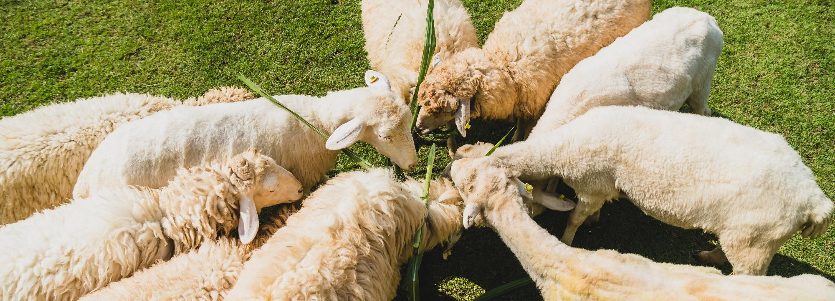


Course 6: Bringing Innovation to Farms
M3: Livestock Monitoring Systems
www.smartskillsproject.eu

Slide 2
Objectives and Learning Outcomes
Explore…
…how automation enhances feeding and environmental control in livestock farming.
This module explores the role of automation in livestock farming, focusing on how smart monitoring systems enhance animal health, welfare, and productivity. Learners will discover how automated feeding systems, wearable sensors, and environmental controls work together to optimise livestock management. By examining real-world applications, they will gain insight into the benefits of integrating technology for real-time health tracking, precision feeding, and efficient resource use. This module will provide a strong foundation for understanding how automation improves farm operations while ensuring sustainable and ethical livestock practices.
Understand…
…the role of wearable sensors in tracking animal well-being.
Identify…
…benefits and challenges of integrating smart livestock management systems.

Slide 3
contents
This module provides an overview of how technology enhances livestock management through automated feeding, health monitoring, and environmental control. Explore the role of wearable sensors and smart systems in improving efficiency, animal welfare, and decision-making!
01
Automating feeding, health monitoring, and environment control
02
Wearable sensors for tracking livestock well-being
03
Examples of integrated livestock management systems
04
Let’s Practice!

Slide 4
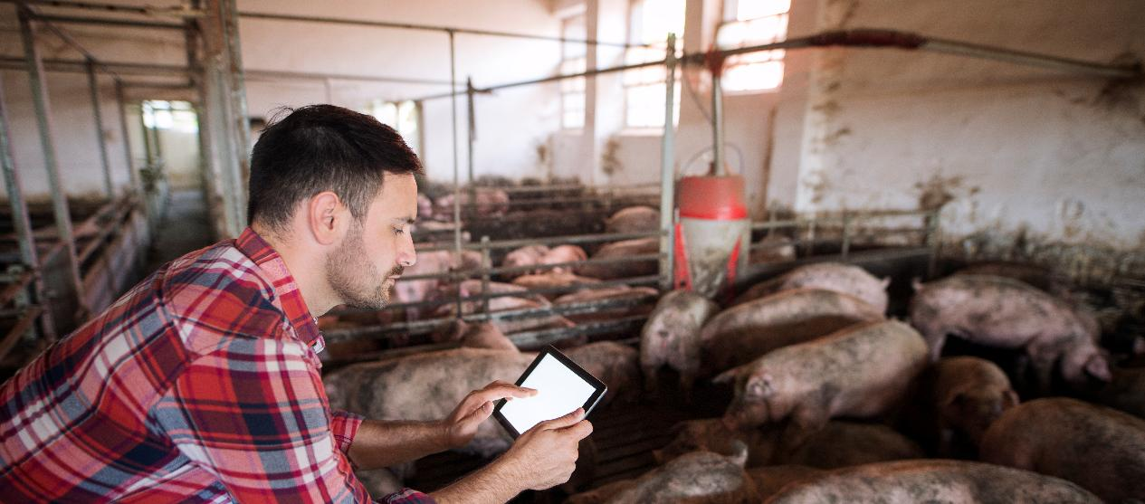
01
AUTOMATING FEEDING, HEALTH MONITORING, AND ENVIRONMENT CONTROL

Slide 5




Automating Feeding Processes
Automating livestock management through advanced technologies significantly:
enhances efficiency
reduces labour costs
improves animal welfare
tracks food consumption
Automated feeding systems ensure that animals receive the correct amount of food at optimal times, improving nutrition and growth rates while minimising waste. These systems can be programmed to distribute feed based on individual animal needs, reducing overfeeding and ensuring consistent dietary intake.

Slide 6


Automated Health Monitoring
Health monitoring is another key component of automation in livestock management.
In order to detect early signs of illness or distress Smart sensors and Internet of Things (IoT) devices can continuously track:
vital signs,
By analysing real-time data, farmers can intervene promptly in order to:
prevent the spread of disease
Automated health monitoring:
reduces the need for manual inspections
allows to efficiently oversee well-being of hundreds animals simultaneously
activity levels,
reduce medical costs
behavioral patterns
For more information on lifestock management, be inspired by this podcast on latest advice, insights and technical updates for the sheep industry.

Slide 7
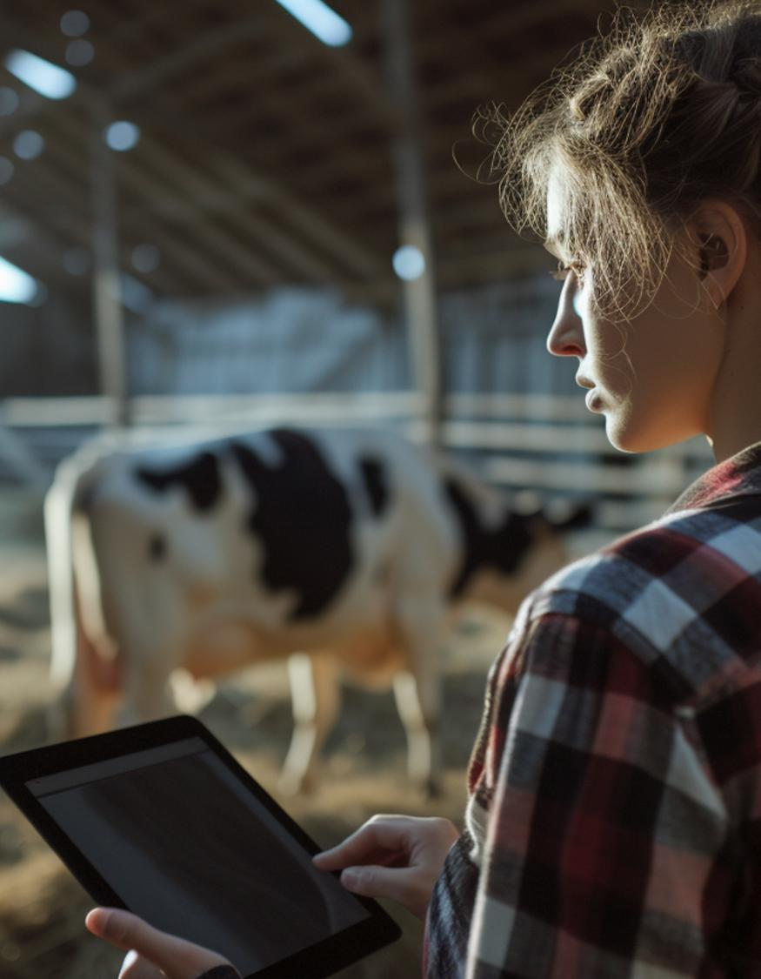
Environmental Benefits
Environmental control systems play a crucial role in maintaining optimal conditions for livestock. Automated ventilation, heating, and cooling systems adjust temperature and humidity levels based on real-time data, ensuring a comfortable environment that promotes healthy growth.
Sensors can detect harmful gases such as ammonia and hydrogen sulphide, activating ventilation systems to maintain air quality. These smart systems not only improve animal welfare but also contribute to higher productivity and sustainability by reducing resource wastage and improving farm efficiency.

Slide 8
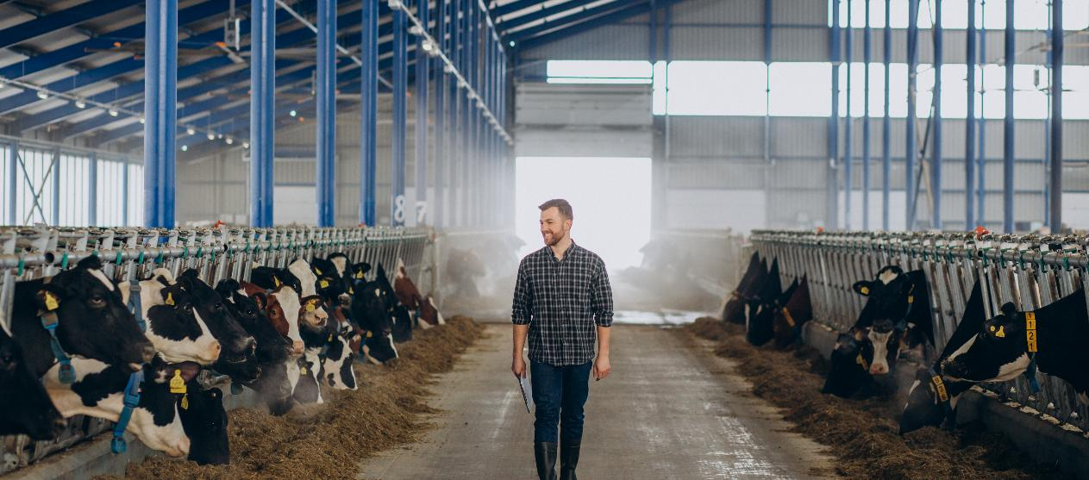
02
WEARABLE SENSORS FOR TRACKING LIVESTOCK WELL-BEING

Slide 9
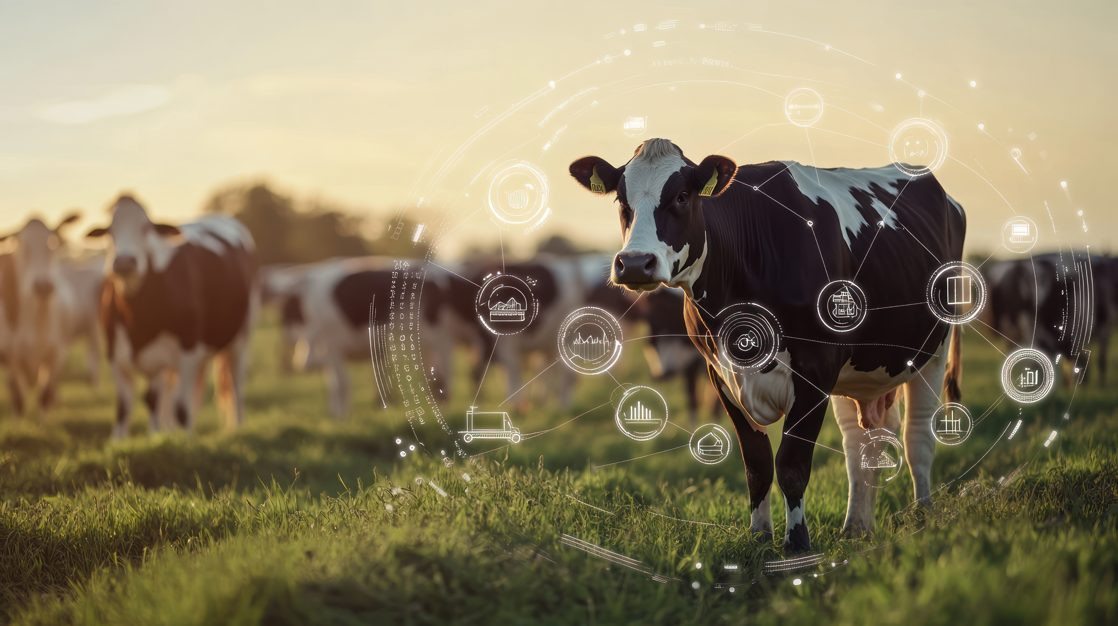
Wearable Sensors For Lifestock Management
Wearable sensors have transformed livestock management by providing continuous health and behavioural monitoring. These devices, attached to animals via collars, ear tags, or leg bands, collect real-time data on movement, body temperature, heart rate, and feeding patterns.
By analysing this data, farmers can detect early signs of illness, stress, or injury, enabling timely intervention and reducing losses. Wearable sensors also play a crucial role in tracking reproductive cycles, helping optimise breeding programmes and improve fertility rates.
IoT Analysis of cattle activity "U-motion(R)" -- Short version

Slide 10
Benefits of Wearable Sensors
Real-Time
Health Monitoring
Behavioural Tracking
Automated Alerts and Notifications
GPS Tracking and Security
Sensors track vital signs such as temperature and heart rate, helping detect diseases and health issues before they become severe.
Movement sensors analyse feeding, resting, and social behaviours to identify signs of distress or abnormal patterns.
Farmers receive instant alerts when sensors detect unusual health or activity trends, allowing quick action to prevent problems.
Some sensors include GPS technology to track livestock location, prevent theft, and monitor grazing patterns.
Wearable sensors also contribute to reproductive cycle management and resource optimisation. By detecting heat cycles and pregnancy, these devices support more efficient breeding, leading to higher reproductive success rates. Additionally, insights from sensors improve pasture management, feed distribution, and environmental conditions, helping farmers enhance productivity while minimising waste.

Slide 11
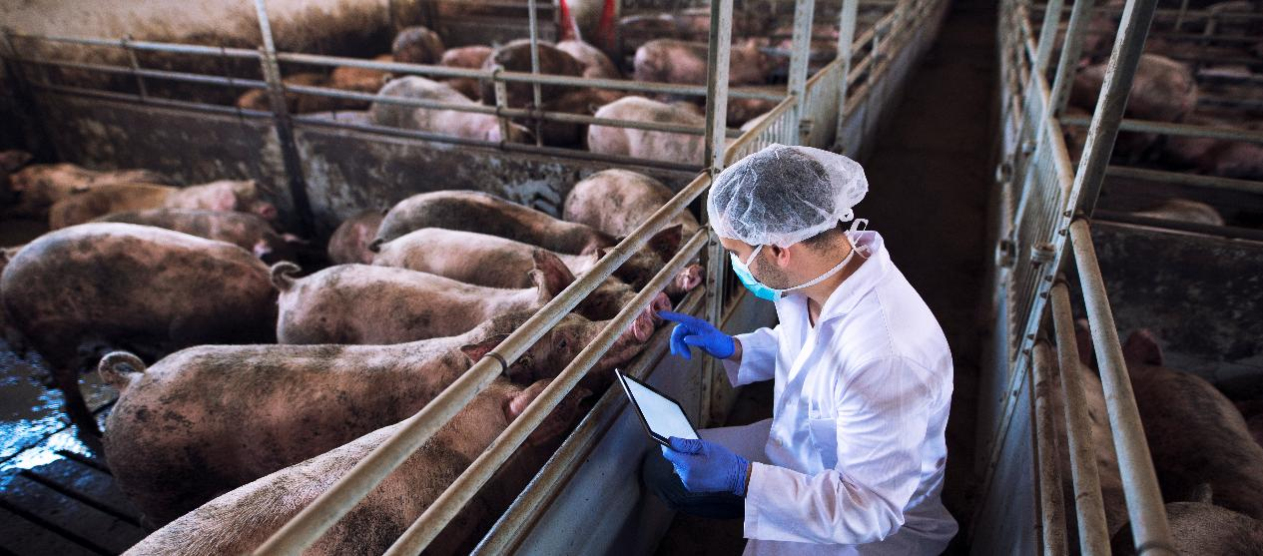
03
EXAMPLES OF INTEGRATED LIVESTOCK MANAGEMENT SYSTEMS

Slide 12

Be inspired…
…by the power of Digitanimal’s smart tracking technology, designed to give you total peace of mind over your livestock. With real-time location tracking, activity monitoring, and virtual fencing, you’ll always know where your animals are and how they’re doing—reducing losses and improving productivity effortlessly.
Take control…
…of your farm with cutting-edge IoT technology and long-lasting battery life, ensuring seamless monitoring with minimal effort.
Visit…
…Digitanimal’s website today and discover how smart farming can transform the way you manage your livestock!

Slide 13

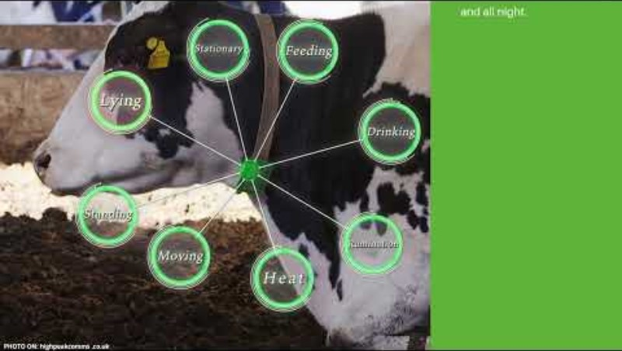

Be inspired…
Dive into the world of Agriculture 4.0 and learn more about the use of IoT on Polish dairy farms with the CowMonitor App! ➔
For more information, check out their website for fascinating insights into the technology:
https://www.cowmonitor.pl/

Slide 14

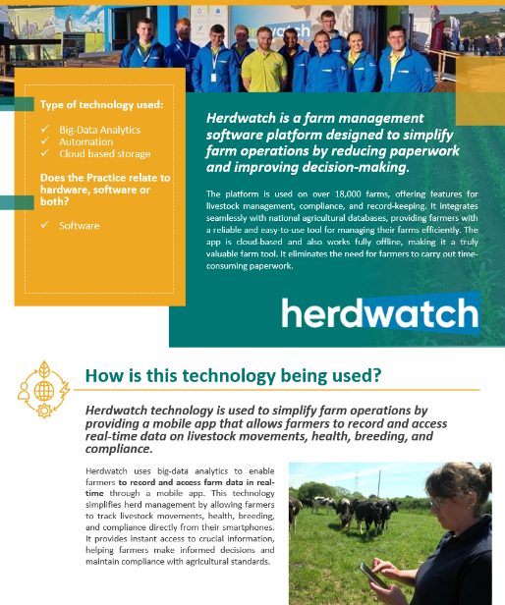
Case Study…
…Be inspired by Herdwatch’s innovative approach to digital farm management, helping farmers save time, reduce paperwork, and make smarter decisions for a more sustainable future.
…Visit Herdwatch to see how its easy-to-use mobile app is transforming farm operations with real-time data tracking and seamless compliance management.
…Read more in our Good Practice Compendium to explore how Herdwatch is revolutionizing agriculture with big-data analytics and farm-to-fork integration.

Slide 15

04
LET’S PRACTICE

Slide 16

Time for Self-Reflection
Imagine you are a livestock farmer using automation and wearable sensors to manage your animals. Below are two real-life scenarios. For each, decide how you would respond using the technology available. Discuss your choices with the group!
Scenarios:
A cow’s activity levels have suddenly dropped according to its wearable sensor.
  What action do you take?
  How can automation help you respond quickly?
Your environmental control system detects high ammonia levels in the barn.
  What changes should be made to improve air quality?
  How does this impact animal health?

Slide 17

“SUSTAINABILITY IS NO LONGER ABOUT DOING LESS HARM. IT’S ABOUT DOING MORE GOOD.”
– Jochen Zeitz

Slide 18

Bravo!
You finished the third module of Course 6! Keep going on this learning journey.
In the next module you will learn about Field Automation and Real-Time Monitoring!

Slide 19
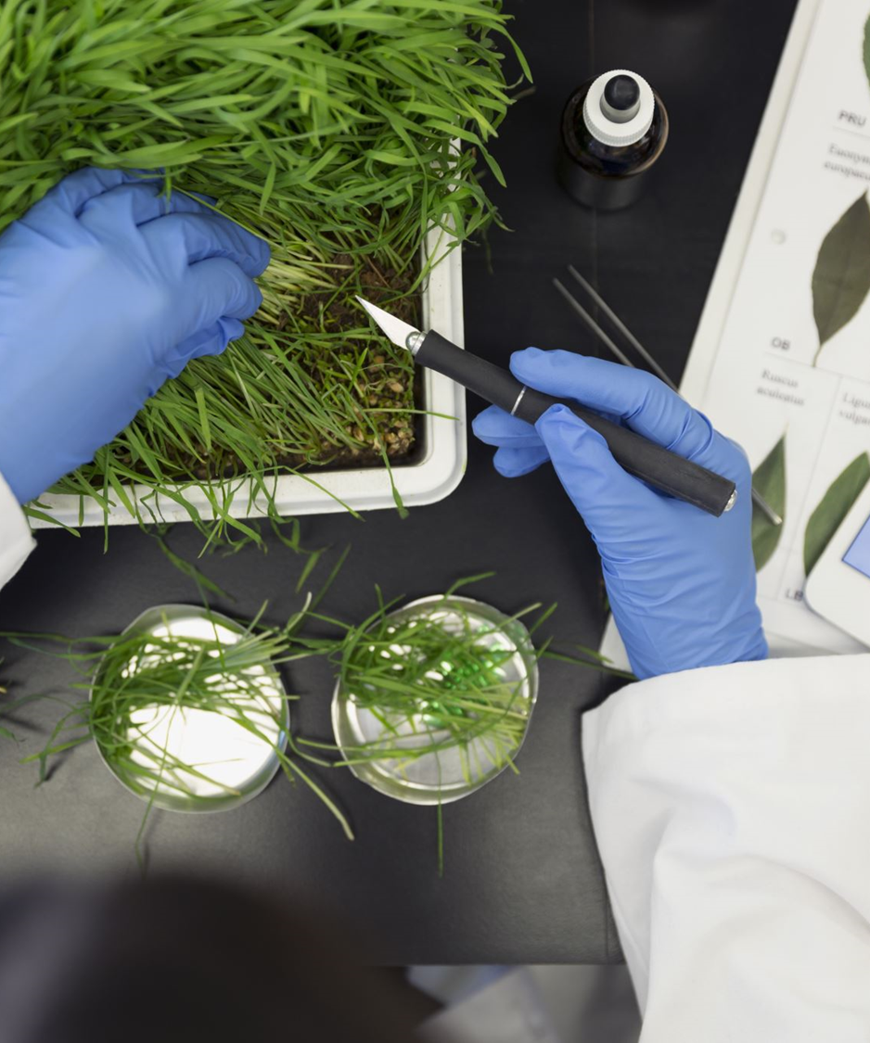

www.smartskillsproject.eu
Follow our journey

