Slide 1
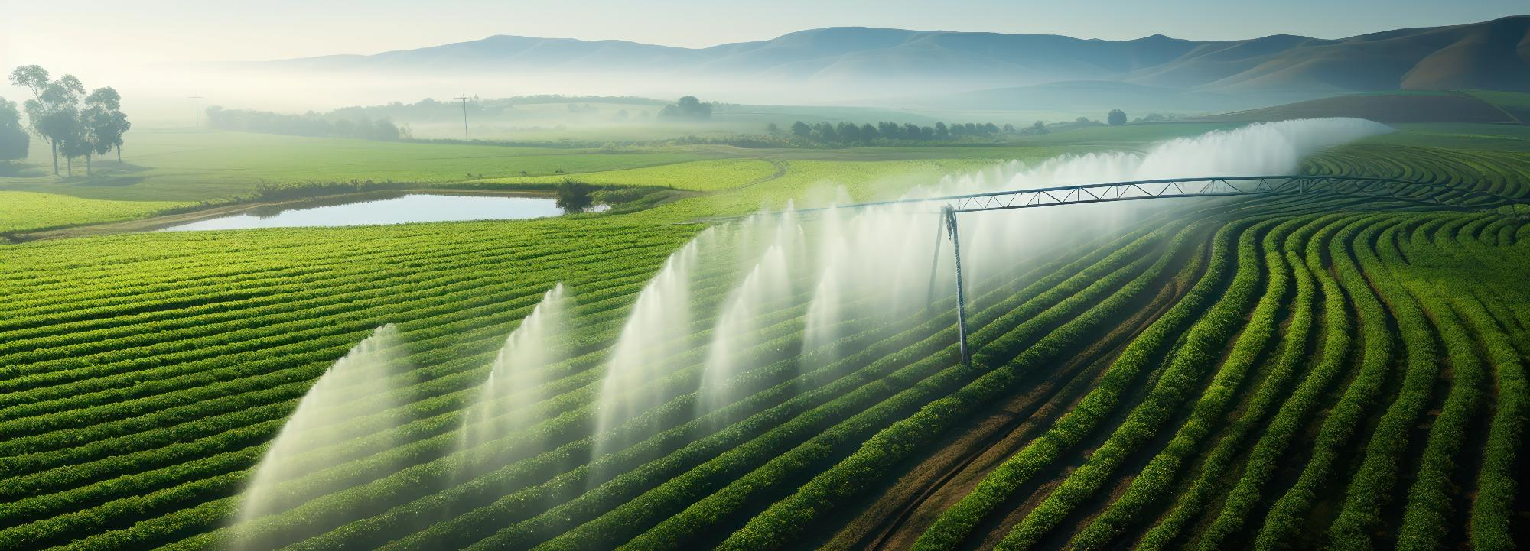


Course 6: Bringing Innovation to Farms
M4: Field Automation & Real-Time Monitoring
www.smartskillsproject.eu

Slide 2
Objectives and Learning Outcomes
Learn…
…how automated irrigation and crop monitoring systems optimise field operations.
This module focuses on the use of automation and real-time monitoring to enhance field operations in agriculture. Learners will explore how automated irrigation systems, IoT sensors, and drones contribute to precision farming by optimising water usage, monitoring crop health, and improving resource efficiency. Through practical examples, they will understand the benefits of real-time data collection and decision-making in farm management. By the end of this module, learners will have a solid grasp of how smart technologies can drive sustainability and productivity in modern agriculture.
Understand…
…the advantages of real-time monitoring for resource efficiency and sustainability.
Explore…
…practical applications of drones, IoT sensors, and AI in precision farming.

Slide 3
contents
This module is about the use of advanced irrigation technologies and real-time monitoring to enhance resource efficiency in agriculture. It covers the practical setup of automated systems and the integration of AI and IoT for sustainable water management and optimised crop performance.
01
Using control systems for automated irrigation and crop management
02
Benefits of real-time monitoring for resource efficiency
03
Practical setup of automated systems for field use
04
Let’s Practice!

Slide 4
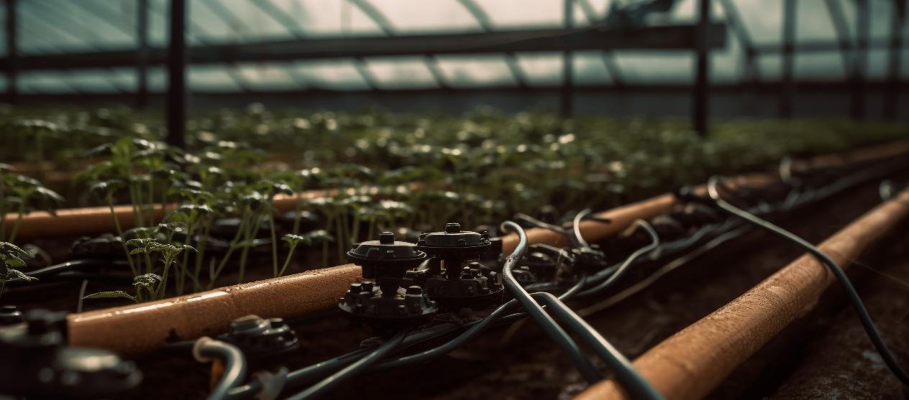
01
USING CONTROL SYSTEMS FOR AUTOMATED IRRIGATION AND CROP MANAGEMENT

Slide 5
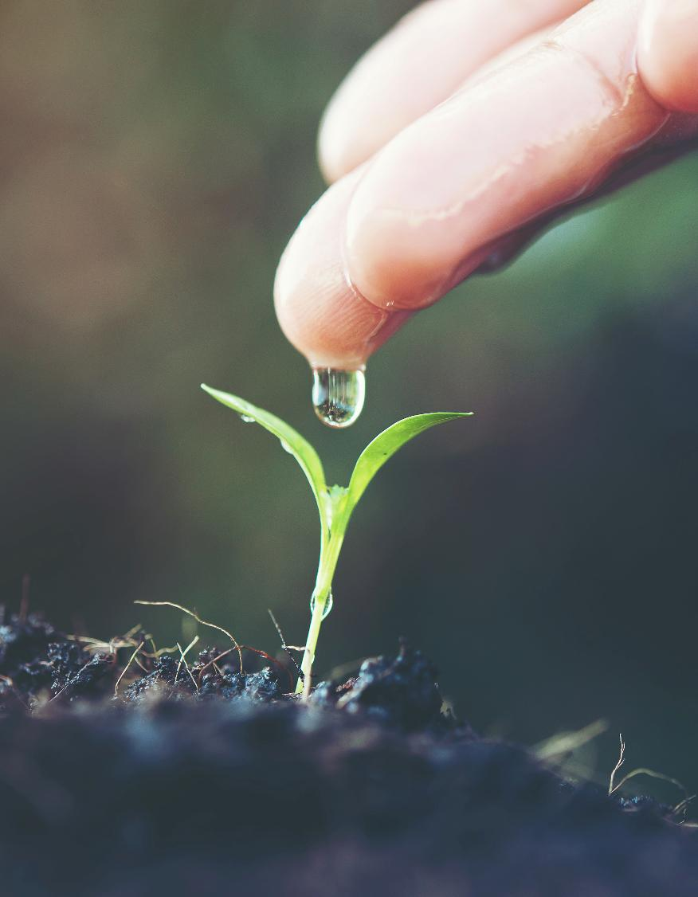
Smart Irrigation for Efficient Water Management
Automated irrigation systems improve water efficiency by reducing losses and preventing underground contamination. By integrating advanced technologies, farmers can ensure crops receive the necessary water while minimising waste.
Sensors track soil moisture for accurate scheduling
Subsurface drip systems minimise unnecessary water loss
Ultra-low flow emitters deliver water directly to plant roots
DSS combines data and analytics for better decision-making

Slide 6






Smart Irrigation Cycle for Efficient Water Use
Precision Water Application
Irrigation Scheduling & Decision-Making
Smart irrigation systems distribute water efficiently, reducing waste and ensuring plants get the right amount
Based on collected data, automated systems determine the optimal amount and timing for irrigation.
Evaluation & Adjustment
Data Collection & Monitoring
System performance is analysed, and water usage is optimised for future cycles, feeding back into updated monitoring.
Sensors track soil moisture, weather conditions, and plant water needs in real time.
Watch this video for more information!

Slide 7
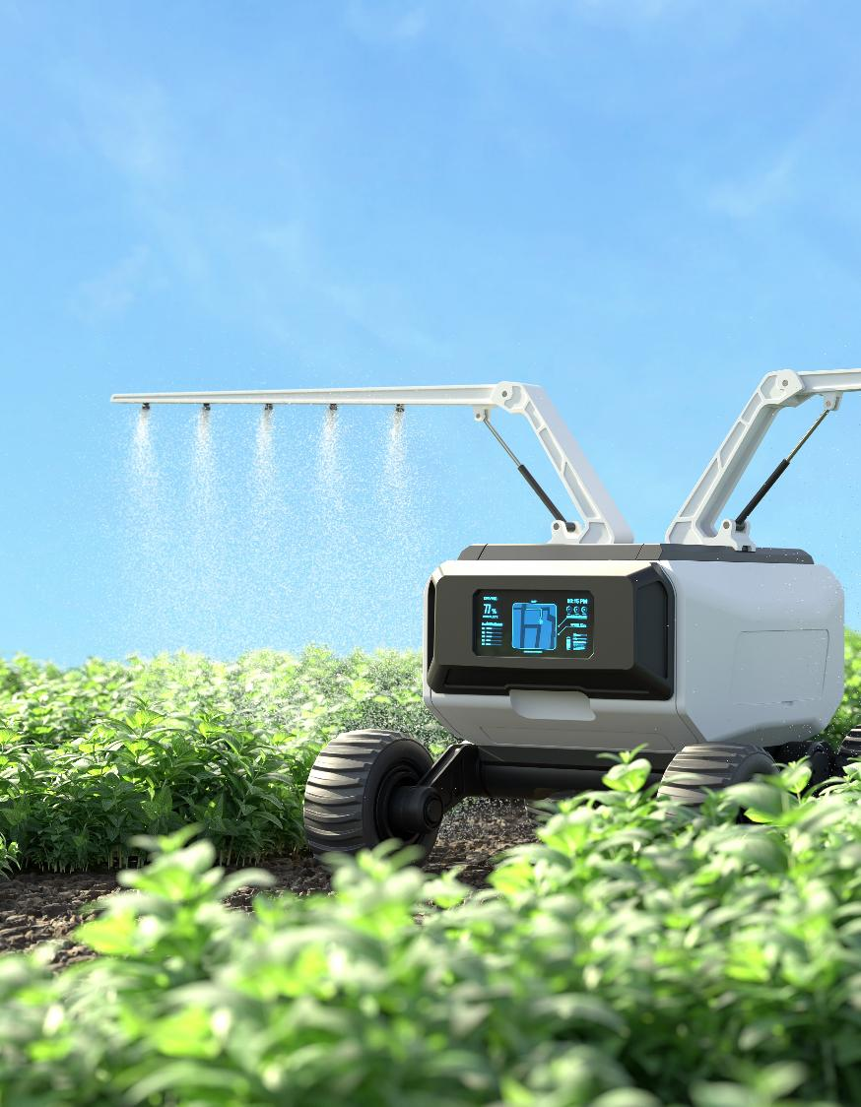
Challenges & Future Perspectives
Beyond water efficiency, automated systems also play a crucial role in crop management. Environmental variability and the absence of standardised precision irrigation technologies make it difficult to ensure optimal growing conditions. Crop productivity depends on balancing water and nutrient availability
AI and IoT enable adaptive water and nutrient control
RDI supports plant resilience under water constraints
Smart irrigation improves root development and crop yield
Policy measures encourage data-driven farming practices

Slide 8
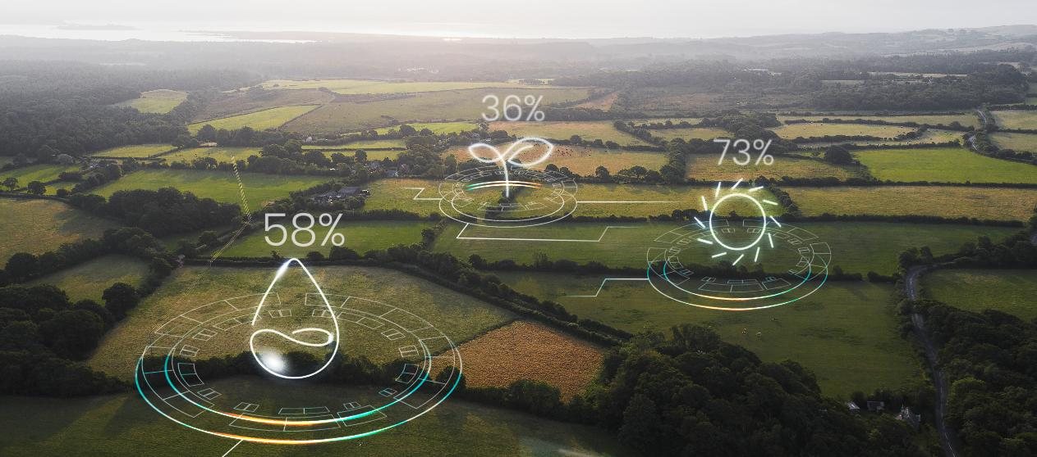
02
BENEFITS OF REAL-TIME MONITORING FOR RESOURCE EFFICIENCY

Slide 9
Benefits of Optimising Resource Efficiency with Real-Time Monitoring
Improved Land Use Efficiency
Real-time monitoring helps track land use changes and optimise biofuel crop placement to minimise negative environmental impacts. It supports decision-making to reduce direct and indirect land use changes, preventing deforestation and biodiversity loss.
Enhanced Energy Efficiency
Continuous data collection on crop performance enables better selection of high-energy-yield crops. It ensures optimal fertilisation and irrigation to maximise biofuel energy output while reducing resource waste.
Lower Greenhouse Gas (GHG) Emissions
Real-time tracking of emissions allows farmers to adjust fertilisation and tillage practices to reduce nitrous oxide (N₂O) emissions.

Slide 10
Environmental Benefits
Reduction of Eutrophication
Sustainable Water Management
01
02
Monitoring nutrient runoff ensures efficient nitrogen use, preventing water pollution. It helps farmers apply fertilisers only when needed, reducing excessive nitrogen leaching.
Tracking real-time soil needs prevents the overuse of freshwater resources. It supports data-driven decisions on crop selection to maximise yield with minimal water input.

Slide 11
Economic Benefits
Cost Savings & Higher Yields
Certification & Compliance
03
04
Real-time monitoring reduces input costs such as fertilisers, water, and energy. It increases profitability by optimising biomass production and improving biofuel conversion efficiency.
By providing verifiable data on emissions, land use, and resource efficiency, real-time monitoring helps biofuel producers meet sustainability certifications.

Slide 12
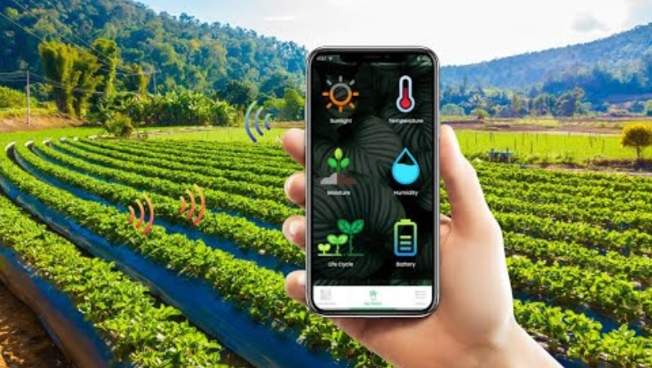
Benefits of Smart Farming Technologies
Smart Farming Optimising Agriculture with Advanced Technologies

Slide 13

03
PRACTICAL SETUP OF AUTOMATED SYSTEMS FOR FIELD USE

Slide 14





Evaluate existing workflows to identify inefficiencies and repetitive tasks. Define clear automation goals, such as reducing response times or improving resource allocation.
Assess Current Field Operations
Select a system that fits your industry needs and budget. Look for features like scheduling, real-time tracking, and mobile accessibility. Ensure scalability for future growth.
Choose the Right Automation Solution
Ensure compatibility with CRM, ERP, and other tools to streamline data flow. Set up protocols for seamless communication between platforms and test integrations for reliability.
Plan System Integrations
Automate job assignments based on technician skills, availability, and location. Optimise routing to reduce travel time and costs while preventing scheduling conflicts.
Deploy Scheduling & Dispatch Software

Slide 15




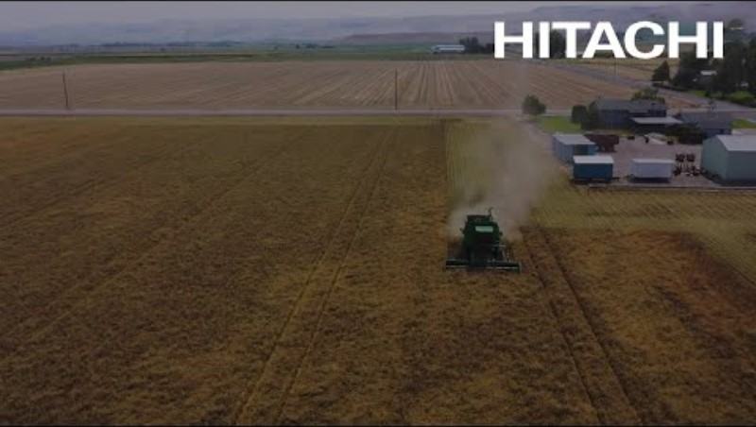
Equip Field Teams with Mobile Applications
Provide mobile access to job details, digital forms, and communication tools. Enable real-time data entry and offline functionality for remote areas.
Offer hands-on training and create user guides to ensure smooth adoption. Provide ongoing support to address challenges and maximise efficiency.
Train Employees on System Usage
Track key metrics like response times and task completion rates. Gather feedback from employees and customers to refine automation processes and improve overall performance.
Monitor Performance & Optimise
Here is an inspiring video about how Hitachi and Ag Automation are revolutionising agriculture with automated soil moisture monitoring and irrigation.
Watch now to see how technology is driving sustainability and efficiency in farming!

Slide 16

04
LET’S PRACTICE

Slide 17
Arrange the Steps in the Correct Order
Below are several steps related to the implementation of a field operations automation system. Your task is to reorder these steps in a logical sequence, from initial assessment to optimisation. Write the number of each step in the correct order.
Steps:
____ Deploy Scheduling & Dispatch Software
____ Assess Current Field Operations
____ Train Employees on System Usage
____ Monitor Performance & Optimise
____ Plan System Integrations
____ Equip Field Teams with Mobile Applications
____ Choose the Right Automation Solution

Slide 18
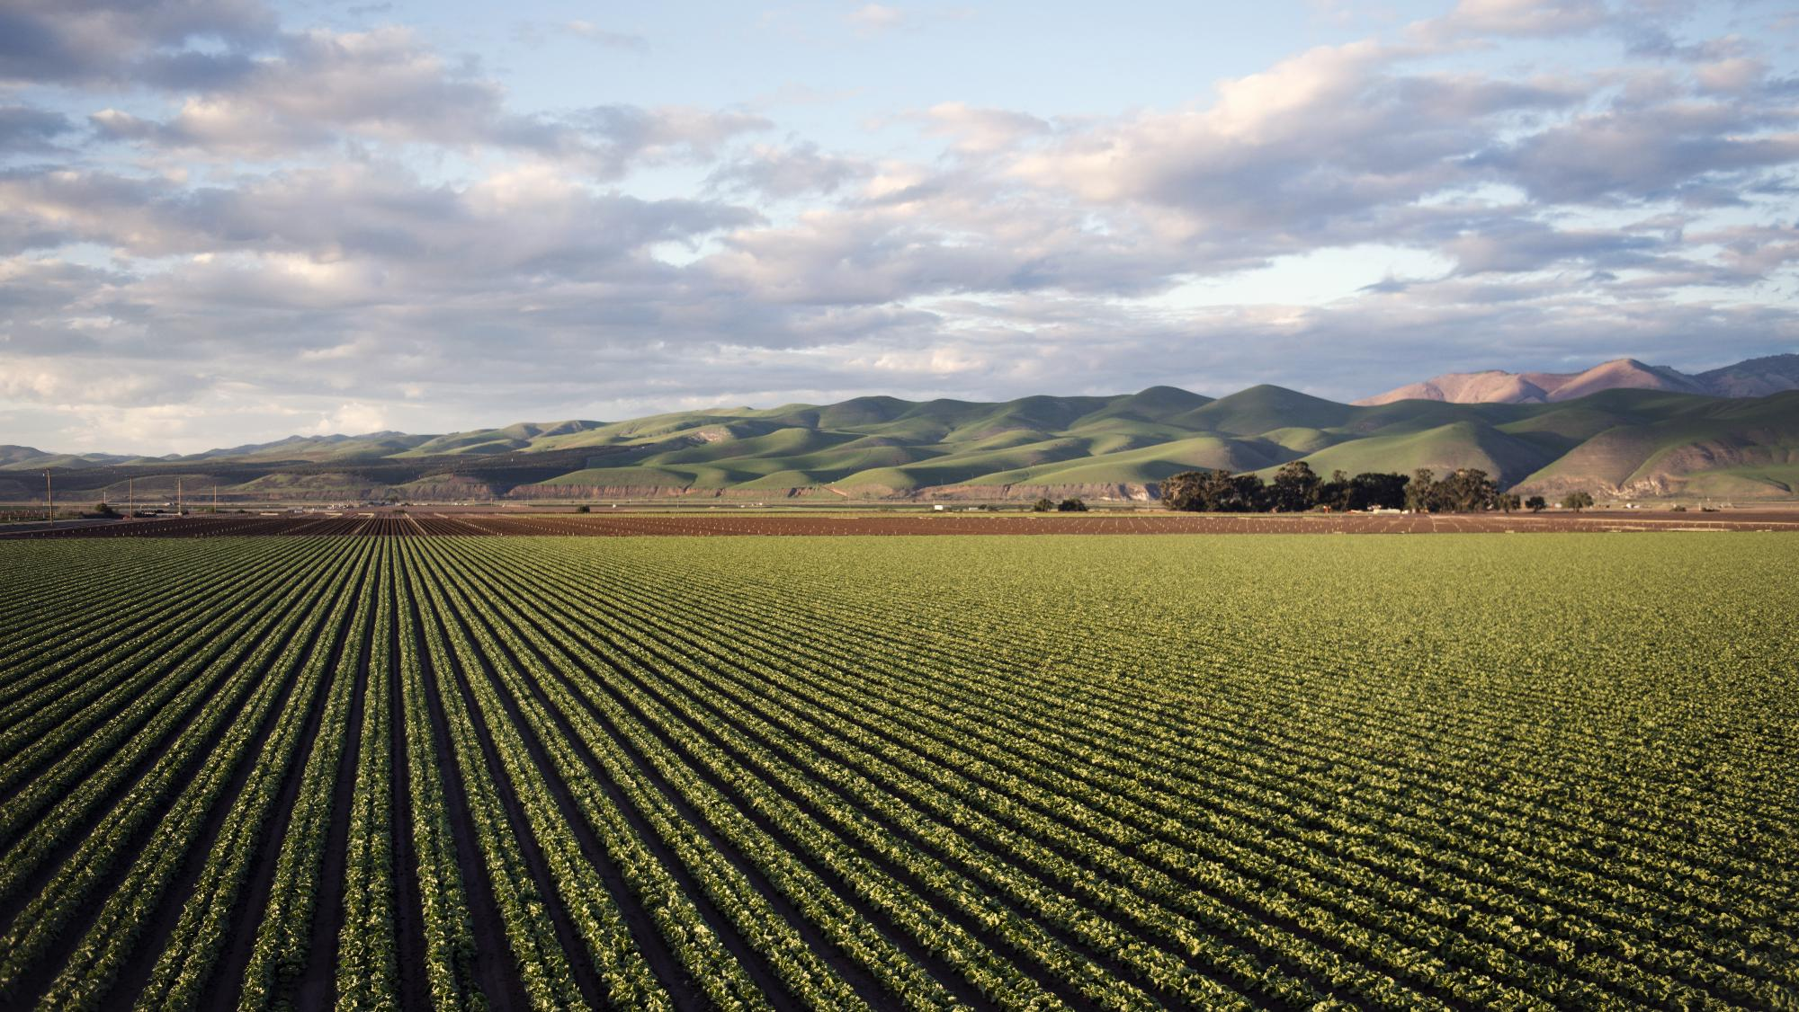
“DO WHAT YOU CAN, WITH WHAT YOU HAVE, WHERE YOU ARE.”
– Theodore Roosevelt

Slide 19

Great Job!
You finished the fourth module of Course 6! Keep going on this learning journey.
In the next module you will learn about Integrating Smart Systems for Whole-Farm Management!

Slide 20


www.smartskillsproject.eu
Follow our journey

