Slide 1



Course 6: Bringing Innovation to Farms
M1: Introduction to Control Systems
www.smartskillsproject.eu

Slide 2
What will you learn?
Understand…
…the role and importance of control systems in modern agriculture.
This module aims to provide you with a comprehensive introduction to control systems in agriculture. It will explore the essential components of automated systems, such as sensors, controllers, and actuators, and how they work together to optimise farming operations. You will gain a clear understanding of SCADA and PLC systems, discovering their roles in enhancing efficiency, precision, and productivity across various agricultural tasks, from irrigation to crop monitoring. By the end, you will be able to appreciate the impact of automation on modern farming practices and its potential to revolutionise the industry.
Identify…
…key components of control systems, including sensors, controllers, and actuators.
Explain…
…the basic functions of SCADA and PLC systems in farm automation.

Slide 3

contents
This module is about how SCADA and PLCs automate agriculture, optimising irrigation, climate control, and livestock management. By integrating sensors, controllers, and actuators, these technologies enhance efficiency, reduce labour, and improve sustainability.
01
Introduction to Control Systems
02
SCADA & PLC Systems
03
Automation Basics
04
Let’s Practice!
This license enables reusers to distribute, remix, adapt, and build upon the material in any medium or format, so long as attribution is given to the creator. The license allows for commercial use. CC BY includes the following elements:
BY: credit must be given to the creator.
This project has been funded with support from the European Commission. The author is solely responsible for this publication (communication) and the Commission accepts no responsibility for any use may be made of the information contained therein. In compliance of the new GDPR framework, please note that the Partnership will only process your personal data in the sole interest and purpose of the project and without any prejudice to your rights.

Slide 4
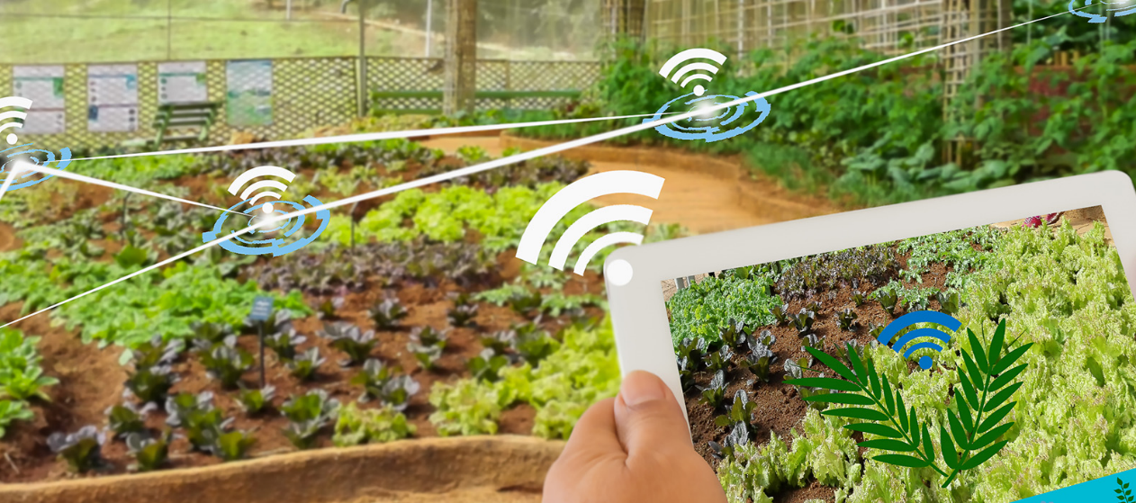
01
CONTROL SYSTEMS

Slide 5

What are Control Systems?
Control systems in agriculture use automated technologies to manage farming operations without direct human intervention. These include:
Supervisory Control and Data Acquisition (SCADA),
Programmable Logic Controllers (PLCs),
Automation technologies,
which integrate sensors, controllers, and actuators to optimise processes. They are widely used in irrigation, livestock management, greenhouse control, and precision farming.

Slide 6
How does automation improve farming efficiency?
Automation enhances efficiency by reducing labour demands, improving precision, and optimising resource use, resulting in higher productivity and sustainability. By streamlining operations and minimising waste, farms can lower costs while ensuring more resilient and environmentally friendly agricultural production.
Smart irrigation and automated feeding systems help conserve water and energy, reducing environmental impact.
Precision farming techniques ensure efficient use of inputs, maximising yields while minimising waste.
Sustainability
Resource Optimisation
01
02

Slide 7




How does automation improve farming efficiency?
Real-Time Monitoring & Data-Driven Decisions
Precision and Accuracy
Labour Efficiency
Increased Safety
Automated systems, such as drones and robotic machinery, ensure precise application of inputs like water, fertilisers, and pesticides, minimising waste and environmental impact.
IoT sensors and SCADA systems provide real-time data on soil conditions, crop health, and livestock well-being, enabling timely interventions and better resource management.
Technologies like unmanned aerial vehicles (UAVs) and autonomous sprayers help reduce human exposure to hazardous chemicals and unsafe working conditions.
Automation reduces the need for manual labour in repetitive and physically demanding tasks, allowing farmers to focus on strategic decision-making.

Slide 8
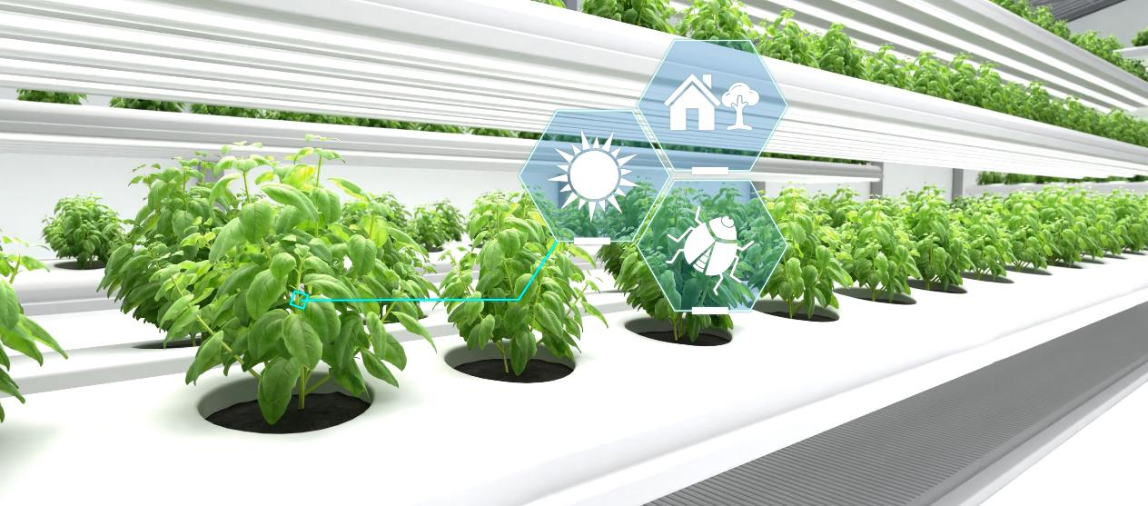
02
SCADA & PLC SYSTEMS

Slide 9
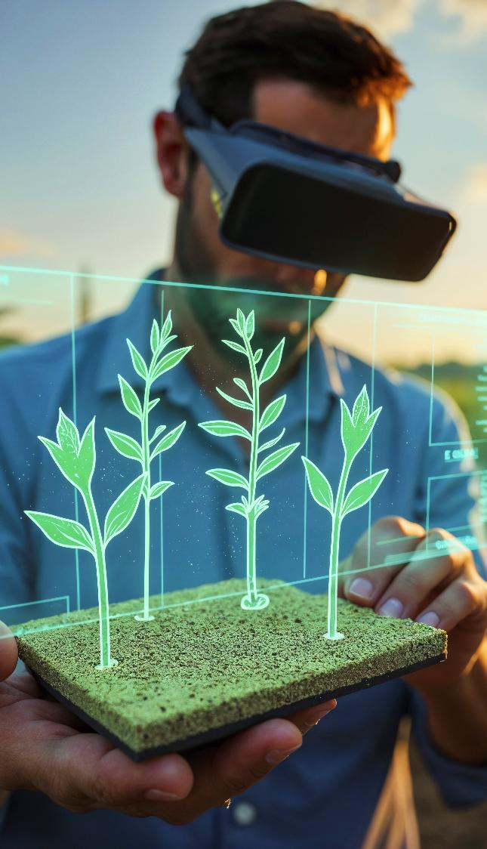
SCADA Control Systems
SCADA (Supervisory Control and Data Acquisition) is a centralised system that monitors and controls farming operations like irrigation, greenhouse climate, and livestock management in real time.
Enhanced Efficiency and Automation: SCADA automates irrigation, climate control, and feeding, reducing labour, optimising resources and boosting productivity.
Remote Monitoring and Decision-Making: Farmers can remotely monitor farm conditions via SCADA’s interface, accessing real-time data on soil, temperature, and equipment for precision management. This enables timely interventions, reduces costs, and ensures precision in farm management.
➔ More information on SCADA

Slide 10
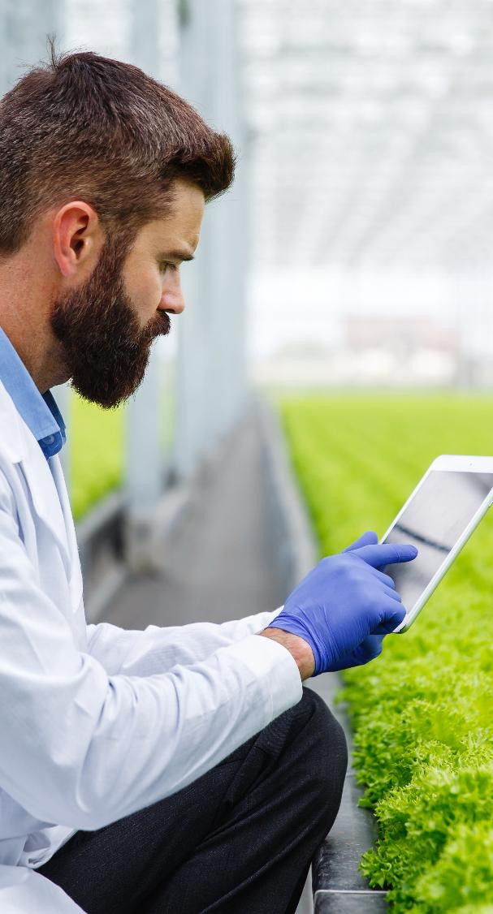
PLC Control Systems
Programmable Logic Controllers (PLCs) are industrial computers that automate key agricultural processes like irrigation, climate control, and livestock management, ensuring precision and efficiency.
Reliable and Customisable Automation: PLCs automate water distribution, fertilisation, and greenhouse adjustments, allowing tailored control for improved yields. Their flexibility allows farmers to tailor automation to specific crop or livestock needs, improving yield consistency.
Real-Time Monitoring and Quick Response: Sensors collect real-time data on soil, temperature, and humidity, enabling automated adjustments that reduce errors and conserve resources. The system then automatically adjusts operations based on preset parameters, reducing human error, conserving resources, and ensuring optimal growing conditions.

Slide 11
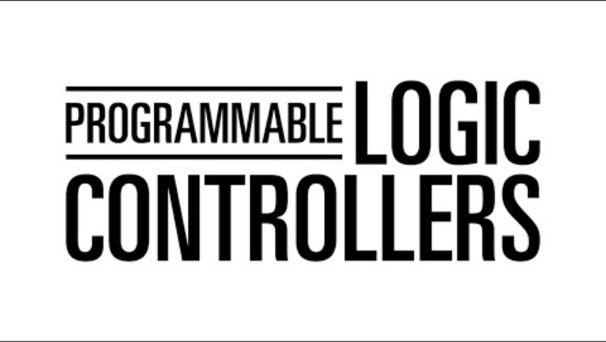
PLC Control Systems
PLCs can integrate with IoT devices and AI-driven analytics to enhance decision-making, predict equipment failures, and optimize resource allocation in real time. If you want to learn more about the technology of PLCs, click on the following video.
⬅
Programmable Logic Controllers

Slide 12
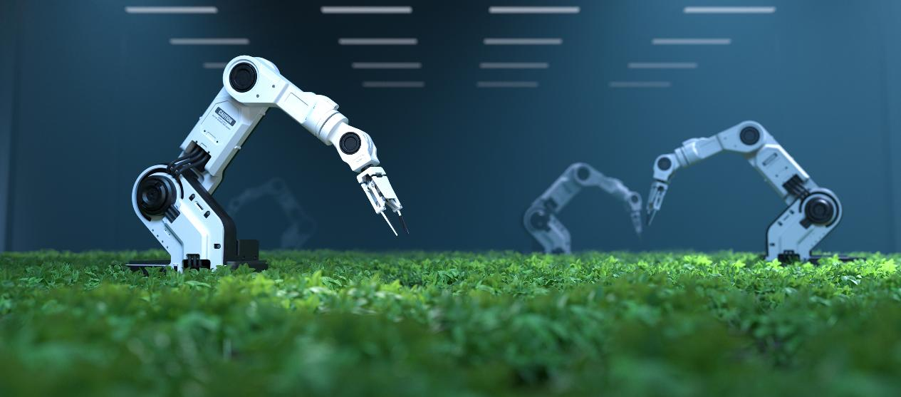
03
AUTOMATION BASICS

Slide 13

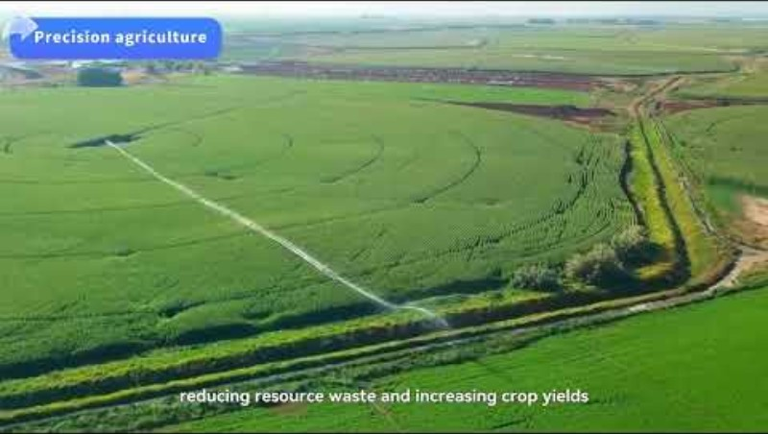
What is Automation in Agriculture?
Agricultural automation has progressed from simple mechanisation, which primarily aids in performing tasks, to advanced digital technologies that automate diagnosis and decision-making. Modern systems, including sensors, AI, and robotics, enable precise, data-driven farm management by integrating all three phases of agricultural operations. This evolution enhances productivity, optimises resource use and improves environmental sustainability by reducing waste and increasing efficiency.
DIAGNOSIS
DECISION-MAKING
PERFORMING
Check out this video for more information!
What is agricultural automation?

Slide 14
Key Components of Automation in Agriculture
Automation in agriculture relies on three components that work together to optimise farming operations with minimal human intervention.
SENSORS ➔
CONTROLLERS ➔
ACTUATORS ➔
Measure environmental and operational variables such as soil moisture, temperature, humidity, light levels, and livestock health. They collect real-time data, providing the foundation for automation.
Process sensor data and make decisions based on predefined algorithms or AI models. They send commands to actuators to adjust farming operations automatically.
Carry out physical actions based on controller signals. Examples include opening irrigation valves, adjusting greenhouse ventilation, activating feeding systems, or operating robotic arms for harvesting.

Slide 15
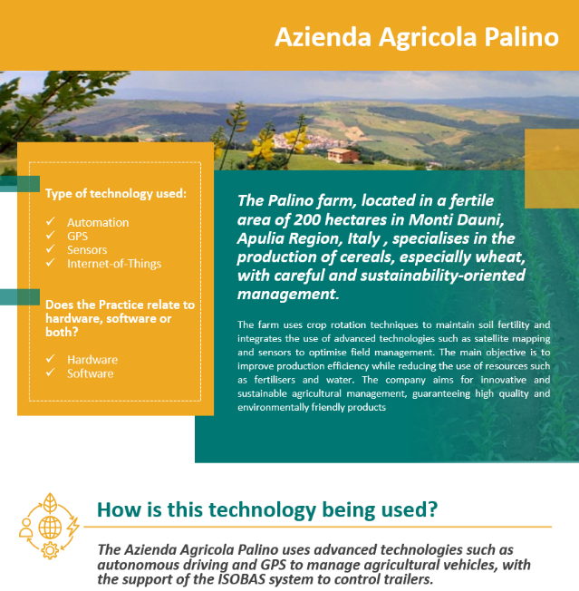
Be Inspired…
Be inspired by how the Palino Farm combines technology and sustainability, using data-driven decision-making to maximise productivity while minimising the environmental impact.
This good practice highlights the role of control systems in optimising farm management. Azienda Agricola Palino demonstrates how automation, georeferenced fertilisation, and real-time data improve efficiency and sustainability.
Download the Smart Skills Good Practice Guide for more inspirational examples!
➔

Slide 16

04
LET’S PRACTICE

Slide 17
Drag and drop the correct term into the corresponding definition.
Sensors – Controllers – Actuators
______ collect real-time data on environmental conditions such as soil moisture, temperature, and humidity, forming the foundation for automation.
______ process sensor data and make decisions based on predefined rules or AI models, sending commands to other components.
______ execute physical actions such as opening irrigation valves, adjusting greenhouse ventilation, or operating robotic arms.

Slide 18
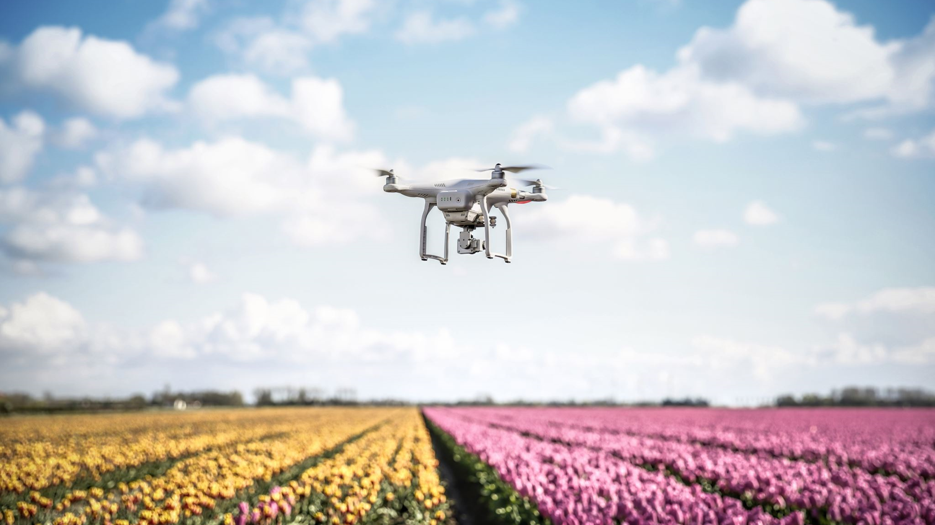
A LITTLE PROGRESS EACH DAY ADDS UP TO BIG RESULTS

Slide 19

Well Done!!!
You finished the first module of Course 6! Keep going on this learning journey.
In the next module you will learn about Greenhouse Automation.

Slide 20


www.smartskillsproject.eu
Follow our journey

