Slide 1
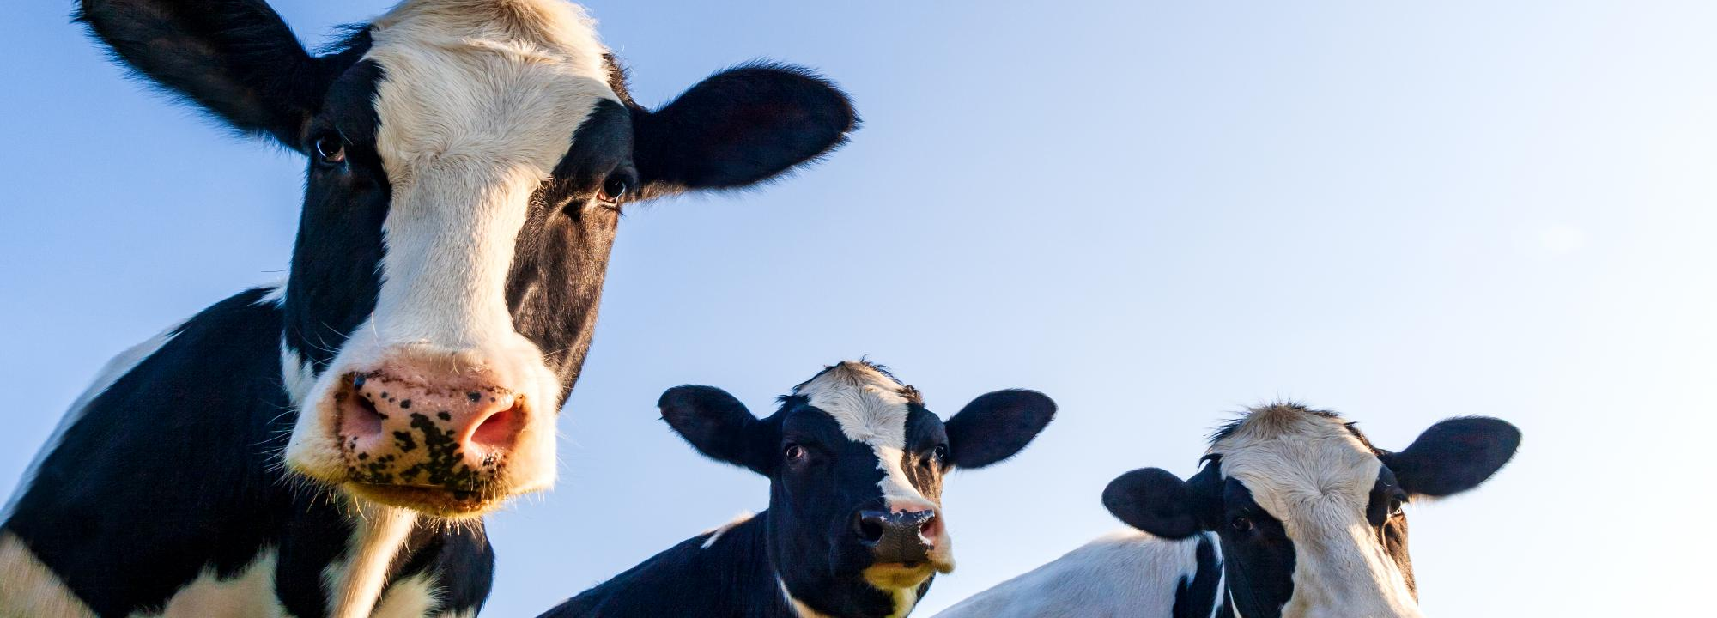


Course 5: Climate-Smart Agriculture (CSA) Techniques
M5: Reducing Emissions in Livestock and Crop Systems
www.smartskillsproject.eu

Slide 2

contents
This module introduces practical strategies to reduce greenhouse gas emissions (GHGs) in agriculture, focusing on livestock management, crop fertilization, and energy use. The goal is to support climate-smart farming practices that lower environmental impact while maintaining productivity.
01
Lowering Methane Emissions from Livestock Through Feed Adjustments
02
Reducing Nitrous Oxide Emissions with Precision Fertilization
03
Integrating Renewable Energy to Minimize the Carbon Footprint of Farm Operations
04
Let’s Practice!
This license enables reusers to distribute, remix, adapt, and build upon the material in any medium or format, so long as attribution is given to the creator. The license allows for commercial use. CC BY includes the following elements:
BY: credit must be given to the creator.
This project has been funded with support from the European Commission. The author is solely responsible for this publication (communication) and the Commission accepts no responsibility for any use may be made of the information contained therein. In compliance of the new GDPR framework, please note that the Partnership will only process your personal data in the sole interest and purpose of the project and without any prejudice to your rights.

Slide 3
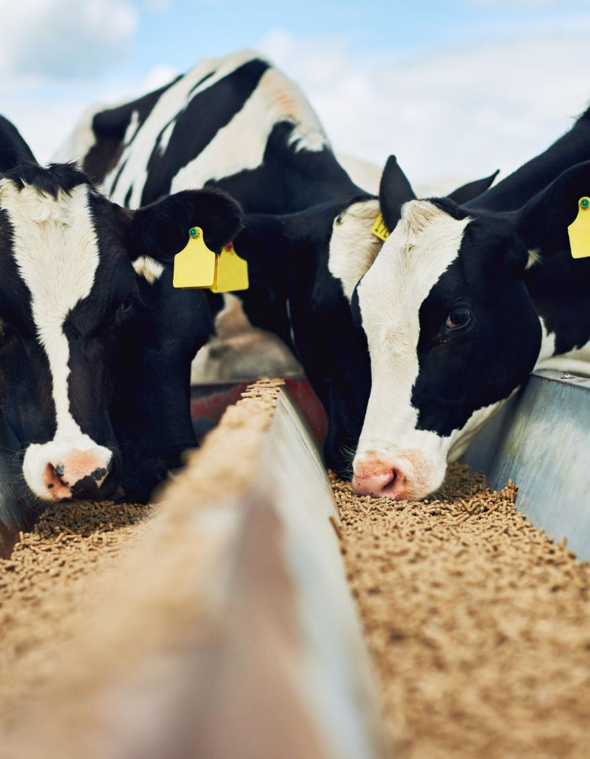
What will you learn
By the end of this module, learners will be able to:
Identify feed strategies to reduce methane emissions from livestock.
Understand how to lower nitrous oxide emissions using precision fertilization.
Explore how renewable energy integration reduces the carbon footprint of farm operations.

Slide 4
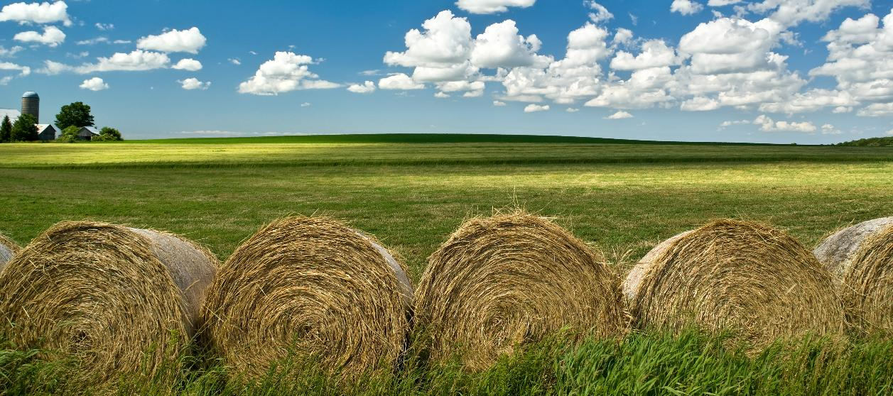
01
LOWERING METHANE EMISSIONS FROM LIVESTOCK THROUGH FEED ADJUSTMENTS

Slide 5
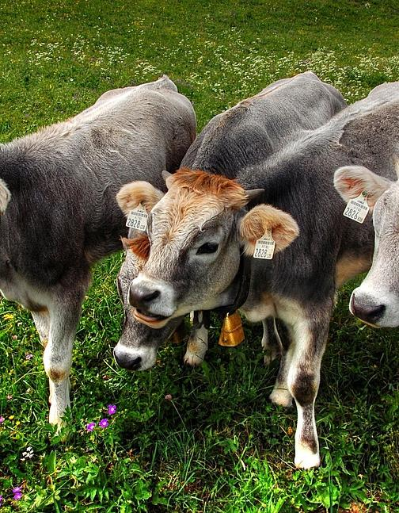
Why Reduce Methane from Livestock?
Livestock, especially ruminants (cows, sheep), produce methane (CH₄) during digestion.
Climate-smart feed strategies help reduce emissions without lowering productivity.
Methane is a powerful greenhouse gas—25x more potent than CO₂.

Slide 6
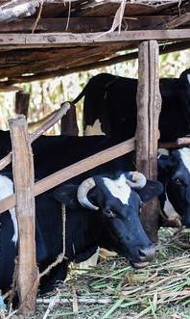
Feed Strategies to Cut Methane
Improve forage quality
Harvest earlier for better digestibility = less methane per kg of milk or meat.
Add fats and oils
Lipids suppress methane-producing microbes in the rumen.
Example: Adding 10g of fat/kg of feed can cut CH₄ by ~1g/kg DM
Use natural additives
Tannins and essential oils can reduce methane by up to 50%.
Precision feeding
Balance protein and energy to avoid nitrogen losses and boost efficiency.

Slide 7
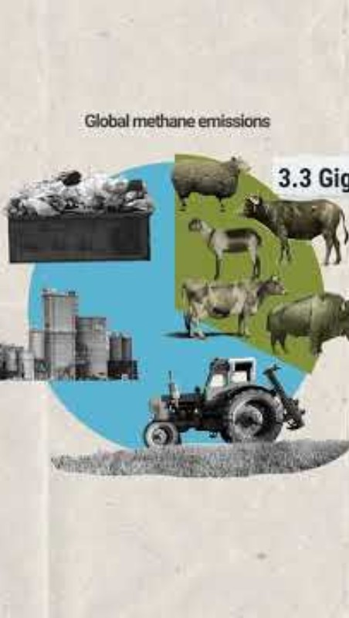
The livestock sector is one of the main contributors to global methane & other GHG emissions.
Better management practices related to:
feed
husbandry
grazing
manure
Livestock and enteric methane - YouTube

Slide 8

02
REDUCING NITROUS OXIDE EMISSIONS WITH PRECISION FERTILIZATION

Slide 9

Why Nitrous Oxide Matters
Nitrous oxide (N₂O) is a potent greenhouse gas—nearly 300 times more powerful than CO₂.
It’s mainly released from excess nitrogen in fertilizers that is not absorbed by crops.
Precision fertilization = better nutrient use + fewer emissions + cost savings.

Slide 10



Smart Fertilization Practices
Slow-release fertilizers
Right dose
Right timing
Right placement
Apply nutrients based on crop needs and soil tests.
Avoid fertilizing before heavy rain to prevent runoff.
Place fertilizers near roots to improve uptake.
Reduce leaching and nitrous oxide formation.
Use organic fertilizers!

Slide 11

03
INTEGRATING RENEWABLE ENERGY TO MINIMIZE THE CARBON FOOTPRINT

Slide 12
Why Renewable Energy on Farms?
Farm operations (irrigation, machinery, storage) often rely on fossil fuels, contributing to CO₂ emissions.
Switching to renewable energy reduces the carbon footprint and operational costs.
It also increases energy independence, especially in remote or off-grid rural areas.

Slide 13

Types of Renewable Solutions
Solar panels – Power irrigation pumps, lights, electric fencing.
Biogas – Use animal manure or crop residues to produce energy for cooking, heating, or electricity.
Wind energy – Suitable for open landscapes to power small farm equipment.
Energy-efficient technologies – Combine renewables with LED lighting, low-energy coolers, or electric tractors.
Smart integration – Use sensors and timers to reduce waste and maximize energy use.
Discussed in Course 4!!!

Slide 14

04
LETS PRACTICE

Slide 15
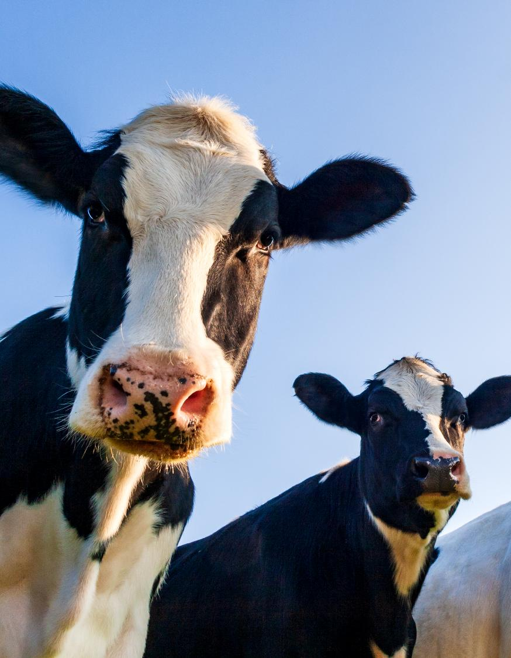
Farm Emissions Challenge
Scenario: You manage a mixed farm (crops + dairy cows) and want to reduce your greenhouse gas emissions while maintaining productivity.

Slide 16
Why Renewable Energy on Farms?
What combination of practices should you apply first?
Option A
Feed cows high-protein diets year-round
Use synthetic fertilizers without testing
Power irrigation with diesel pumps
Option B
Introduce tannin-based additives in cattle feed
Apply slow-release fertilizer based on soil tests
Install solar panels for irrigation
Option C
Harvest hay later for better volume
Use more fertilizer to ensure yield
Replace cover crops with bare fallows

Slide 17
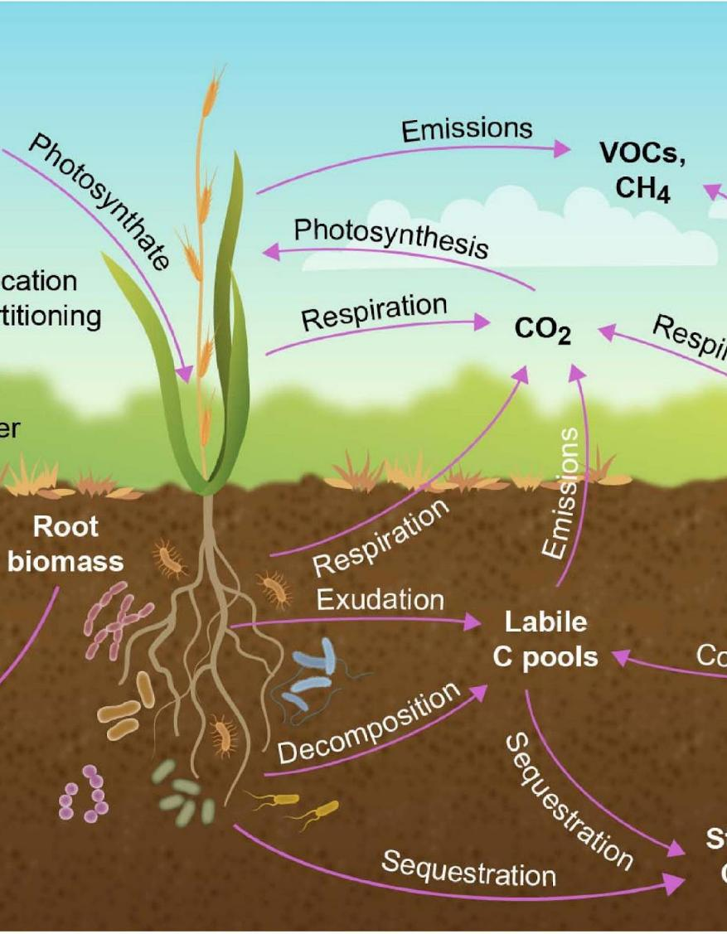
Feedback
Correct Answer: Option B
This option reflects a climate-smart approach:
Reduces methane with feed additives
Lowers nitrous oxide emissions with precision fertilization
Cuts CO₂ through renewable energy use
Questa foto di Autore sconosciuto è concesso in licenza da CC BY

Slide 18
Well done!
You've completed the journey through Climate-Smart Agriculture Techniques!
In this final module, you explored how to:
Reduce methane emissions through smart livestock feeding
Cut nitrous oxide by applying precision fertilization
Use renewable energy to power farm operations sustainably
You’re now ready to apply CSA principles on your farm, in your classroom, or in your community!

Slide 19

Make your last step!
Your final Smart Skills course will be: "Bringing Innovation to Farms". This module aims to provide you with a comprehensive introduction to control systems in agriculture!

Slide 20


www.smartskillsproject.eu
Follow our journey

