Slide 1
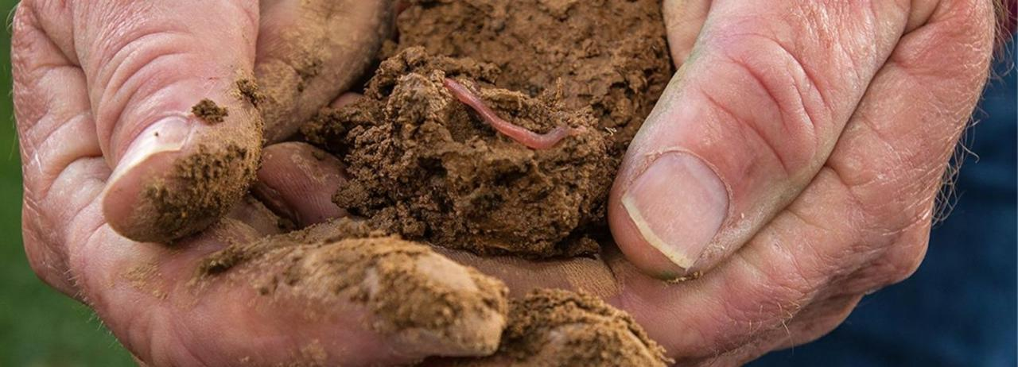


Course 5: Climate-Smart Agriculture (CSA) Techniques
M3: Soil Conservation & Carbon Sequestration
www.smartskillsproject.eu

Slide 2
contents
In this module, learners will discover techniques to prevent soil erosion, promote carbon capture, and understand how to monitor soil health with technological tools. We will discuss:
Enhancing soil health with organic matter.
The benefits of cover cropping
Monitoring and adjusting practices to suit the soils needs
01
Techniques for preventing soil erosion & degradation
02
Agroforestry & cover cropping in carbon sequestration
03
Monitoring & enhancing soil health with technology
04
Let’s Practice!
This license enables reusers to distribute, remix, adapt, and build upon the material in any medium or format, so long as attribution is given to the creator. The license allows for commercial use. CC BY includes the following elements:
BY: credit must be given to the creator.
This project has been funded with support from the European Commission. The author is solely responsible for this publication (communication) and the Commission accepts no responsibility for any use may be made of the information contained therein. In compliance of the new GDPR framework, please note that the Partnership will only process your personal data in the sole interest and purpose of the project and without any prejudice to your rights.

Slide 3
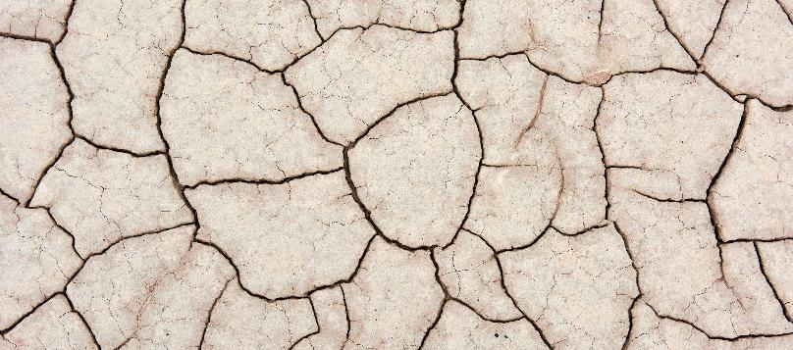
01
TECHNIQUES FOR PREVENTING SOIL EROSION & DEGRADATION

Slide 4

Enhancing Soil Health with Organic Matter
Maintaining healthy soil is essential to prevent erosion and preserve agricultural productivity. Practices that increase organic matter help improve soil structure, promote water retention and reduce the risk of degradation.
10 WAYS TO PREVENT SOIL EROSION

Slide 5



Enhancing Soil Health with Organic Matter
Composting and organic inputs
Cover Cropping and green manuring
Reduced tillage (No-Till/Min-Till)
Adding compost, stimulating microbial activity and improving soil fertility.
Cover crops (legumes, cereals) between harvests protect the soil surface from erosion
Tilling the soil less limits surface erosion. Increases the accumulation of organic carbon.

Slide 6
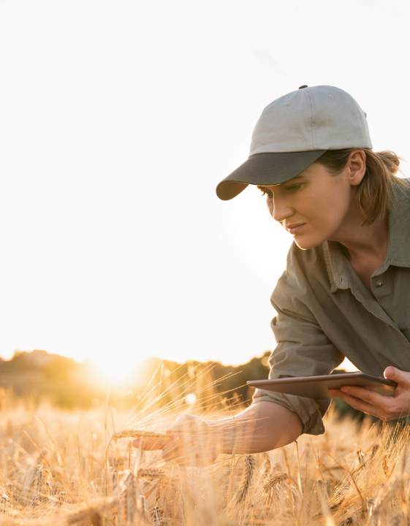
Enhancing Soil Health with Organic Matter
These techniques, central to Climate-Smart Agriculture, reduce dependence on chemical fertilisers and ensure long-lasting productivity, even in variable climatic conditions.
Find out more

Slide 7
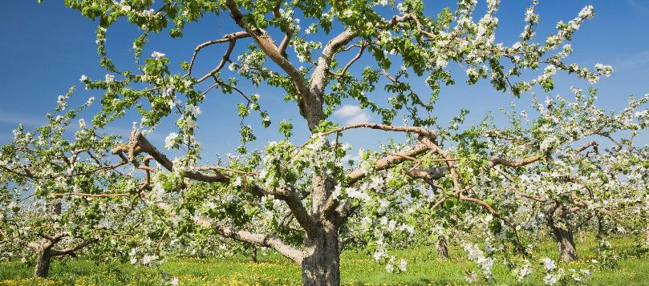
02
ROLE OF AGROFORESTRY & COVER CROPPING IN CARBON SEQUESTRATION.

Slide 8

Agroforestry: trees in synergy with agriculture
Carbon sequestration: Trees absorb CO₂, contributing to the mitigation of climate change.
Crop protection: They act as windbreaks and provide shade, reducing erosion and heat stress.

Slide 9
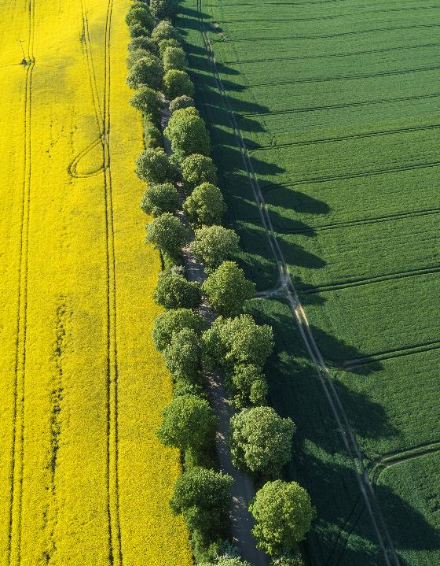
Agroforestry: trees in synergy with agriculture
Biodiversity and microclimate: They offer a habitat for pollinators and natural predators of parasites, improving the health of the ecosystem and regulating temperatures.
Income diversification: Additional products (wood, fruit, nuts, medicinal plants) reduce the economic risk associated with climate variations.

Slide 10
Cover Cropping: to enrich the soil
Increase of organic matter: legumes and other species fix nitrogen and, once incorporated, enrich the soil with carbon.
Soil protection: they reduce erosion between one crop cycle and another, keeping the soil covered.
Natural pest management: A wide crop diversity helps control pests, reducing the use of pesticides.
Together, agroforestry and cover cropping promote resilience to climate change, improve agricultural productivity and make a significant contribution to mitigation (by sequestering carbon and protecting biodiversity). These practices embody the three objectives of Climate-Smart Agriculture: mitigation, adaptation and improvement of livelihoods.

Slide 11
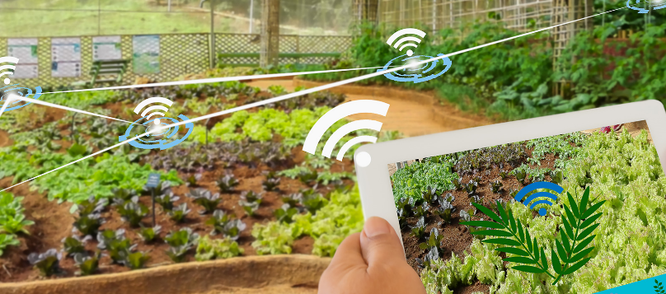
03
MONITORING & ENHANCING SOIL HEALTH WITH TECHNOLOGY

Slide 12
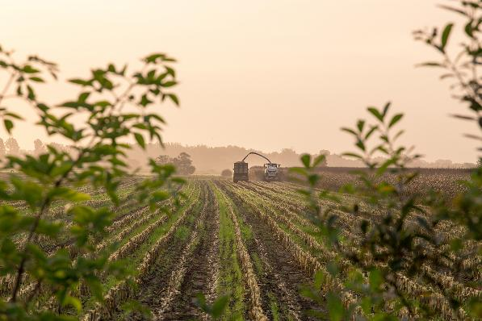
Climate-smart agriculture offers a comprehensive framework for tackling the intertwined challenges of food security, climate change, and environmental degradation.
(Alliance Biodiversity & CIAT)
Quote here

Slide 13
More efficient irrigation technologies
Precision agriculture uses the latest technology to optimise farming practices by collecting and analysing data on soil conditions, weather patterns, and crop health, providing farmers with the best information to make informed decisions.
Remote sensing: Drones, satellites, and sensors can monitor crop health and detect issues like water stress or pest infestations early, allowing farmers to address problems before they become serious.
GPS-guided machinery: Tractors and other farm machinery equipped with GPS can precisely plant seeds and apply inputs, reducing waste and improving efficiency.

Slide 14
More efficient irrigation technologies
Smart irrigation systems: These systems use data from weather forecasts and soil moisture sensors to automatically adjust water levels, ensuring that crops receive just the right amount of water.
Geospatial technology and GIS: Geographic Information Systems (GIS) allow farmers to map their fields and track the performance of different areas. This helps optimize planting strategies and ensures that inputs are applied where they are most needed.

Slide 15
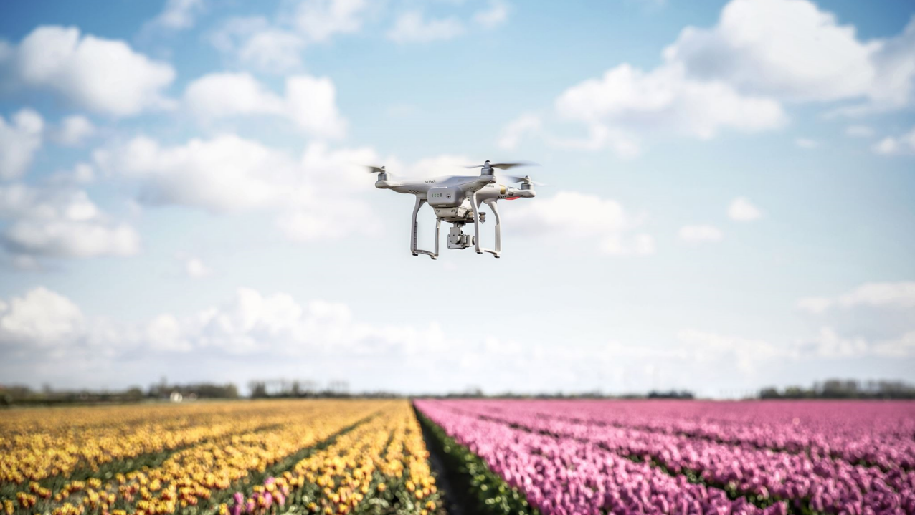
We need to develop and strengthen integrated information systems to address pressing multisectoral challenges, which should be available to all – especially to farmers who are the custodians of our natural resources, as well as their final controllers.
FAO Director-General
A LITTLE PROGRESS EACH DAY ADDS UP TO BIG RESULTS

Slide 16

04
LETS PRACTICE

Slide 17
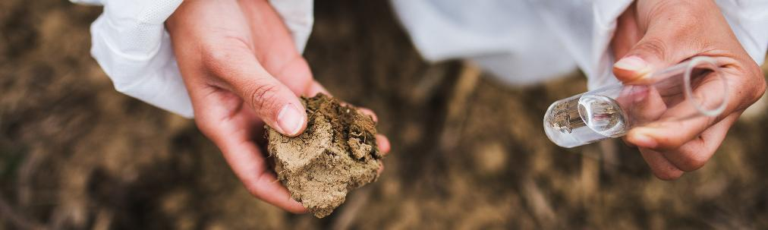
Choices for a Resilient Soil
Scenario: You manage a small hillside farm. In recent years, you’ve observed increasing soil erosion, declining fertility, and loss of biodiversity.
Goal: Choose the combination of practices mentioned on the next slide that best restores soil health and enhances carbon sequestration.

Slide 18
Which option do you choose?
Option A
Deep ploughing
Intensive monoculture
No ground cover between crop cycles
Option B
No-till or reduced tillage
Introduction of cover crops (e.g., clover or vetch)
Composting and organic fertilization
Option C
Frequent drainage and irrigation
High doses of chemical fertilizers
Removing hedgerows to expand cultivated land

Slide 19
Feedback
✔️ Option B is the best choice!
It combines soil conservation and organic matter enhancement practices, improving fertility, structure, and the soil’s ability to store carbon.
❌ Options A and C can worsen soil degradation and reduce biodiversity, moving away from Climate-Smart Agriculture principles.

Slide 20
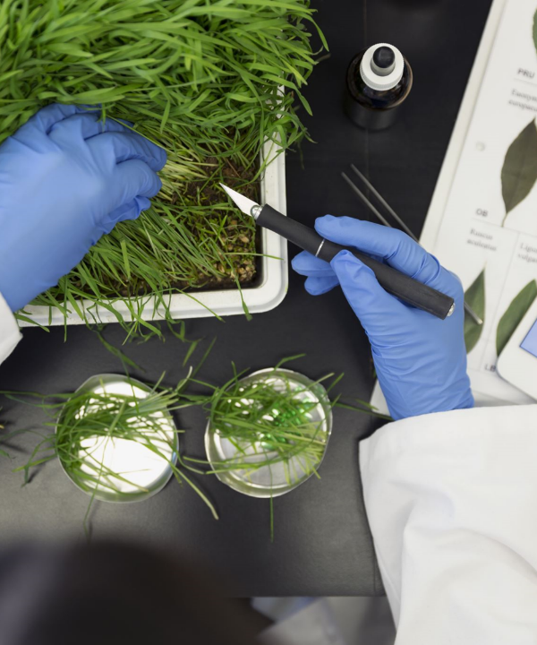

www.smartskillsproject.eu
Follow our journey

