Slide 1
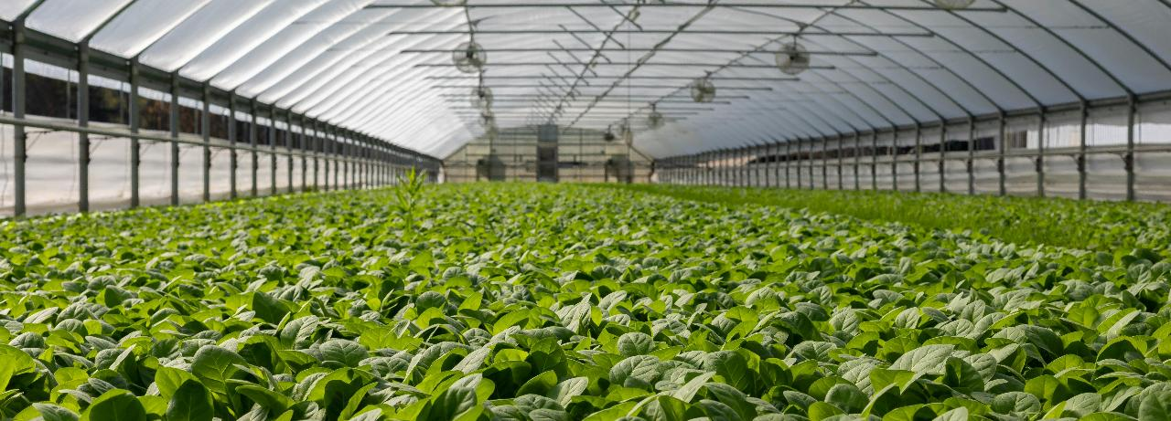


Course 4: Renewable Energy Integration in Agriculture
M4: Renewable Energy in Greenhouses & Controlled Environments
www.smartskillsproject.eu

Slide 2
What will you learn?
Understand…
This module aims to provide an understanding of renewable energy applications in greenhouses and controlled environments. It will explore the design and implementation of renewable-powered heating and cooling systems, ensuring optimal growing conditions while reducing energy consumption.
You will gain insight into practical examples of renewable energy integration in modern greenhouses, including solar panels, geothermal heating, and biomass systems. Additionally, the module will cover methods for tracking energy consumption and assessing sustainability metrics, helping to improve efficiency and environmental impact.
By the end of this module, you will have a clear understanding of how renewable energy solutions can enhance greenhouse operations, promote sustainability, and contribute to energy independence in modern agriculture.
  …the design of renewable-powered heating and cooling systems
Identify…
…examples of renewable energy integration in modern greenhouses
Explain…
… how to track energy consumption and sustainability indicators

Slide 3
contents
This module is about renewable energy that can be used in greenhouses and other controlled environments. We will discuss examples of integrating renewable energy in modern greenhouses and sustainability indicators.
01
  Designing renewable-powered heating & cooling systems.
02
Renewable energy integration in modern greenhouses.
03
  Tracking energy consumption and sustainability metrics.
04
Let’s Practice!
This license enables reusers to distribute, remix, adapt, and build upon the material in any medium or format, so long as attribution is given to the creator. The license allows for commercial use. CC BY includes the following elements:
BY: credit must be given to the creator.
This project has been funded with support from the European Commission. The author is solely responsible for this publication (communication) and the Commission accepts no responsibility for any use may be made of the information contained therein. In compliance of the new GDPR framework, please note that the Partnership will only process your personal data in the sole interest and purpose of the project and without any prejudice to your rights.

Slide 4

01
  DESIGNING RENEWABLE-POWERED HEATING & COOLING SYSTEMS

Slide 5
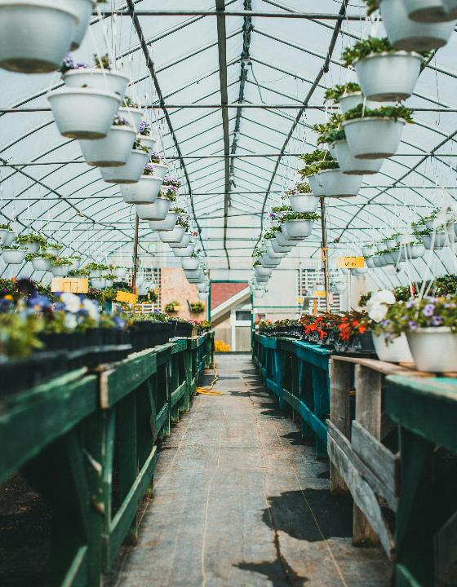
Overview
Greenhouses and other controlled growing environments (high tunnels / polytunnels, vertical farming, etc.) require precise management of temperature, humidity and air exchange to ensure optimal growing conditions for plants all year round.
Using renewable energy for heating and cooling systems not only reduces operating costs but also minimises the impact on the environment.

Slide 6

Key aspects of designing renewable heating and cooling systems
Selection of the right energy source
Energy efficiency
Automation and monitoring
Integration of Back-up or Hybrid system
local resources, climatic conditions and availability of raw materials should be taken into account and obtain permits if required (especially for biomass & geothermal).
the use of thermal energy storage technologies (e.g. storage tanks for water heated by solar energy) allows for optimal temperature management.
the use of intelligent temperature and humidity control systems allows energy consumption to be adjusted to the current needs of the crop.
a combination of solar energy and biomass, for example, can ensure greater stability of energy supply at different times of the year.
Ensure systems meet national energy efficiency standards & health/safety codes and explore financial incentives or subsidies for installation.

Slide 7
Keep in mind
Install, Monitor & Maintain
Educate Users & Build Capacity
Remember to attend training courses on use and safety.
Remember to monitor energy consumption and apply energy-saving practices.
Use qualified installers.
Implement simple monitoring tools (e.g., energy meters, dashboards).
Schedule regular maintenance for longevity & efficiency.
2 good sources of info:
IRENA Heating & Cooling Guide: link, Renewable Energy Directive: link

Slide 8
Renewable energy sources in heating and cooling systems
Resource | Heating Option | Cooling Option
Solar | Solar thermal panels for water/space heating | PV-powered AC or absorption chillers
Wind | Wind turbine to power heat pumps or boilers | Wind-powered electric cooling systems
Biomass | Biomass boiler, stove, or digester | Limited use for cooling; indirect via electricity
Geothermal | Ground-source heat pump | Ground cooling loop for passive cooling

Slide 9
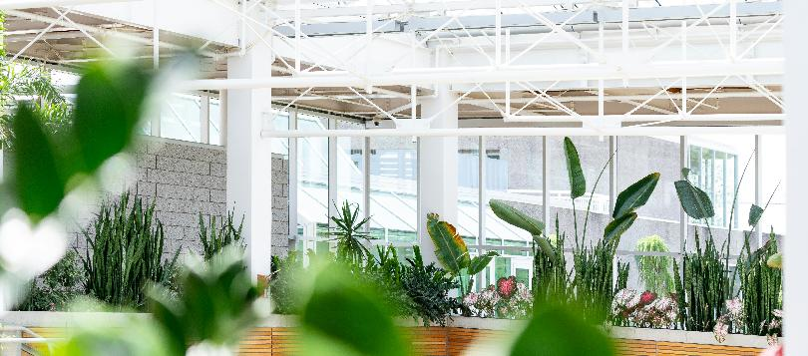
02
EXAMPLES OF RENEWABLE ENERGY INTEGRATION IN MODERN GREENHOUSES

Slide 10
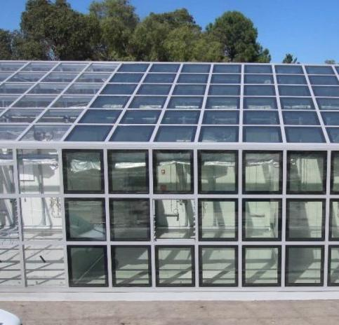
Greenhouses powered by solar
These greenhouses are fully powered by solar energy, using photovoltaic panels located both on the roof and in adjacent ground installations.
The electricity generated by the PV panels powers the ventilation systems, LED lighting and automatic irrigation.
Excess energy is stored in batteries, which allows for energy independence even on cloudy days.

Slide 11
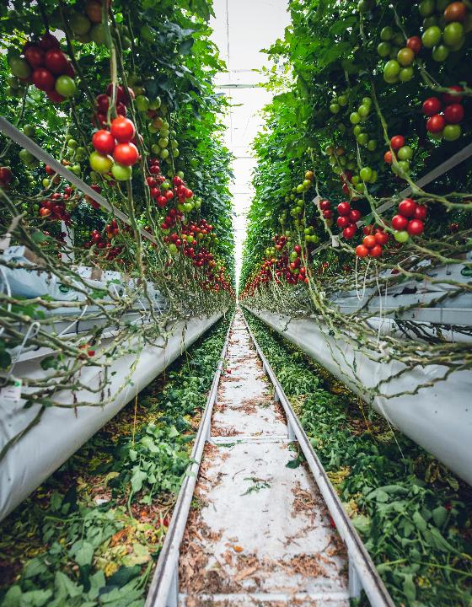
Heating systems for greenhouses based on biomass
In some farms, vegetable waste and wood from local sources are used to produce thermal energy in biomass boilers.
The heat is distributed in the greenhouse through a system of pipes and fans, ensuring an optimal temperature for the crops throughout the year.
The system works with automatic sensors that adjust the temperature depending on the weather conditions.

Slide 12
Be Inspired: Hofgut Duelli from Germany
Hofgut Duelli produces electricity and heat on site from renewable sources, and heat is also supplied to local households in the municipality. A biogas upgrading plant has also recently been installed there, which produces compressed natural gas (CNG) from biogas.
The farm uses a biogas plant that processes organic waste such as animal manure and crop residues through anaerobic fermentation. This process produces biogas, a renewable energy source consisting mainly of methane, which can be used for heating, electricity generation or as fuel for vehicles.
Type of technology used:
✓Smart sensors
✓Biogas production plant
✓Agri-PV
Find more information in our Good Practice Compendium

Slide 13
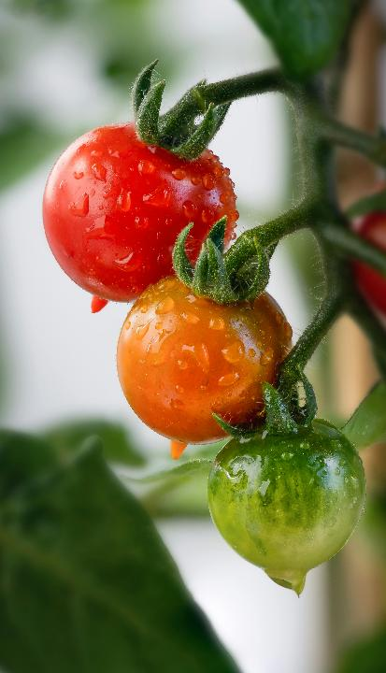
Use of wind turbines in greenhouses
These greenhouses are equipped with medium-power wind turbines that supply energy to water pumps and cooling systems.
Excess energy generated by the wind turbines is stored in batteries and supplemented by solar panels during periods of low energy production.
Sometimes, a hybrid system is used (wind + solar energy), allowing farms to operate independently of the national power grid.

Slide 14

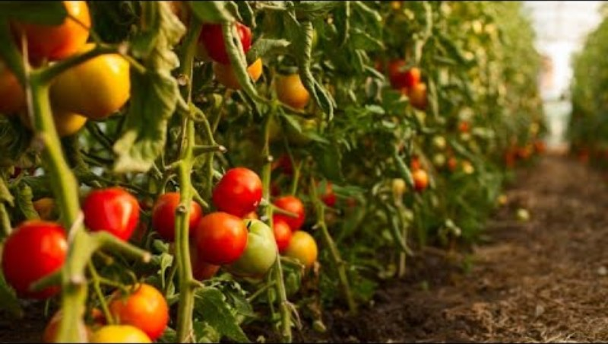
Be Inspired…
This short video looks at the relationship between renewable energy and greenhouse facilities
Greenhouses powered by renewables could change the way food is grown ➔

Slide 15

03
  TRACKING ENERGY CONSUMPTION & SUSTAINABILITY METRICS

Slide 16
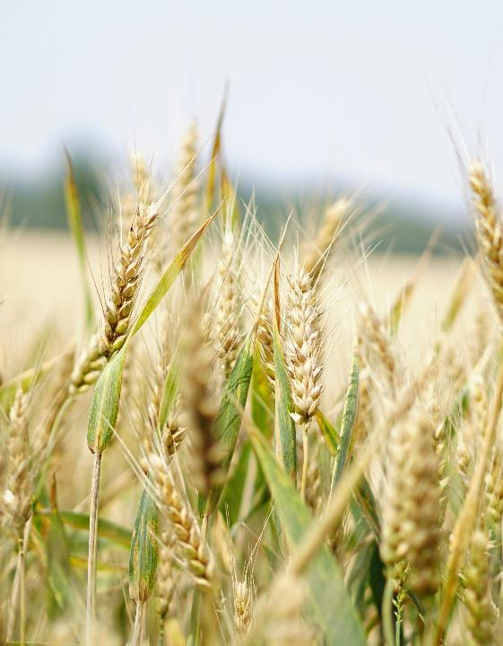
Overview
Modern agriculture is moving towards greater energy efficiency and sustainability. To achieve these goals, it is necessary to monitor energy consumption and analyse key indicators affecting the environment and the farm's economy. Thanks to modern technologies and analytical systems, farmers can optimise resource consumption, reduce costs and minimise the carbon footprint of their operations.

Slide 17
Technologies for tracking energy consumption
Energy Management Systems (EMS)
Energy monitoring systems
IoT (Internet of Things) in agriculture
Smart energy meters measure consumption in real time, providing data on machinery, lighting, heating and irrigation systems.
Data analysis allows for the identification of areas of excessive consumption and the adjustment of energy management strategies.
Sensors connected to the network can monitor the performance of photovoltaic panels, wind turbines and biogas systems.
The data collected by IoT allows for automatic process regulation, e.g. adjusting the intensity of irrigation to the available energy from renewable sources.
Read more about IOT
Advanced platforms integrating data on energy consumption, weather forecasts, and energy demand on the farm.
Automatic optimisation of equipment operation, e.g. starting water pumps during periods of highest energy production from solar panels.

Slide 18
Practical benefits of monitoring energy and sustainability indicators
Better cost control – The ability to track energy consumption and adjust operational strategies leads to lower electricity and fuel costs.
Optimisation of resources – Intelligent energy management systems help to automatically adjust the operation of equipment and minimise waste.
Reduced environmental impact – Lower energy and water consumption, reduced CO₂ emissions and efficient waste management make the farm more environmentally friendly.
Increased energy independence – Monitoring and data analysis enable better use of renewable energy sources, which increases the farm's resilience to changes in energy and fuel prices.

Slide 19

04
LET’S PRACTICE

Slide 20
Consider the following questions
Considering Resilience & Future Readiness
Is my current energy system resilient to price fluctuations or energy supply interruptions?
How will my operation adapt to future energy regulations or carbon taxes?
Am I building a system that supports long-term sustainability goals?

Slide 21
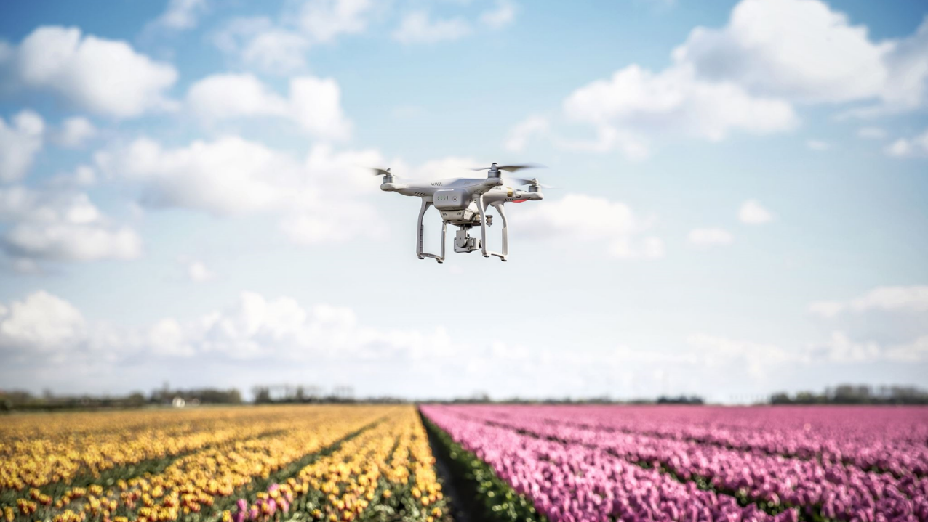
When we power our greenhouses with clean energy, we grow more than crops—we grow solutions.
— Green Innovation Forum, 2022

Slide 22

Well Done!!!
You finished the fourth module of Course 4! Keep going on this learning journey.
In the next module you will learn about Government Policies and Incentives for Renewable Energy Adoption.

Slide 23
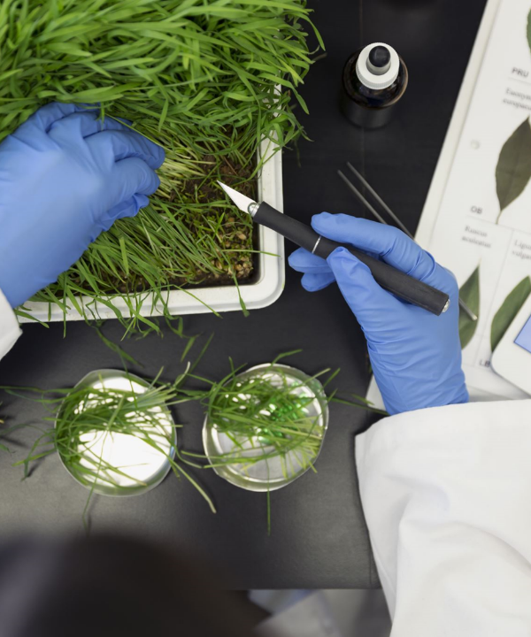

www.smartskillsproject.eu
Follow our journey

