Slide 1
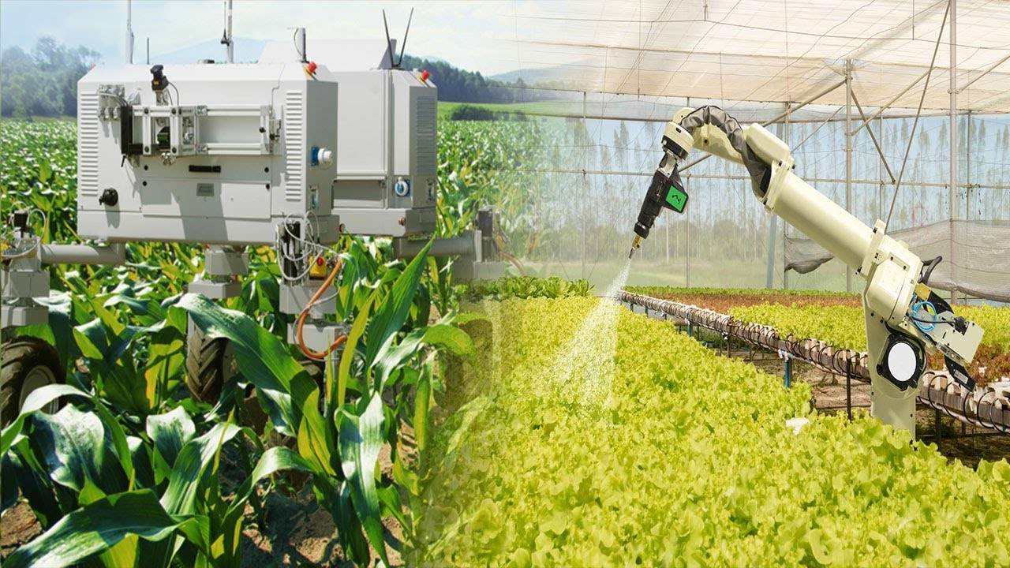


Course 3: Mechatronics in Agriculture
M5: Future Trends
www.smartskillsproject.eu

Slide 2

contents
This module summarises the transformative role of mechatronics in modern agriculture. Learners will explore how innovations such as precision farming, autonomous vehicles, swarm robotics, and adaptive machine learning systems are reshaping agricultural practices. The module will also examine the impact of these emerging trends on the efficiency, sustainability, and future direction of farming operations.
01
Future Trends in Mechatronics
02
Key Technologies in Autonomous Agriculture
03
Let’s Practice!
This license enables reusers to distribute, remix, adapt, and build upon the material in any medium or format, so long as attribution is given to the creator. The license allows for commercial use. CC BY includes the following elements:
BY: credit must be given to the creator.
This project has been funded with support from the European Commission. The author is solely responsible for this publication (communication) and the Commission accepts no responsibility for any use may be made of the information contained therein. In compliance of the new GDPR framework, please note that the Partnership will only process your personal data in the sole interest and purpose of the project and without any prejudice to your rights.

Slide 3
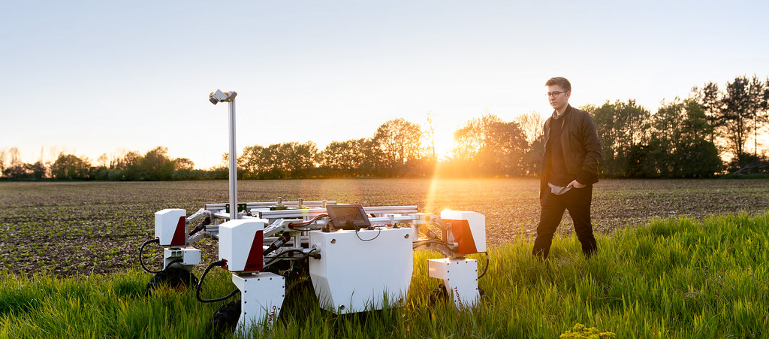
01
FUTURE TRENDS IN MECHATRONICS

Slide 4
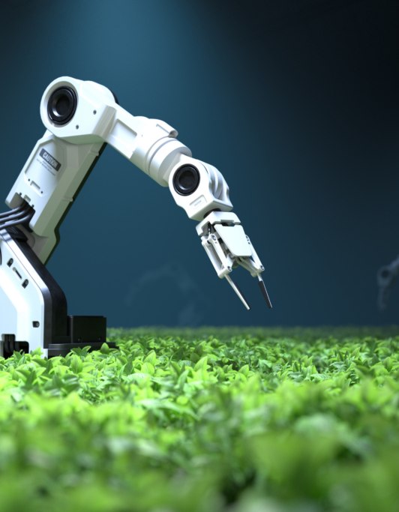
Future Trends in Mechatronics
The future of mechatronics in agriculture is being shaped by advancements in automation, robotics, and artificial intelligence (AI). As farms become more reliant on data-driven decision-making and precision farming, new technologies such as autonomous vehicles, swarm robotics, and adaptive machine learning systems will play a critical role in transforming agricultural operations. This module explores these emerging trends and their impact on the future of farming.

Slide 5
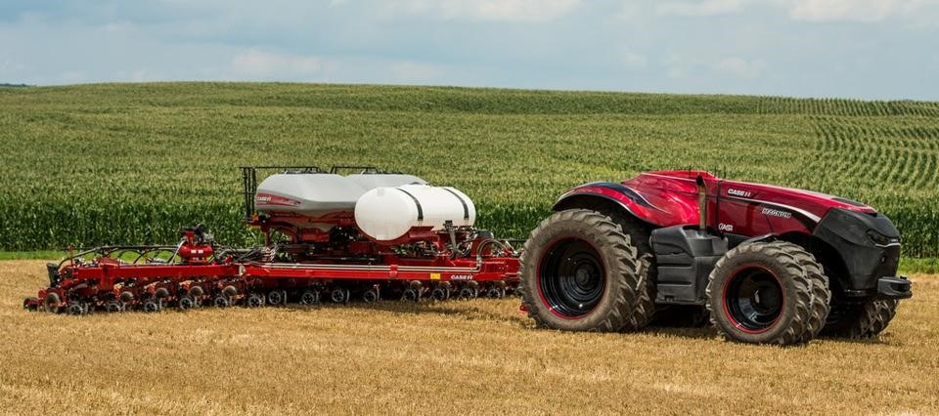
Autonomous Systems and Self-Driving Vehicles in Agriculture
Autonomous systems are revolutionising modern farming by reducing the need for human intervention in field operations.
Self-driving tractors, robotic harvesters, and AI-powered drones use GPS, LiDAR, and AI-driven analytics to navigate fields, plant crops, apply fertilisers, and monitor crop health with minimal supervision.

Slide 6
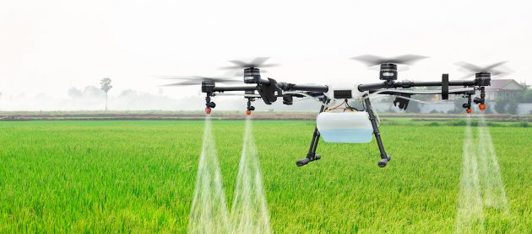
02
KEY TECHNOLOGIES IN AUTONOMOUS AGRICULTURE

Slide 7



Key Technologies in Autonomous Agriculture
GPS-guided tractors and harvesters perform precise fieldwork without human drivers.
AI-powered drones scan fields for crop health, pest infestations, and irrigation needs.
Autonomous irrigation systems detect soil moisture levels and adjust water distribution.

Slide 8
The Rise of Swarm Robotics in Large-Scale Farming
Automated Weed Control: Swarm robots detect and remove weeds without herbicides.
Crop Monitoring and Data Collection: A network of robots gathers real-time data on soil health, crop growth, and disease detection.
Precision Planting and Seeding: Small robots individually plant seeds at optimal spacing.

Slide 9
Trends in Machine Learning for Adaptive Mechatronics
Adaptive Weed Recognition
AI-based robotic weeders improve accuracy by distinguishing crops from weeds in diverse environments.
Machine learning (ML) is making agricultural mechatronic systems more intelligent, adaptive, and efficient. AI-powered robots can learn from real-time data, improving their performance over time.
How Machine Learning is Enhancing Mechatronics:
Yield Prediction & Smart Harvesting
ML models analyze climate, soil, and crop data to predict optimal harvest times.
Autonomous Equipment Optimisation
Self-learning tractors and drones adjust settings based on real-time field conditions.

Slide 10

03
LET’S PRACTICE

Slide 11
Learner Exercise: Technology Match-Up
Match each agricultural technology below with its correct description.
Bonus Discussion Question:
Which of these technologies do you think will have the biggest impact on the future of farming, and why?
Technologies:
A. Precision Farming
B. Autonomous Vehicles
C. Swarm Robotics
D. Adaptive Machine Learning
E. Data-Driven Decision-Making
Descriptions:
A system that uses patterns in farm data to continuously improve predictions & recommendations.
GPS-enabled machines that operate without human drivers to perform farm tasks.
Using analytics and sensors to guide planting, irrigation, and fertilization.
Coordinated groups of robots working together to complete agricultural tasks.
Using farm data to guide planning and operational decisions for higher efficiency.

Slide 12


www.smartskillsproject.eu
Follow our journey

