Slide 1
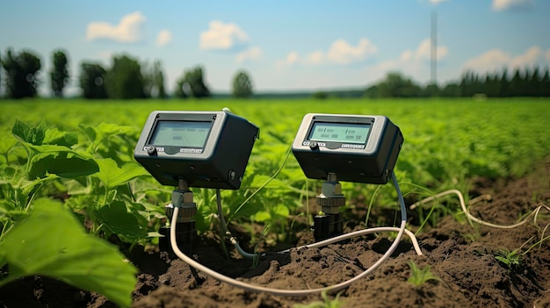


Course 3: Mechatronics in Agriculture
M3: Sensors and Actuators
www.smartskillsproject.eu

Slide 2

contents
In this module, learners will understand the role of sensors and actuators in agriculture, recognising how these components form the backbone of mechatronic systems, enabling real-time monitoring, intelligent decision-making, and automated control of equipment.
01
Sensors and Actuators in Agricultural Machinery
02
Case study: Mechatronics for Smart Greenhouse Systems
03
Let’s Practice!
This license enables reusers to distribute, remix, adapt, and build upon the material in any medium or format, so long as attribution is given to the creator. The license allows for commercial use. CC BY includes the following elements:
BY: credit must be given to the creator.
This project has been funded with support from the European Commission. The author is solely responsible for this publication (communication) and the Commission accepts no responsibility for any use may be made of the information contained therein. In compliance of the new GDPR framework, please note that the Partnership will only process your personal data in the sole interest and purpose of the project and without any prejudice to your rights.

Slide 3
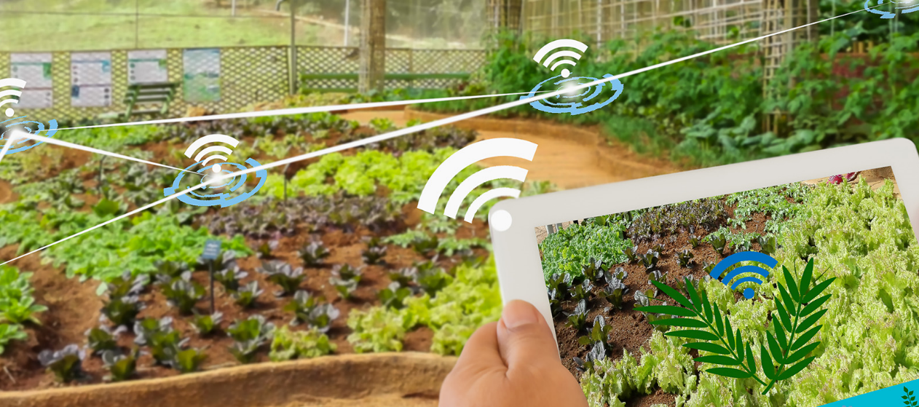
01
SENSORS AND ACTUATORS IN AGRICULTURAL MACHINERY

Slide 4
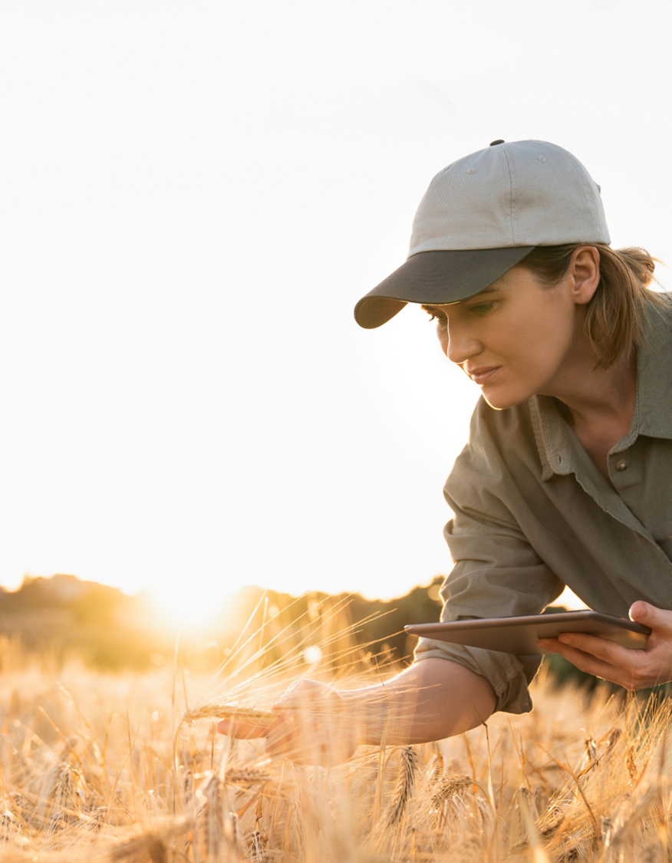
Sensors and Actuators in Agricultural Machinery
Modern agricultural machinery relies heavily on sensors and actuators to enhance efficiency, automation, and precision in farming operations. These components form the backbone of mechatronic systems, enabling real-time monitoring, intelligent decision-making, and automated control of equipment. This module explores how sensors improve machine efficiency, the role of actuators in farming, and a case study on mechatronics in smart greenhouse systems.

Slide 5
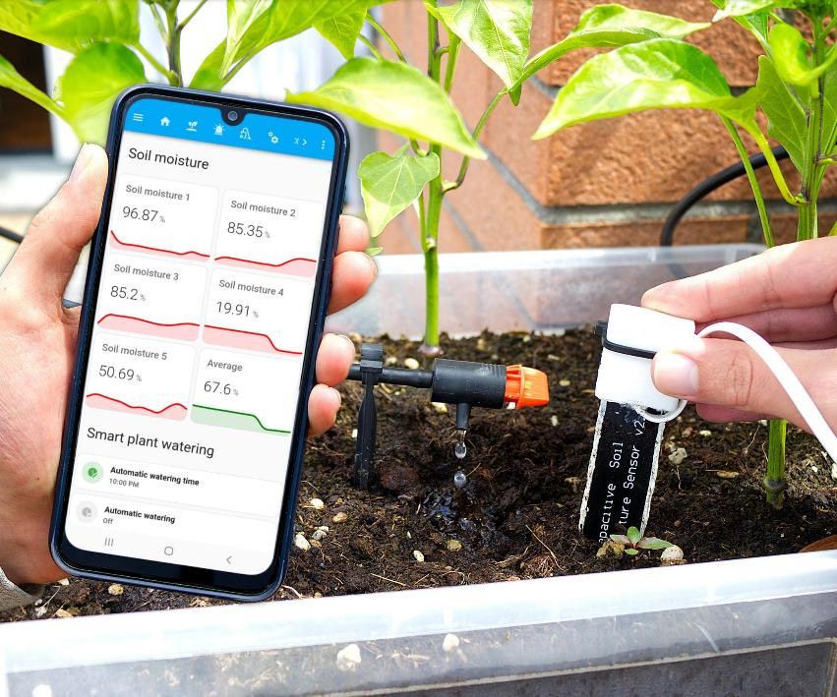
How Sensors Enhance Machine Efficiency
Sensors play a crucial role in data collection and decision-making in agricultural machinery. By continuously monitoring environmental and operational conditions, sensors help optimise processes, reduce resource waste, and improve crop yields.
Example: Smart irrigation systems use soil moisture sensors to trigger water pumps only when necessary, improving water conservation and crop health.
https://www.instructables.com/ESP32-Soil-Moisture-Sensors-DIY-Automatic-Watering/

Slide 6
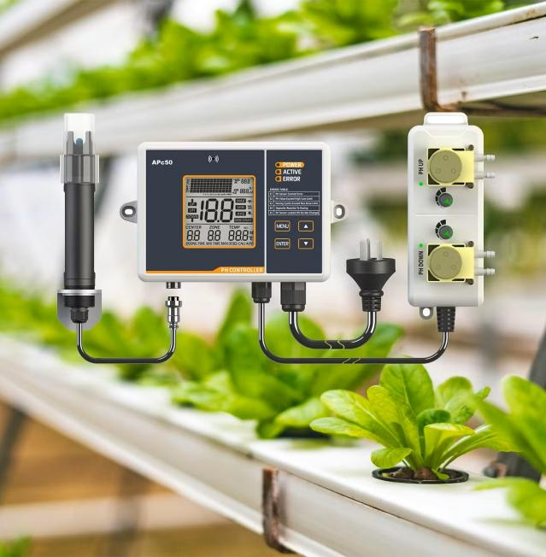
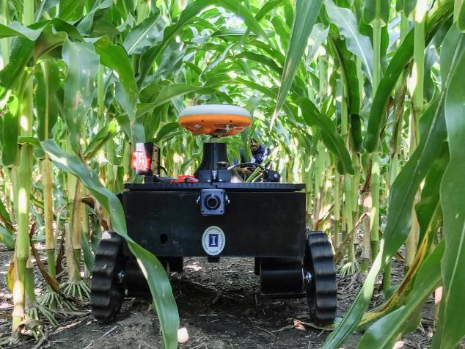
Key Functions of Sensors in Agriculture:
Precision Farming: GPS and LiDAR sensors guide autonomous tractors and drones for accurate navigation and efficient land use.
Irrigation Optimisation: Soil moisture sensors adjust water supply based on real-time data, preventing overwatering.
Pest and Disease Detection: Multispectral and thermal cameras identify early signs of plant stress, enabling targeted treatment.
Click for more info

Slide 7
Key Functions of Sensors in Agriculture:
Livestock Monitoring: RFID tags and biometric sensors track animal health and movement, ensuring better welfare.
Machine Condition Monitoring: Vibration and pressure sensors detect wear and mechanical faults in machinery, reducing downtime.
Click for more info

Slide 8
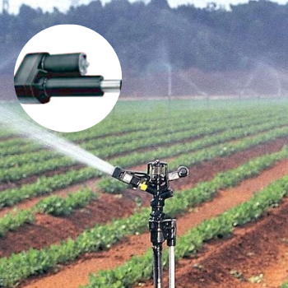
Actuators & their Applications in Farming Equipment
Actuators are mechanical components that convert electrical or hydraulic signals into physical movement, enabling precise control of agricultural machinery. They play a key role in robotic systems, automated irrigation, and harvesting equipment.
Actuators offer motions like push, pull, injection, and trigger to agricultural equipment.

Slide 9
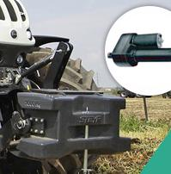
Click for more info
Types of Actuators in Agriculture:
Hydraulic Actuators: Used in heavy-duty machinery like tractors and robotic arms to provide high power and force.
Pneumatic Actuators: Found in lightweight automation systems, such as robotic fruit-picking devices.
Electric Motors & Servo Actuators: Enable precision control in autonomous sprayers, seeders, and robotic weeders.
Linear Actuators: Adjust sprayer nozzles, irrigation valves, and robotic harvesting tools.
Example: Robotic harvesters use electric servo motors to gently grasp and pick fruit without damaging it, improving harvest quality.

Slide 10
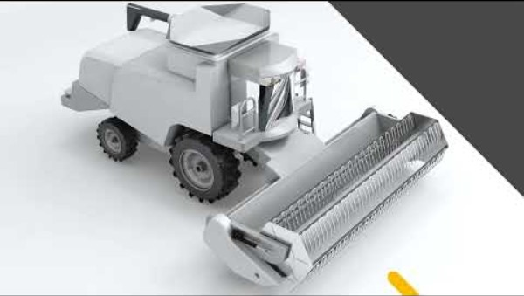
Actuators in Agriculture
For a visual demonstration of electromechanical actuators in agricultural machinery, you might find the following video informative:
Ewellix - Electromechanical actuators for agriculture machinery & equipment - YouTube

Slide 11

02
CASE STUDY: MECHATRONICS FOR SMART GREENHOUSE SYSTEMS

Slide 12
Case Study: Mechatronics for Smart Greenhouse Systems
Greenhouses equipped with mechatronic control systems integrate sensors, actuators, and AI to create an optimised growing environment. These smart systems adjust temperature, humidity, and irrigation based on real-time conditions, enhancing productivity and sustainability.
How It Works:
Sensors monitor climate conditions (temperature, CO₂ levels, soil moisture, and light intensity).
Actuators regulate automated processes such as ventilation, heating, and nutrient delivery.
AI-driven controllers analyse data and make real-time adjustments to optimise plant growth.

Slide 13
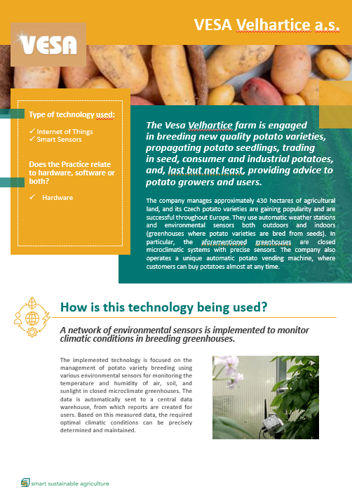
Be Inspired:
In our SmartSkills Good Practice Compendium the Czech case study VESA, demonstrates how they use a network of environmental sensors to monitor climatic conditions in their greenhouses.
For more information:
Vesa Velhartice

Slide 14

03
LET’S PRACTICE

Slide 15
Learner Activity:
Practical Activity: “Exploring Sensor and Actuator Applications in Agriculture”
Identify one type of sensor and one type of actuator commonly used in modern agricultural machinery.
Task: Write a brief explanation (100-150 words) of how they function, their role in farming operations, and their benefits.
Optional: Find an image or video demonstrating these components in action.

Slide 16
Group Activity:
Discussion Prompt:
How do you think advanced sensors and actuators will shape the future of smart farming? What challenges might arise in their widespread adoption?
Purpose: This activity engages learners in understanding real-world applications, encourages critical thinking, and highlights the impact of automation in agriculture.

Slide 17


www.smartskillsproject.eu
Follow our journey

