Slide 1



Course 3: Mechatronics in Agriculture
M4: Maintenance & Troubleshooting
www.smartskillsproject.eu

Slide 2

contents
In this module, learners will be introduced to key maintenance practices, common problems and solutions in agricultural robotics, and hands-on activities for diagnosing system issues.
01
Maintenance and Troubleshooting
02
Essential Maintenance Practices
03
Lets Practice: Activities for System Diagnostics
This license enables reusers to distribute, remix, adapt, and build upon the material in any medium or format, so long as attribution is given to the creator. The license allows for commercial use. CC BY includes the following elements:
BY: credit must be given to the creator.
This project has been funded with support from the European Commission. The author is solely responsible for this publication (communication) and the Commission accepts no responsibility for any use may be made of the information contained therein. In compliance of the new GDPR framework, please note that the Partnership will only process your personal data in the sole interest and purpose of the project and without any prejudice to your rights.

Slide 3
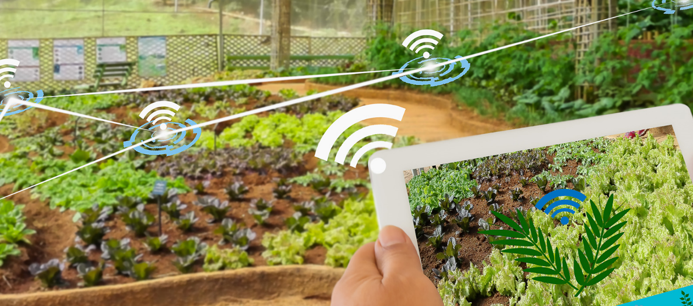
01
MAINTENANCE & TROUBLESHOOTING

Slide 4

Maintenance and Troubleshooting
Proper maintenance and troubleshooting are essential for ensuring the longevity, efficiency, and reliability of mechatronic systems in agriculture.
Regular upkeep helps prevent unexpected failures, reduces downtime, and optimises the performance of robotic systems, sensors, and actuators.

Slide 5
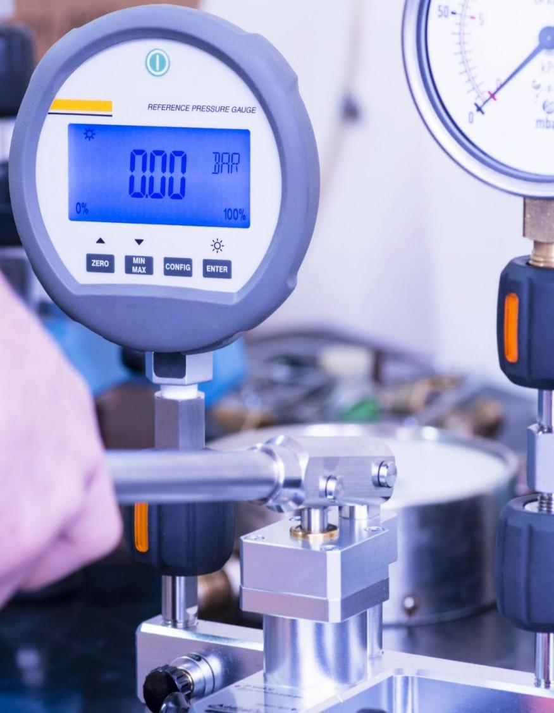
Key Practices for Maintaining Mechatronic Systems
To keep agricultural robotics and automation systems functioning efficiently, farmers and technicians must implement a preventive maintenance routine.
Example: A farmer using an autonomous weeding robot should calibrate its vision sensors weekly, ensuring precise weed detection and removal.

Slide 6

Maintenance and Troubleshooting
Regular maintenance and troubleshooting are key to maximizing efficiency in agricultural mechatronics. By following structured preventive care, identifying common system failures, and performing hands-on diagnostics, farmers and technicians can reduce downtime, improve precision, and extend the lifespan of robotic machinery. As automation continues to grow in agriculture, proper maintenance will be essential in ensuring long-term success and reliability.

Slide 7
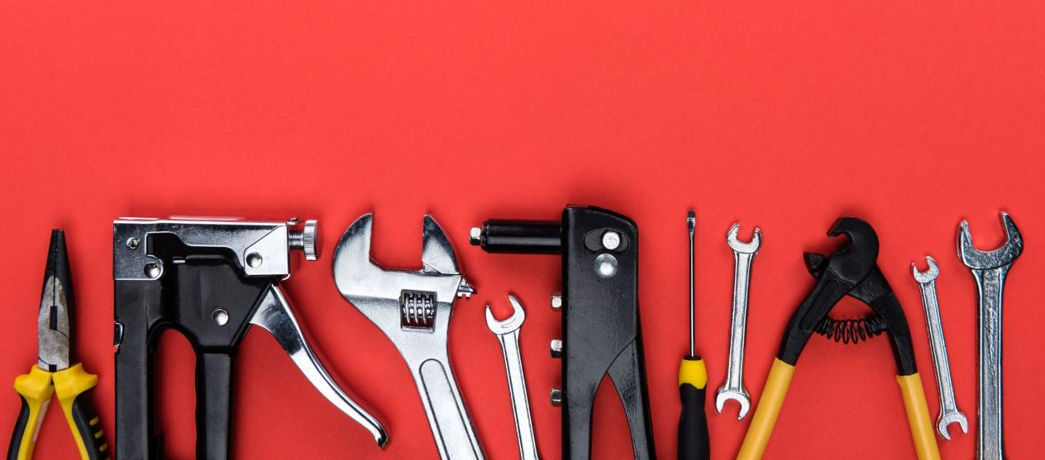
02
ESSENTIAL MAINTENANCE PRACTICES

Slide 8
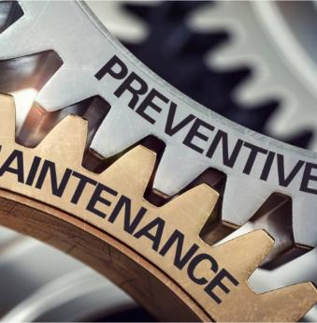
Essential Maintenance Practices
Regular Sensor Calibration: Ensures accurate data collection for precision agriculture tools (e.g., soil moisture sensors, GPS guidance systems).
Lubrication and Cleaning: Reduces wear and tear on robotic arms, actuators, and mechanical components.
Battery and Power System Checks: Maintains battery health in autonomous robots and drones for uninterrupted operation.
Firmware and Software Updates: Keeps AI algorithms, machine learning models, and automation software up to date.
Mechanical Inspection: Identifies potential failures in gears, motors, and hydraulic systems before they cause downtime.
Click for more info

Slide 9

Common Problems & Solutions for Agricultural Robotics
Despite advanced technology, agricultural robots can experience technical failures due to environmental conditions, software malfunctions, or hardware wear and tear. Below are common issues and troubleshooting steps:
Common Issues & Troubleshooting Tips:
Sensor Malfunctions: If sensors provide inaccurate readings, clean them, check wiring, and recalibrate.
Connectivity Failures: Robots relying on GPS or IoT networks may experience signal loss. Ensure firmware is updated and networks are stable.

Slide 10

Common Problems & Solutions for Agricultural Robotics
Common Issues & Troubleshooting Tips:
Mechanical Wear & Tear: Actuators and motors can degrade over time. Regularly inspect, lubricate, and replace worn components.
Software Glitches: If an autonomous tractor miscalculates field paths, check for firmware updates and recalibrate the GPS system.
Battery & Power Failures: Robots stopping unexpectedly? Monitor battery cycles, replace degraded units, and optimise energy consumption settings.

Slide 11
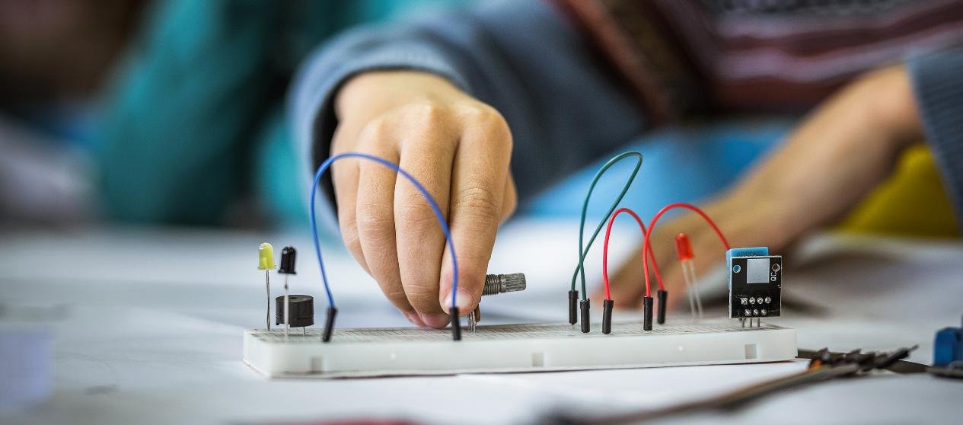
03
ACTIVITIES FOR SYSTEM DIAGNOSTICS

Slide 12
Hands-On Activities for System Diagnostics
Practical troubleshooting exercises help users build confidence in detecting and resolving issues with mechatronic systems.
Activity 1: Sensor Calibration Exercise
Task: Use a handheld soil moisture sensor and compare readings across different soil conditions. Calibrate the sensor to ensure accurate measurements.
Activity 2: Actuator Testing
Task: Check the movement of an electric actuator in a robotic system. Adjust settings, apply lubrication, and observe changes in performance and speed.

Slide 13
Hands-On Activities for System Diagnostics
Practical troubleshooting exercises help users build confidence in detecting and resolving issues with mechatronic systems.
Activity 3: Drone System Check
Task: Inspect aerial or ground-based autonomous systems for power issues, faulty wiring, and connectivity errors. Run a diagnostic report and identify any needed updates.

Slide 14


www.smartskillsproject.eu
Follow our journey

