Slide 1
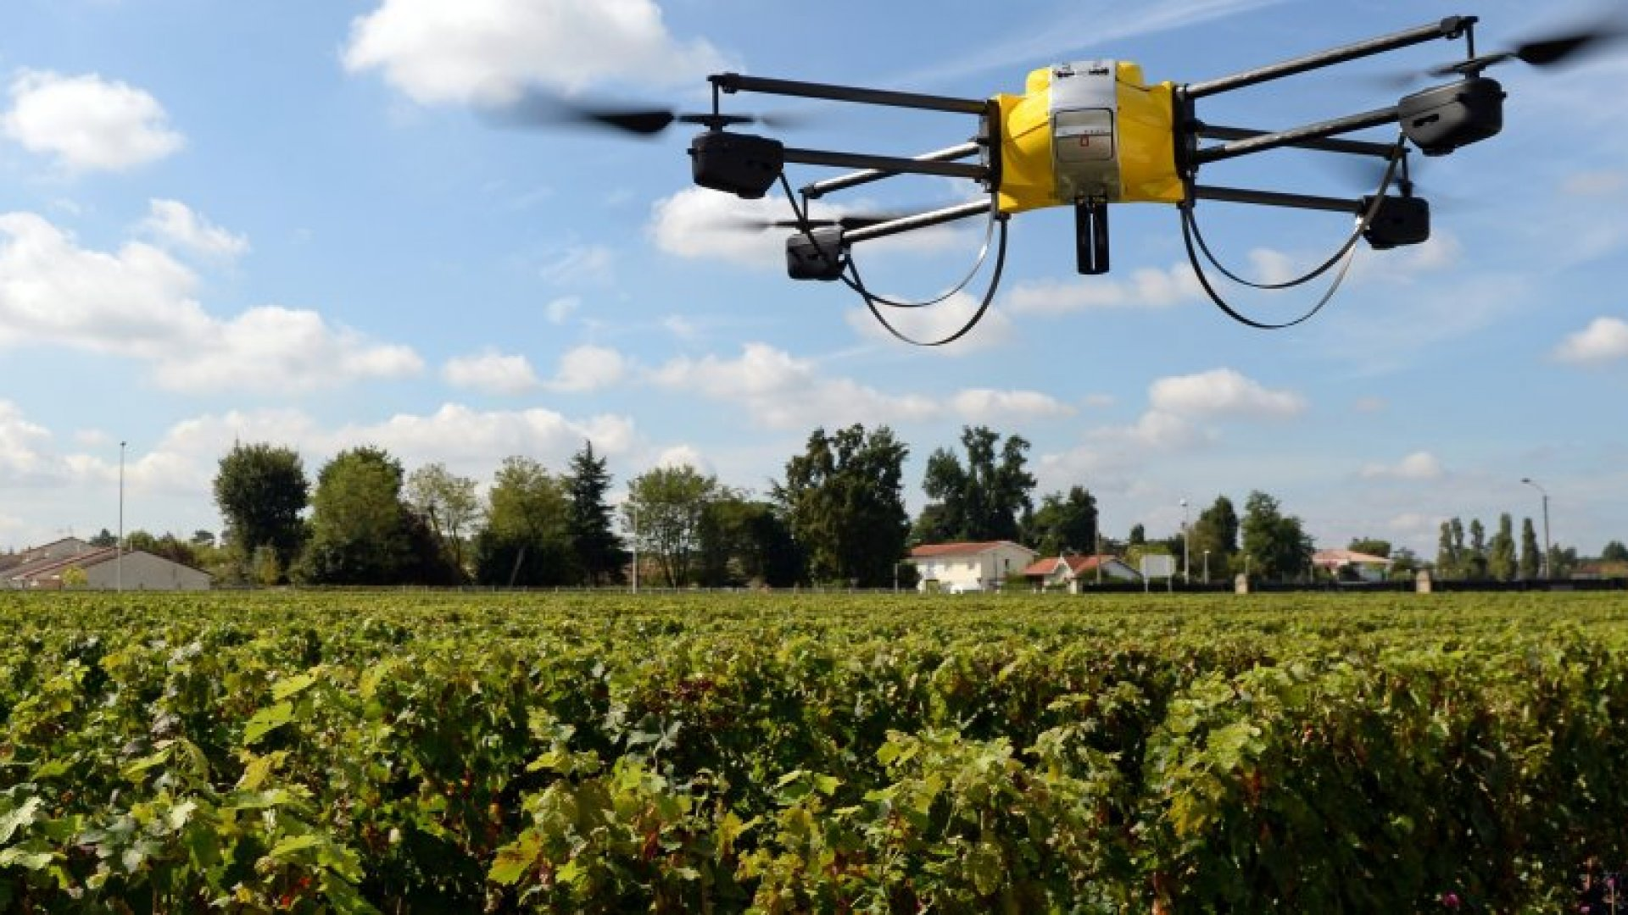


Course 3: Mechatronics in Agriculture
M2: Agricultural Robots
www.smartskillsproject.eu

Slide 2

contents
In this module, Learners will understand the role of robotics in agriculture, recognising how it improves efficiency and sustainability. They will identify key agricultural robots, and the benefits and challenges of robotic integration.
The module will help learners adopt a forward-thinking mindset for sustainable farming while also considering the ethical and social aspects of robotics
01
Introduction to Agricultural Robotics
02
Opportunities and Challenges in Robotic Integration
03
Let’s Practice!
This license enables reusers to distribute, remix, adapt, and build upon the material in any medium or format, so long as attribution is given to the creator. The license allows for commercial use. CC BY includes the following elements:
BY: credit must be given to the creator.
This project has been funded with support from the European Commission. The author is solely responsible for this publication (communication) and the Commission accepts no responsibility for any use may be made of the information contained therein. In compliance of the new GDPR framework, please note that the Partnership will only process your personal data in the sole interest and purpose of the project and without any prejudice to your rights.

Slide 3
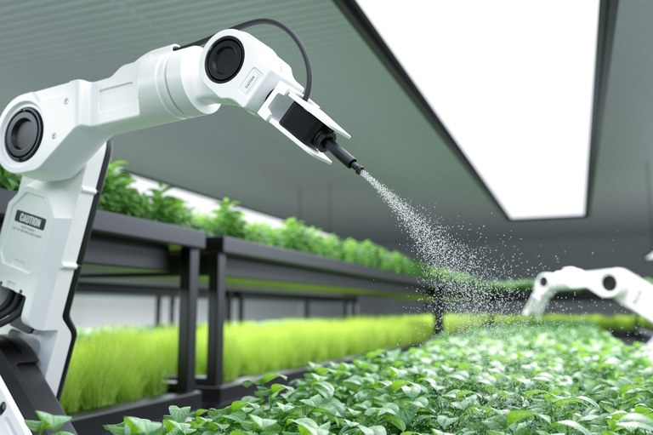
01
INTRODUCTION TO AGRICULTURAL ROBOTICS

Slide 4
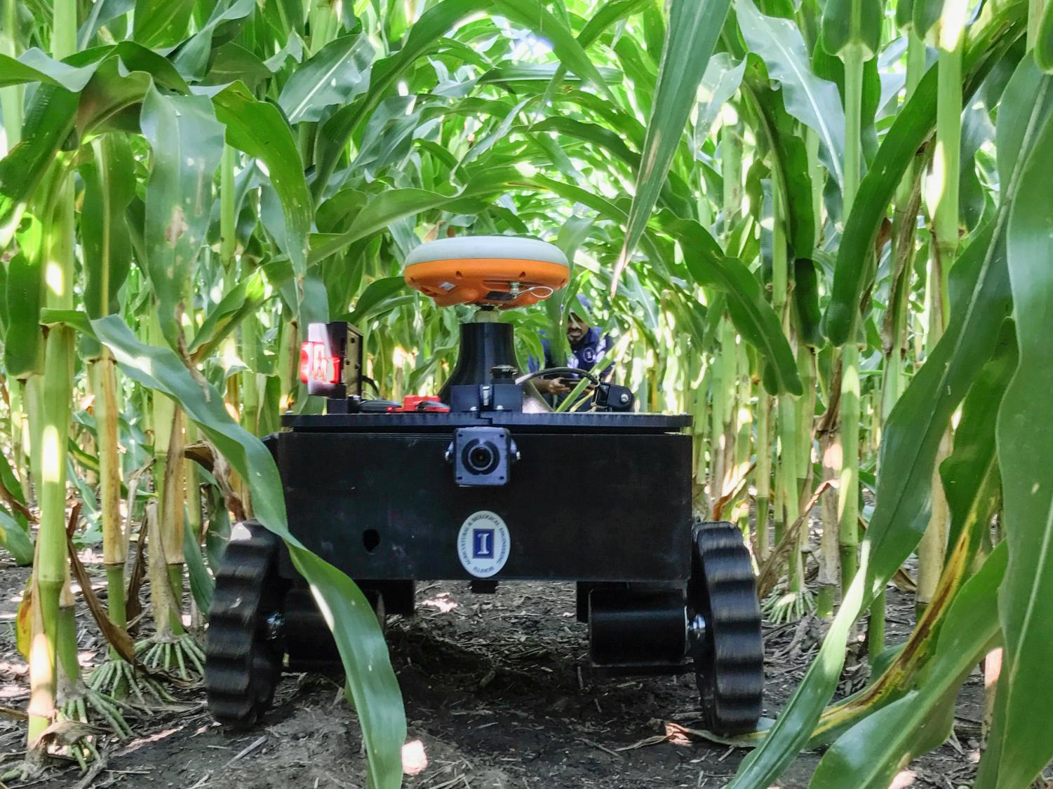
Introduction to Agricultural Robotics
Agricultural robotics is revolutionising modern farming, enhancing efficiency, precision, and sustainability. These advanced systems automate labour-intensive tasks, reducing costs, increasing productivity, and addressing labour shortages.
This module explores how robotics is transforming farming, provides an overview of key robotic solutions, and discusses the opportunities and challenges in their adoption.
Click for more info

Slide 5
How Robots are Transforming Farming Practices
The introduction of AI-driven robots is reshaping agriculture by automating repetitive tasks such as planting, weeding, harvesting, and sorting. These robotic systems use computer vision, machine learning, and sensor technology to operate with high accuracy and efficiency.
Key transformations in agriculture with robotics include reduced labour dependency, as robots replace or assist human workers, addressing labour shortages. Increased precision and productivity allow AI-powered machines to perform tasks faster and more accurately than manual labour. Lower environmental impact is achieved through targeted application of water, fertilizers, and herbicides, minimizing waste and chemical runoff. Additionally, enhanced scalability enables farms to increase production without proportionally increasing labor or resource use.
Example: Autonomous fruit-picking robots use AI and cameras to identify ripe fruits, reducing waste and optimising yield.

Slide 6
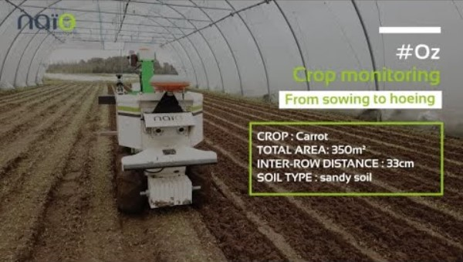
Robotic Weeders
Robotic Weeders detect and remove weeds without herbicides, using mechanical arms or laser technology. This reduces chemical dependency, promoting eco-friendly farming.
Example: Naïo Technologies’ Oz Robot autonomously navigates fields, uprooting weeds while protecting crops.
Click on the Video to see an example
#Oz - 2021 - From sowing to hoeing - YouTube

Slide 7
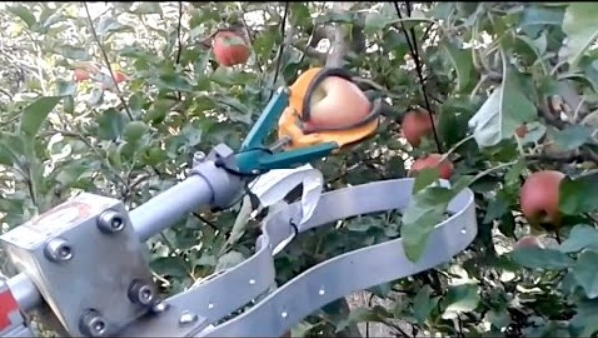
Robotic Pickers
Robotic Pickers use computer vision and robotic arms to pick fruits and vegetables with minimal damage. These robots can operate day and night, maximizing harvest efficiency.
Example: FFRobotics’ Apple Picking Robot mimics human hand movements to carefully detach apples from trees.
Click on the Video to see an example
Automatic fruit picker demonstration by FF Robotics : IFTA 2017 - YouTube

Slide 8
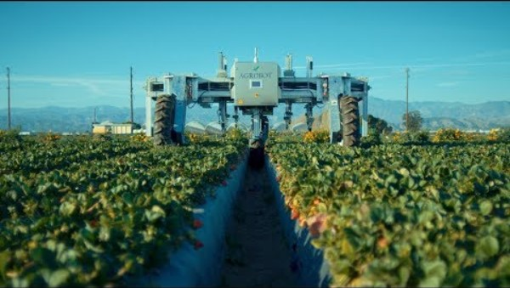
Robotic Harvesters
Robotic Harvesters automate grain, vegetable, and fruit harvesting, optimising speed and quality. They reduce post-harvest losses by preventing bruising and spoilage.
Example: Agrobot’s Strawberry Harvester scans and picks ripe strawberries without damaging the plants.
Click on the Video to see an example
AGROBOT Robotic Strawberry Harvester - YouTube

Slide 9
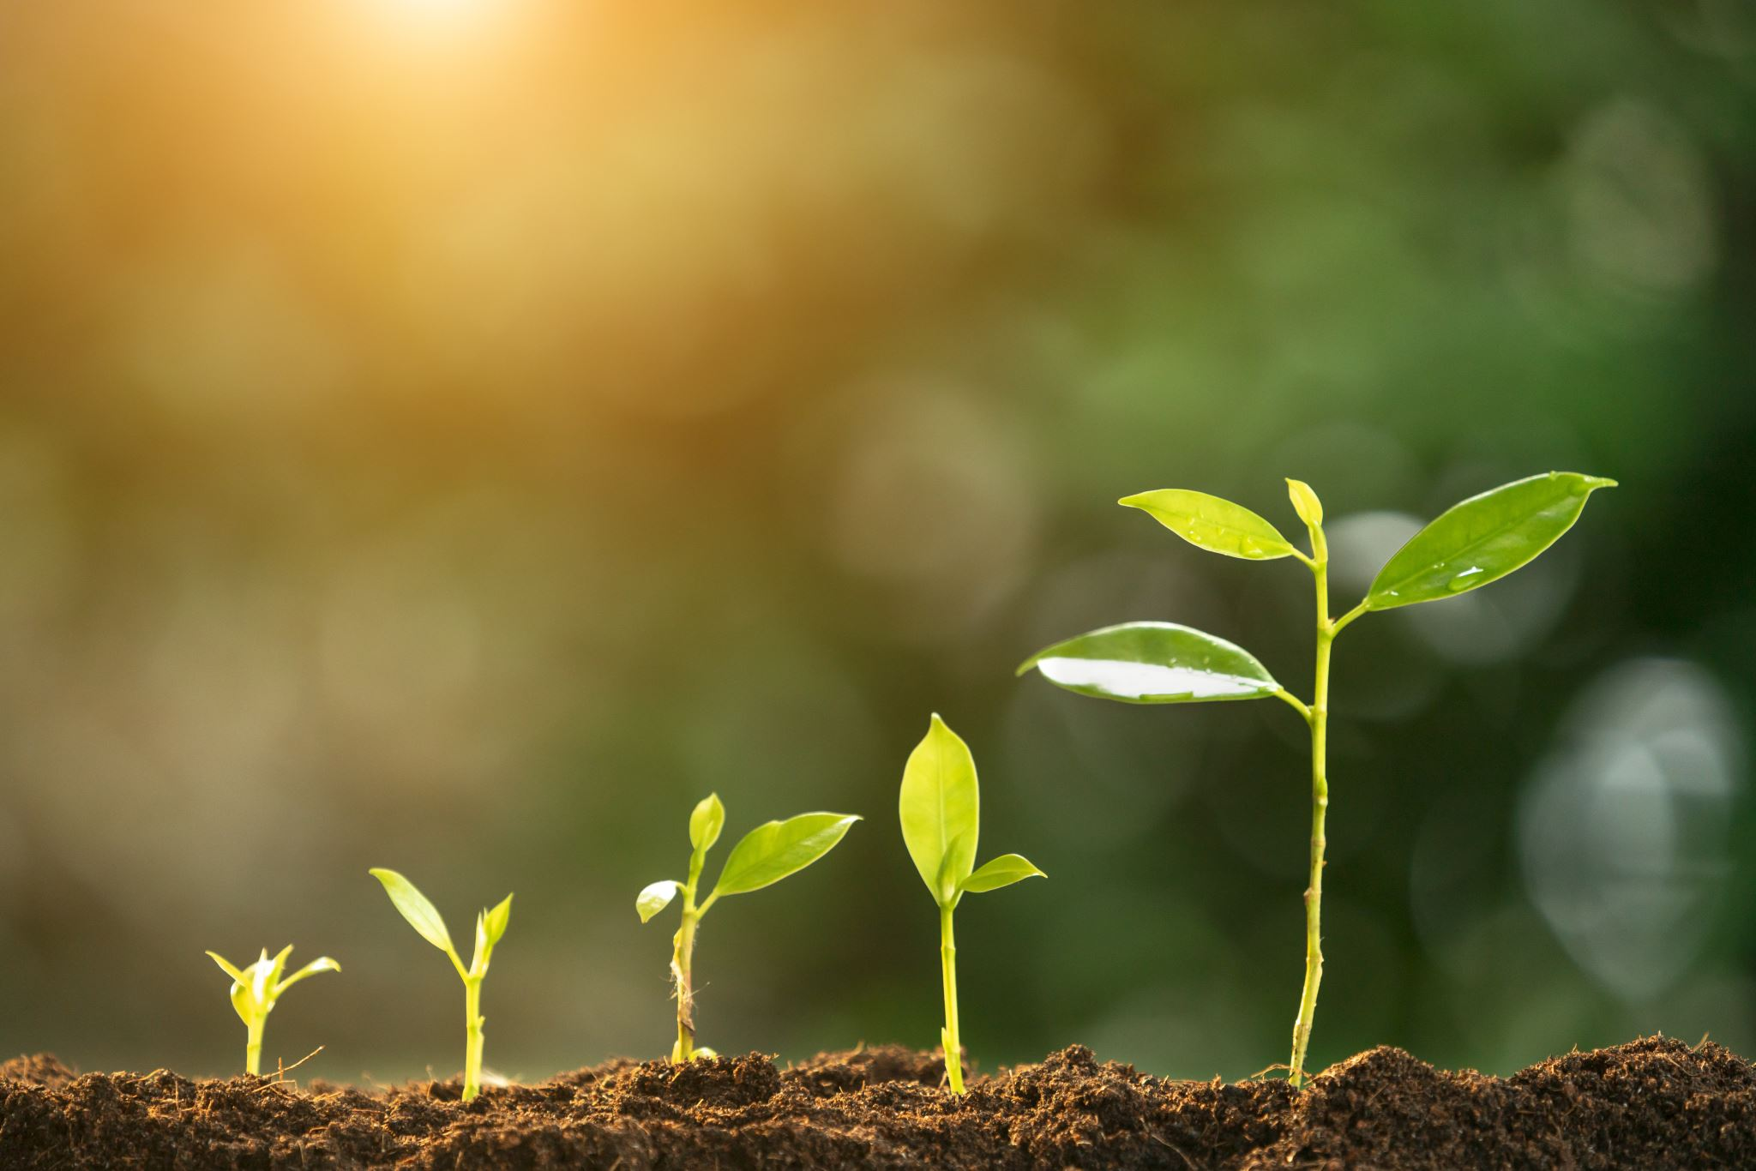
02
OPPORTUNITIES & CHALLENGES IN ROBOTIC INTEGRATION

Slide 10
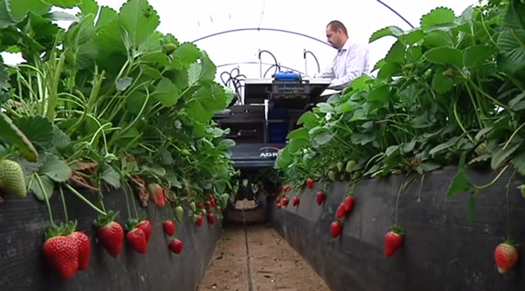
Opportunities in Robotic Integration
The integration of robotics in agriculture presents significant opportunities, including:
increased efficiency, as robots work continuously, unaffected by fatigue or weather conditions
they also provide cost savings over time, as robotic systems, despite high initial costs, reduce long-term labour and operational expenses
additionally, data-driven farming benefits from AI-equipped robots that deliver real-time insights for better decision-making.
https://www.roboticstomorrow.com/story/2015/04/agrobot-strawberry-harvesters/5950/

Slide 11

Challenges in Robotic Integration
However, several challenges remain:
High initial investment is a major barrier for small and medium-sized farms, as robotic solutions require substantial upfront costs.
Technical complexity and maintenance also pose challenges, as farmers need specialised training to operate and repair robotic systems effectively.
Limited adaptability is another issue, as farming environments are unpredictable, making it difficult for robots to operate efficiently in uneven terrain, extreme weather, or highly variable crops.

Slide 12
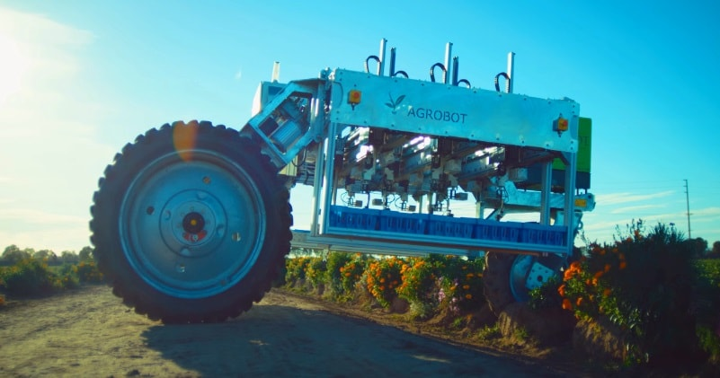
Challenges in Robotic Integration
Beyond technical challenges, regulatory and ethical considerations must also be addressed:
As robots replace human labour in some farming tasks, policies should ensure that workers are reskilled and transitioned into new roles rather than being displaced.
Regulations on AI use in farming and ethical concerns regarding automation and data privacy will need careful management.
https://siamagazin.com/meet-the-agrobot-a-robotic-strawberry-harvester/

Slide 13
Agriculture is the most healthful, most useful, and most noble employment of man, and today, robotics is making it more efficient, sustainable, and innovative than ever before.
Thomas Jefferson

Slide 14

04
LET’S PRACTICE

Slide 15
Learner Exercise:
Practical Activity: “Spot the Robot in Agriculture”
Research one real-world example of an agricultural robot used for planting, weeding, harvesting, or monitoring.
Task: Write a short description (100-150 words) explaining how it works, its key benefits, and any challenges associated with its use.
Optional: Find an image or video of the robot in action and share key takeaways.

Slide 16
Group Exercise:
Discussion Prompt:
What farming tasks do you think should be automated next? How could robotics solve key challenges in modern agriculture?
Purpose: This engages learners, encourages critical thinking, and allows them to connect theory with real-world applications.

Slide 17
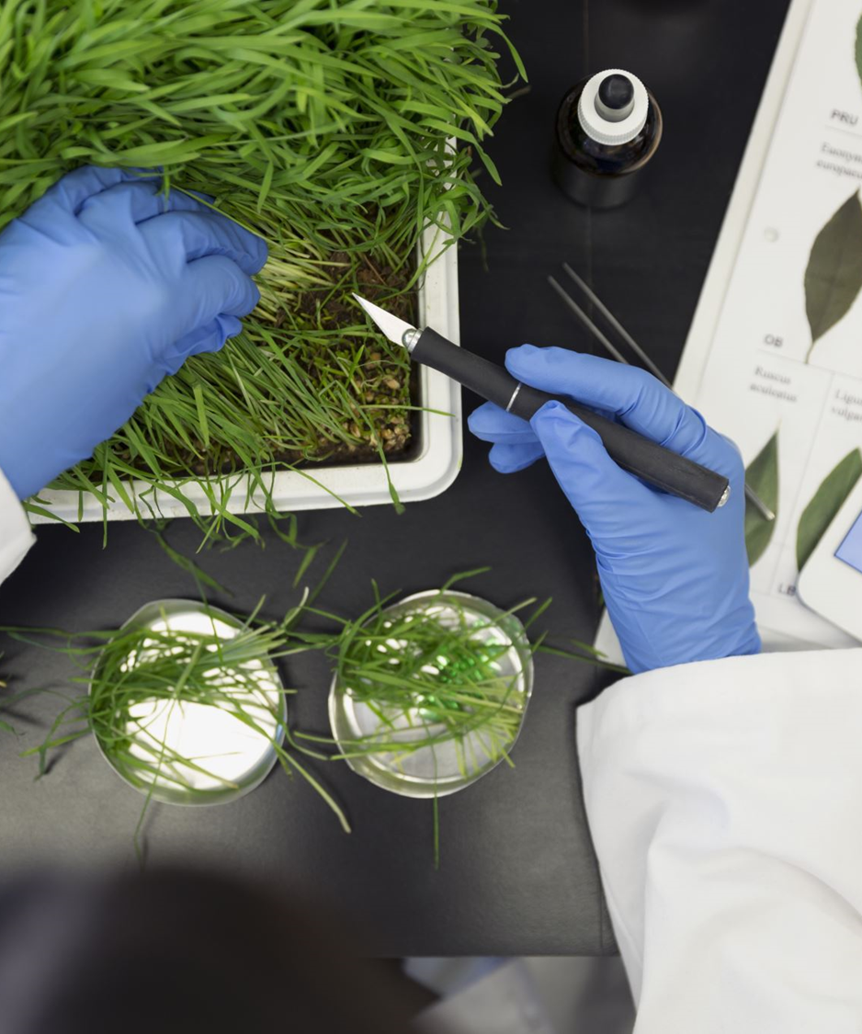

www.smartskillsproject.eu
Follow our journey

