Slide 1
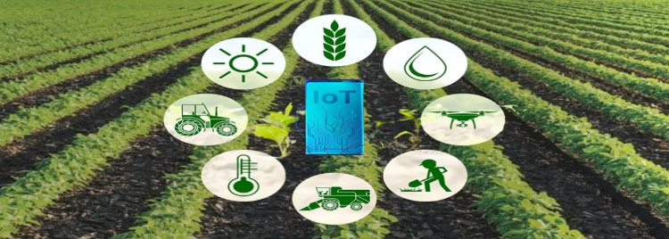


Course 2: Smart Irrigation and Fertilisation
M2: Implementing IoT for Smart Irrigation
www.smartskillsproject.eu

Slide 2
What will you learn?
Understand…
…the principles of proper installation of soil moisture sensors, the principles of their installation and integration with IoT systems.
This module aims to familiarize you with the practical application of IoT technology in smart irrigation. You will learn what conditions to meet to properly install soil moisture sensors that help to precisely determine the water needs of plants. You will also learn how to monitor water consumption in real time. Finally, you will learn what are the most common problems you may encounter with the operation of IoT systems in agriculture. This module is an ideal guide for anyone who wants to combine agriculture with modern technologies.
Identify…
… problems related to IoT irrigation systems.
Explain…
…what real-time monitoring and regulation of water consumption is.

Slide 3

contents
This module guides learners through the practical steps of setting up soil moisture sensors and integrating them with IoT systems for smart irrigation. It explains how to monitor and adjust water usage in real time, and troubleshoot common issues—empowering farmers to save water, boost yields, and manage irrigation more precisely.
01
Setting up and managing soil moisture sensors
02
Real-time water usage monitoring
03
Troubleshooting IoT irrigation systems
04
Let’s Practice!
This license enables reusers to distribute, remix, adapt, and build upon the material in any medium or format, so long as attribution is given to the creator. The license allows for commercial use. CC BY includes the following elements:
BY: credit must be given to the creator.
This project has been funded with support from the European Commission. The author is solely responsible for this publication (communication) and the Commission accepts no responsibility for any use may be made of the information contained therein. In compliance of the new GDPR framework, please note that the Partnership will only process your personal data in the sole interest and purpose of the project and without any prejudice to your rights.

Slide 4
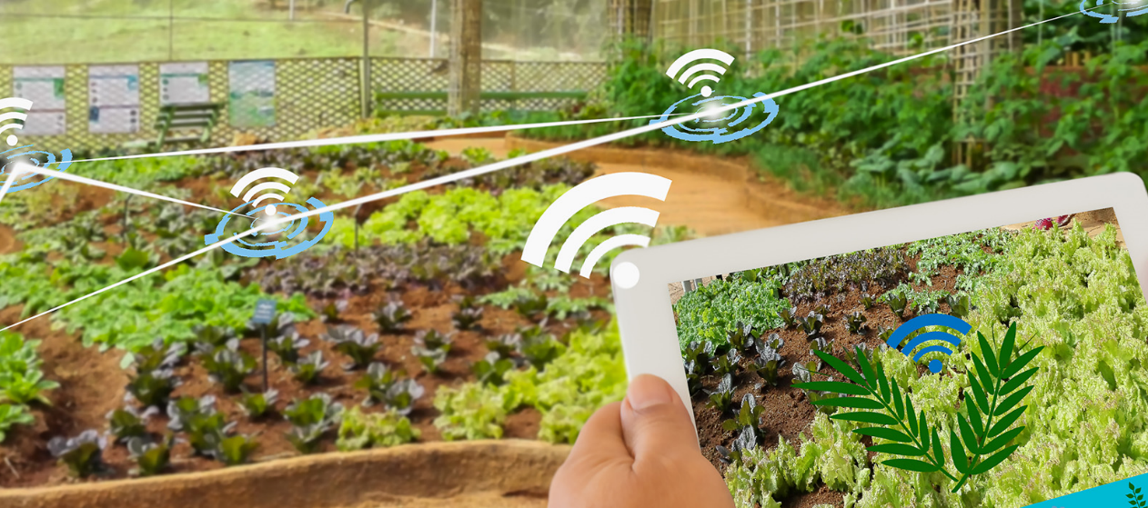
01
SETTING UP & MANAGING SOIL MOISTURE SENSORS

Slide 5

What is a soil moisture sensor?
A soil moisture sensor is a device used to measure the moisture or water content of the soil. It provides information about the amount of water contained in the soil that is necessary for effective irrigation and plant health management. A soil moisture sensor works by measuring the electrical conductivity or resistance of the soil, which is directly related to the moisture content.

Slide 6
Types of soil sensors
Tensiometers – a non-electronic device that measures water tension in the soil
Capacitive sensors – measure humidity levels based on dielectric changes
Resistance sensors – detect changes in the electrical conductivity of the soil
How to adjust the soil moisture sensor to your needs?
Check the soil type
Determine the measurement range
Check IoT compatibility
Pay attention to the resistance of elements to weather conditions

Slide 7
Principles of correct installation of soil sensors
Choosing the right installation location
Avoiding extreme conditions, e.g. shady places, places where water can accumulate naturally
Representativeness of the area – places that best reflect the soil conditions of cultivation
Installation depth and method
Adjusting the depth to the type of crop
Precise placement of the sensor in the soil - vertically or at a slight angle, force the sensor – it is best to dig a hole of sufficient depth and place the sensor
Proper soil contact
No air voids between the sensor and the soil
Preservation of the natural structure of the soil, so as not to alter its natural ability to retain water.
Sensor Protection and Maintenance
Protection against damage
Cable protection
Regular calibration and maintenance

Slide 8
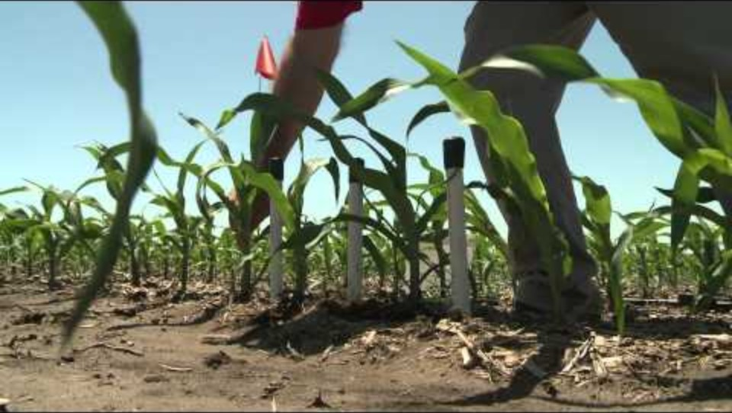
Learning from Others…
Watch the video that shows how to properly install sensors so that they work properly.
Use the knowledge of professionals!
Installing Soil Moisture Sensors in the Field

Slide 9
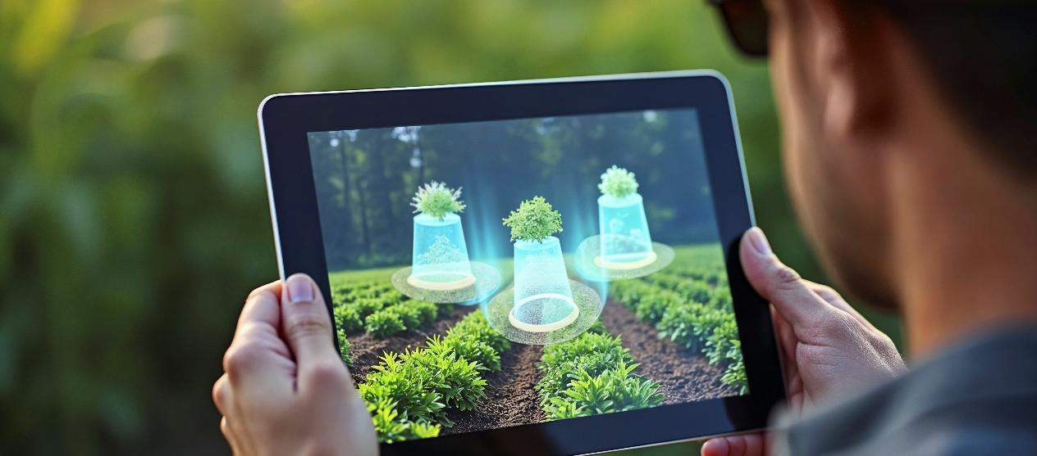
02
REAL-TIME WATER USAGE MONITORING & ADJUSTMENTS

Slide 10
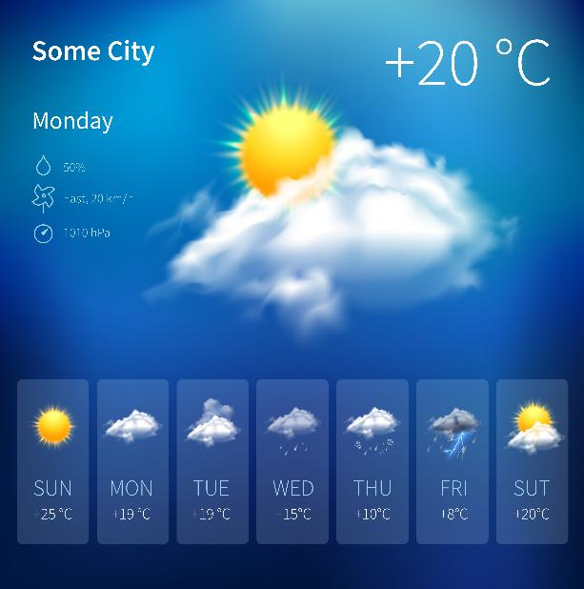
Monitor and adjust water usage in real time
Hydro-optimization (the process of maximally efficient use of water resources) is the foundation of intelligent irrigation systems. With the use of professional controllers, we can control the amount of water supplied to plants with unprecedented precision. These systems can analyze weather forecasts and automatically adjust the watering schedule (saving water in the event of forecast rainfall).
Data collection
Real-time analysis
Automatic irrigation adjustment

Slide 11


Principles for monitoring and adjusting water consumption
Water Usage Monitoring
Precise soil moisture sensors
Weather stations
Title Three
Intelligent irrigation systems
Integration with weather
The use of AI and IoT

Slide 12

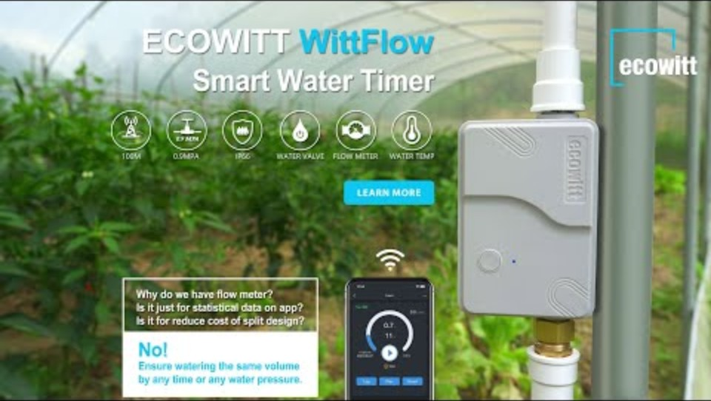
Benefits of smart irrigation systems
By using these technologies, you can save up to 30-50% of water compared to traditional irrigation methods, while improving yields and plant health.
WittFlow: smart water timer with intelligent irrigation system

Slide 13
03
Troubleshooting IoT irrigation systems

Slide 14
Possible problems
Although IoT irrigation systems are precise methods, problems with their proper use may arise. The main problems/issues include:
Connectivity issues where commands are not responded to or are delayed
Usually due to a weak Wi-Fi signal, which needs to be strengthened or NB-IoT technology should be used
Failure of sensors or valves resulting in erroneous humidity readings, leaks, or lack of water in the system
Regular maintenance, cleaning, and replacement of worn components will prevent the system from malfunctioning
Software issues with malfunctions and bugs in the app
This can be prevented by performing regular software updates
Improper settings, or a lack of integration with the weather forecast
A good solution is integration with the real-time weather forecast and the implementation of AI algorithms for the analysis of weather data and soil moisture

Slide 15
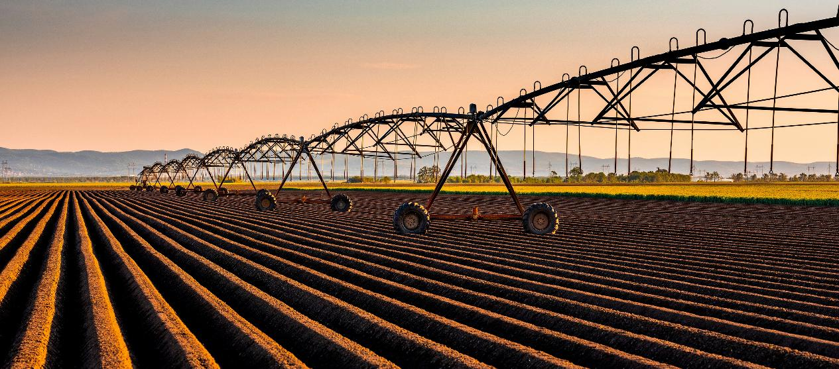
04
LET’S PRACTICE

Slide 16

Learner Exercise: Scenario
2
7
You design an automatic irrigation system. You need to deploy the humidity sensors. You have 5 sensors at your disposal. Select the best located sensors (ie. Those in the most suitable places.)
1
3
4
5
6

Slide 17
Feedback on answers
3 Great choice
1 Incorrect
Too shady place
6 Incorrect
A place where water accumulates naturally
4 Great choice
2 Great choice
5 Great choice
5 Great choice

Slide 18

GREAT JOB!
You now know the importance of properly installed soil moisture sensors and how IoT supports monitoring and proper irrigation. It's time to learn about precision fertilization and the use of chemicals in agriculture.

Slide 19
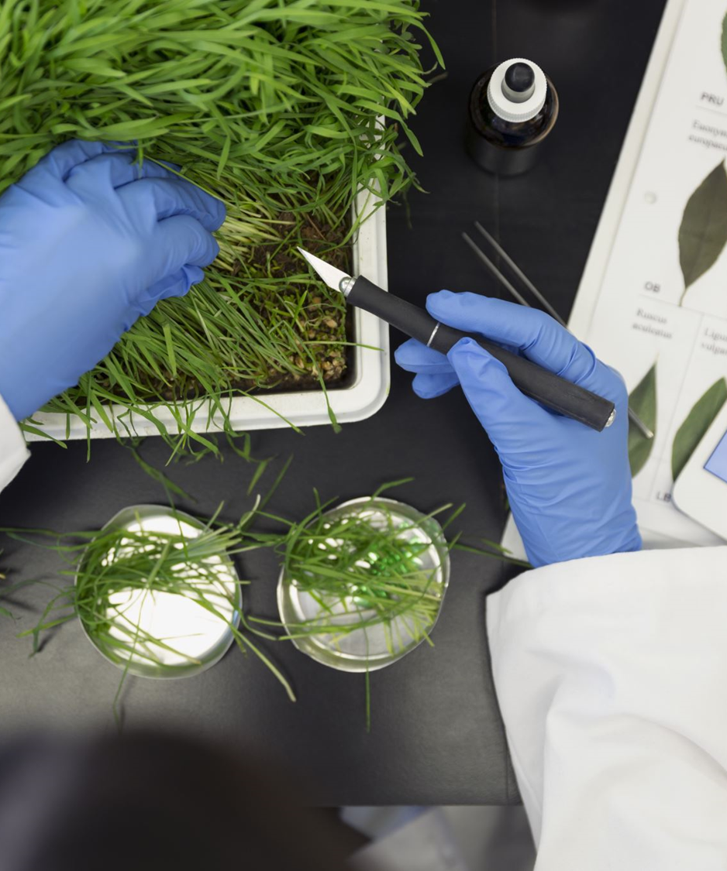

www.smartskills.eu
Follow our journey

