Slide 1



Course 2: Smart Irrigation and Fertilisation
M3: Sustainable Fertilization Practices
www.smartskillsproject.eu

Slide 2
What will you learn?
Understand…
…the concept of precision fertilization.
This module aims to introduce you to the issues related to sustainable fertilization practices in agriculture. You will learn about the nutrient mapping technique, which allows you to tailor fertilization to specific areas of the field, thus avoiding wastage of resources and protecting the environment. You will also learn how to reduce the use of chemicals through targeted fertilizer applications. This module will show you how a modern approach to fertilization can be both effective and environmentally friendly.
Identify…
… influence of external factors on the fertilization process.
Explain…
…what are the benefits of using precise fertilization.

Slide 3

contents
This module introduces precision fertilization techniques that match nutrient delivery to specific field conditions. Learners explore nutrient mapping, the use of drones & sensors, and targeted chemical applications—empowering them to boost yields, reduce input costs, and protect soil health while promoting more sustainable farming.
01
Understanding fertilizer needs
02
Precision nutrient mapping for balanced fertilization
03
Reducing chemical use through targeted applications
04
Let’s Practice!
This license enables reusers to distribute, remix, adapt, and build upon the material in any medium or format, so long as attribution is given to the creator. The license allows for commercial use. CC BY includes the following elements:
BY: credit must be given to the creator.
This project has been funded with support from the European Commission. The author is solely responsible for this publication (communication) and the Commission accepts no responsibility for any use may be made of the information contained therein. In compliance of the new GDPR framework, please note that the Partnership will only process your personal data in the sole interest and purpose of the project and without any prejudice to your rights.

Slide 4
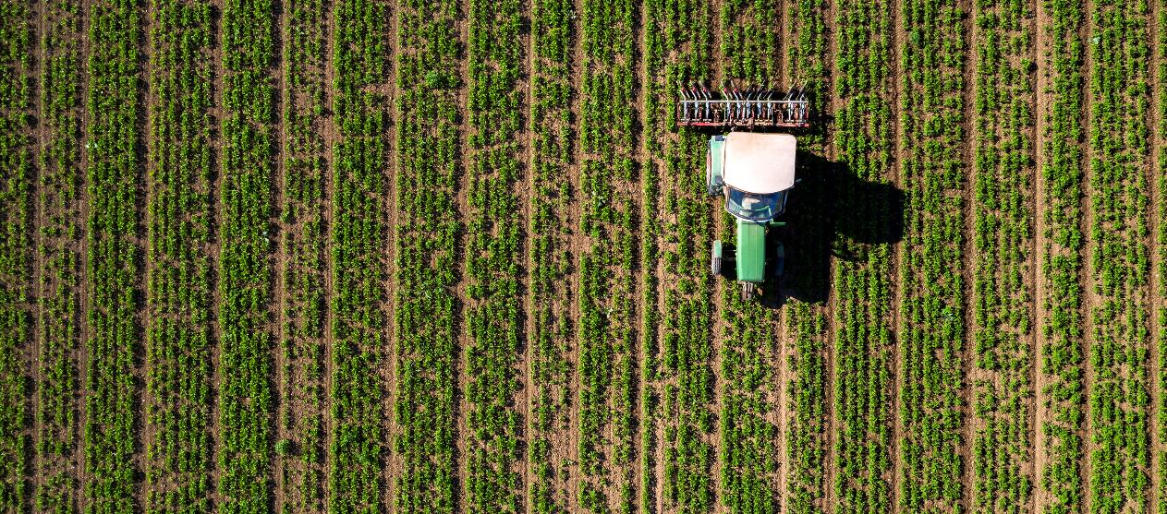
01
UNDERSTANDING FERTILIZER NEEDS

Slide 5

Nutrient requirements
Each plant needs specific nutrients for proper growth and yield. Imbalance leads to weakened plants, reduced yields and susceptibility to diseases. The key to effective fertilization is understanding the needs of plants, choosing the right fertilizers and optimizing their application.

Slide 6
Macro and micronutrients
Macronutrients are elements that plants need in large quantities - nitrogen (N), phosphorus (P), potassium (K), calcium (Ca), magnesium (Mg) and sulfur (S). They play a key role in basic life processes: growth, photosynthesis, tissue building and regulation of water management. Without them, plants quickly lose their vitality, do not develop properly and are unable to produce healthy crops.
Micronutrients are essential elements in trace amounts: iron (Fe), boron (B), copper (Cu), zinc (Zn), manganese (Mn) and molybdenum (Mo). They affect enzymatic processes, crop quality, disease resistance and proper plant development. Their lack can cause serious metabolic disorders, but excess can also be harmful.

Slide 7
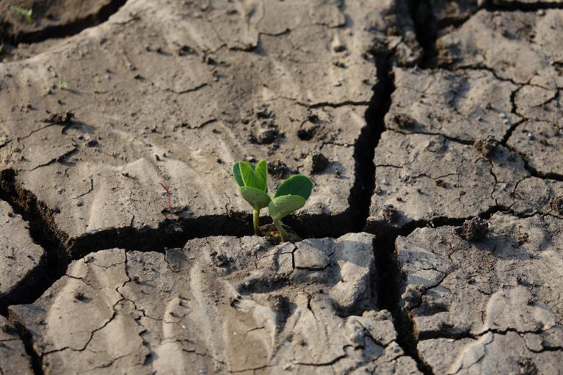
Factors affecting nutrient uptake
Soil pH
Key for the absorption of ingredients
Structure & content of organic matter
Humus improves the soil's ability to retain nutrients
Soil moisture
Water deficiency makes it difficult to transport ingredients, and excess washes them out
Interactions
An excess of one element can block the uptake of another

Slide 8
How to determine the nutrient needs of plants?
Plant tissue analysis
Observation of deficiency symptoms
Soil analysis
Soil testing allows to determine the level of nutrients and determine fertilizer doses
Testing the leaves or other parts of the plant allows you to check whether the nutrients are properly absorbed
Regular inspection of the appearance of plants can help to detect problems quickly, although it requires experience

Slide 9
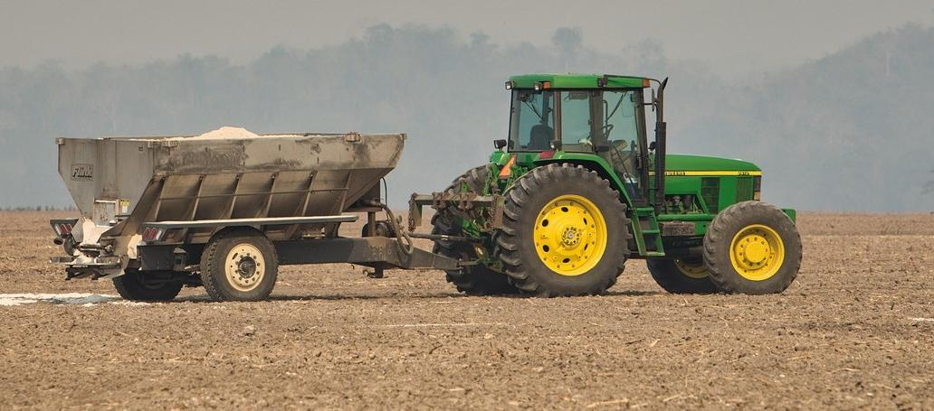
02
USE OF PRECISION NUTRIENT MAPPING FOR BALANCED FERTILIZATION

Slide 10

Precise nutrient mapping
It allows to determine the spatial distribution of nutrients in a given field. By using GPS technology, sensors, drones and laboratory analysis, detailed maps of the macro- and micronutrients in the soil can be created. With this data, farmers can tailor fertilization to the real needs of plants, avoiding excessive fertilizer use where the soil is already rich in nutrients, while providing more nutrients in areas of scarcity.

Slide 11
Nutrient mapping process
Soil sampling
Creating digital soil maps
Adjusting fertilization
01
03
Laboratory Analysis
02
04

Slide 12
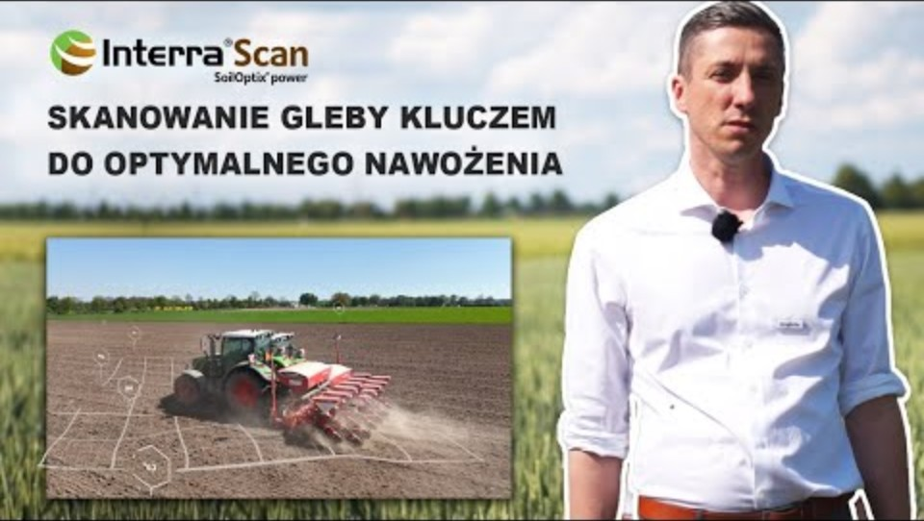
Detailed mapping process
Samples are taken from various locations in the field to determine the nutrient content and pH of the soil. Samples are tested for macro and micronutrient levels. The results of the analyses are processed in GIS systems, creating soil fertility maps that show where there are deficiencies or surpluses. On the basis of the maps, variable fertilizer application is used, i.e. precise application of fertilizers in quantities corresponding to the local needs of the soil.
See what the mapping process looks like

Slide 13
Why use precision mapping? BENEFITS
Fertilizer savings – Avoiding over-fertilization reduces costs.
Increased fertilization efficiency – Nutrients are applied where plants need them.
Improved soil quality – Preventing soil degradation and acidification.
Higher yields – Plants develop evenly and efficiently.
Environmental protection – Less leaching of nitrogen and phosphorus into groundwater.

Slide 14

03
REDUCING CHEMICAL USE THROUGH TARGETED APPLICATIONS

Slide 15

Precise use of chemicals
Reducing the use of chemicals through targeted application is a strategy that involves the precise and selective application of pesticides, herbicides and fertilizers only where they are actually needed. This minimizes the use of chemicals, reduces costs and reduces environmental impact.

Slide 16


Steps for the precise use of chemicals
Field monitoring and analysis
Application map creation
Precise dosing
Application of intelligent spraying systems
See how AI and drones help in precise application Watch this video

Slide 17
What are the advantages of limited use of chemicals?
Reducing the use of pesticides and herbicides – chemicals are used only where they are really needed.
Lower costs – reduction of expenditure on plant protection products and fertilizers.
Care for the environment – fewer harmful substances enter the soil, groundwater and ecosystems.
Less resistant pests and weeds – lower risk of developing resistance to pesticides.
Improved crop quality – less chemical residues in agricultural products.

Slide 18

Practical use of sensors during the dosing of plant protection products and fertilizers
Farms are increasingly reaching for modern technologies and precise tools used during treatments. Check how one farmer evaluates the possibilities of using sensors to reduce fertilizers and chemicals.
4 DAWKA AZOTU W PSZENICY! ISARIA CROP SENSOR

Slide 19

Precision is the new face of modern agriculture

Slide 20
04
Let’s practice

Slide 21
Learner Exercise:
Scenario
Answer A
You apply the same amount of nitrogen to the entire field. You do not perform fungicide treatment.
You have gone to check what your wheat field looks like. Using a drone, you diagnose that in many places the wheat is light green in colour, which is caused by insufficient nitrogen. In addition, your neighbour informs you that a fungal disease has appeared in his field next to the wheat field– yellow rust…WHAT SHOULD YOU DO?
Answer B
Discoloration occurs on 1/3 of the cultivation area, the rest is in good condition so you do not react, but you perform a preventive treatment against fungal disease
Answer C
You use a variable dose of nitrogen fertilization to ensure the right level of macronutrient. You do not perform a fungicide treatment.

Slide 22
Feedback on answers
Option A
Option A
Great choice. Variable fertilization rate will provide tailored access to nutrients. Not spraying before symptoms appear is a good step. Illness in the neighbour's field is not a determinant of the procedure
The use of the same dose of fertilization will cause well-nourished plants to have an excess of nitrogen.
Not spraying is a good solution.
Option B
Failure to apply nitrogen in areas of deficiency can result in reduced yield.
Spraying before the symptoms of the disease appear is an unjustified treatment.

Slide 23

GREAT JOB!
Your knowledge is been taken it to the next level! It's time for module 4. You will learn how to combine the irrigation and fertilization processes to get the maximum benefits.

Slide 24


www.smartskills.eu
Follow our journey

