Slide 1
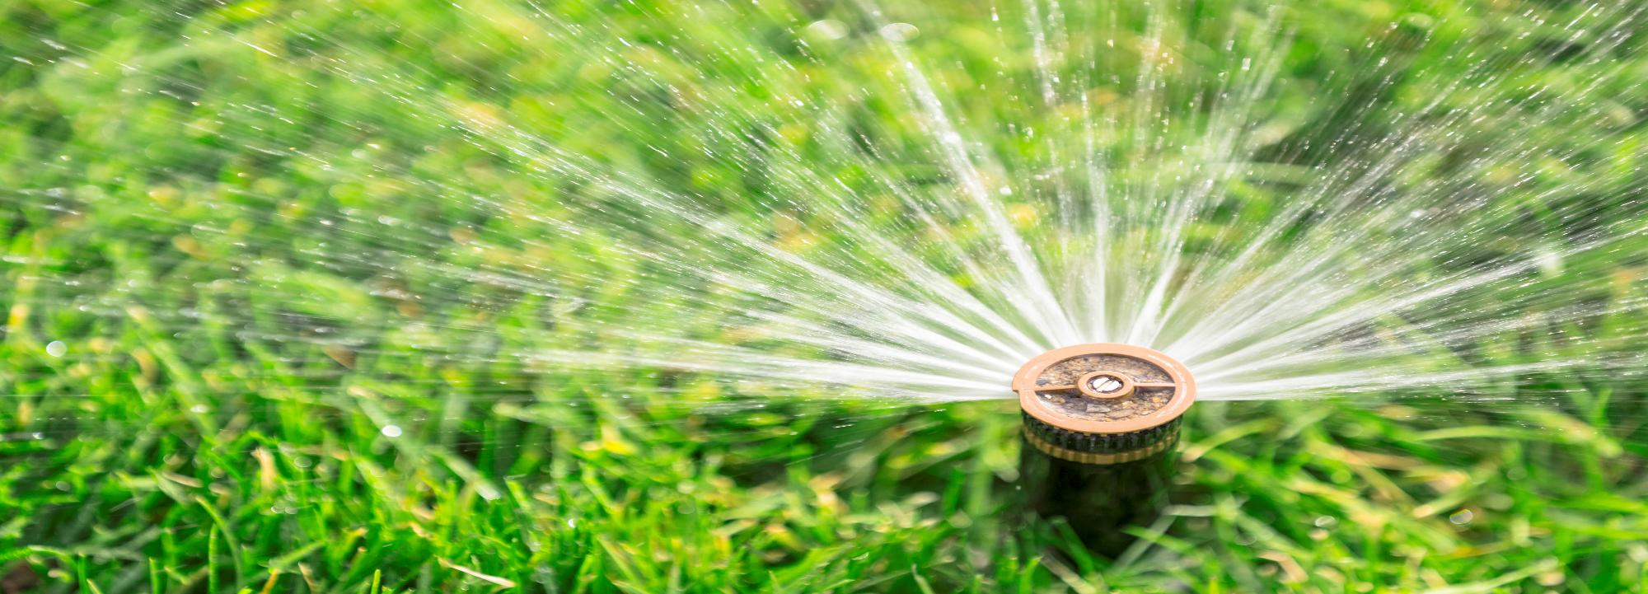


Course 2: Smart Irrigation and Fertilisation
M4: Integrated Irrigation & Fertilization Systems
www.smartskillsproject.eu

Slide 2
What will you learn?
Understand…
…the concept of fertigation.
This module aims to introduce the principles of integrated irrigation and fertilization systems, known as fertigation. You will learn what fertigation systems are and how they enable plants to simultaneously deliver water and nutrients directly to the roots. You will also learn about best practices for implementing fertigation, which help to achieve high yields with fewer resources. This module is a great opportunity to discover how modern technologies support sustainable and smart farming
Identify…
… advantages of using fertigation systems.
Explain…
…principles of fertigation systems.

Slide 3

contents
This module introduces fertigation—the technique of delivering water and nutrients simultaneously through irrigation systems. Learners explore system design, injection methods, and best practices that enhance crop quality while reducing input use, showing how integrated approaches can boost productivity and sustainability in modern farming.
01
Overview of fertigation systems
02
Designing systems for simultaneous water and nutrient delivery
03
Best practices for implementation
04
Let’s Practice!
This license enables reusers to distribute, remix, adapt, and build upon the material in any medium or format, so long as attribution is given to the creator. The license allows for commercial use. CC BY includes the following elements:
BY: credit must be given to the creator.
This project has been funded with support from the European Commission. The author is solely responsible for this publication (communication) and the Commission accepts no responsibility for any use may be made of the information contained therein. In compliance of the new GDPR framework, please note that the Partnership will only process your personal data in the sole interest and purpose of the project and without any prejudice to your rights.

Slide 4
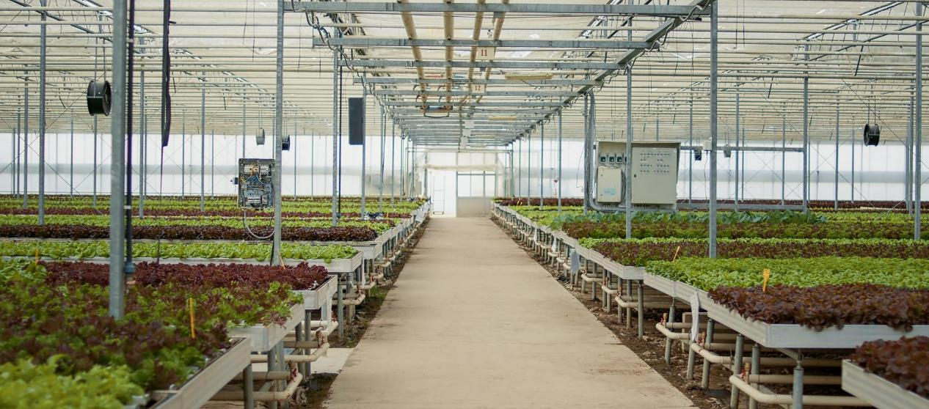
01
OVERVIEW OF FERTIGATION SYSTEMS

Slide 5
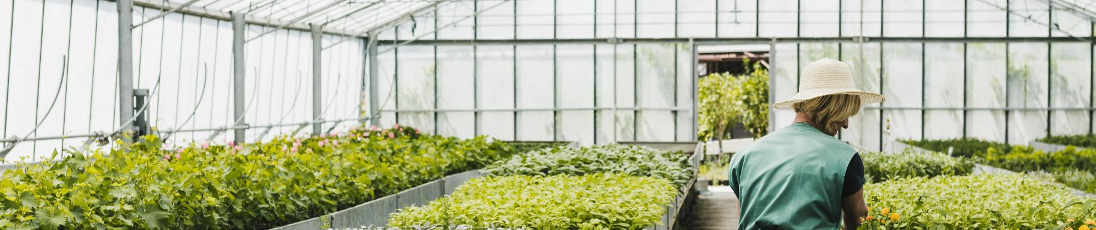
What is fertigation?
Fertigation is the application of fertilization during irrigation using irrigation systems. Fertigation is a common way of fertilizing horticultural crops under cover and crops on inert substrates. It is also used to fertilize field vegetable crops, fruit crops, berry plantations, and ornamental plant nurseries.

Slide 6
Advantages of fertigation
Uniform supply of elements in dissolved form in water
Ease of changing the composition of the nutrient solution depending on the stage of plant development
02
05
Tworzenie cyfrowych map gleby
Possibility of using lower doses of fertilizers
Precise
plant nutrition
Freedom to regulate the amount of application and the frequency of fertilization
Increased rate of nutrient delivery to the root zone
01
04
03
06

Slide 7
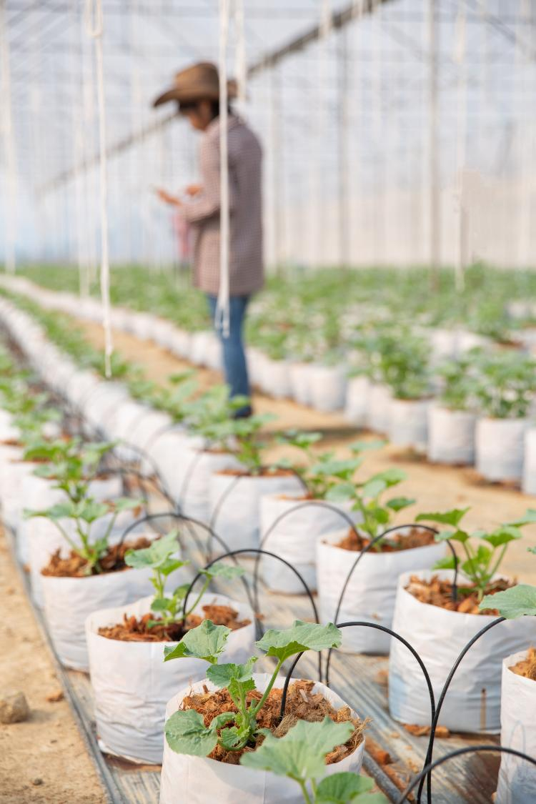
Basic proper fertigation
The installation of a fertigation system should start with water and soil analysis. In the case of water, it is important to check its pH, as well as to test its electrical conductivity and hardness. In the case of soil, the pH index is the most important, because knowledge of this parameter allows you to determine the absorption of nutrients by plants and select the most appropriate minerals for specific plants.

Slide 8
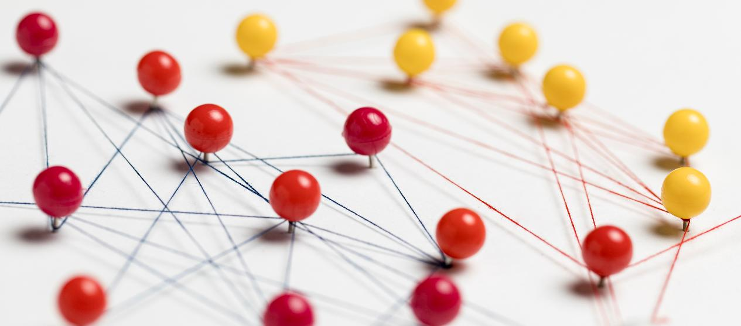
02
DESIGNING SYSTEMS FOR SIMULTANEOUS WATER AND NUTRIENT DELIVERY

Slide 9
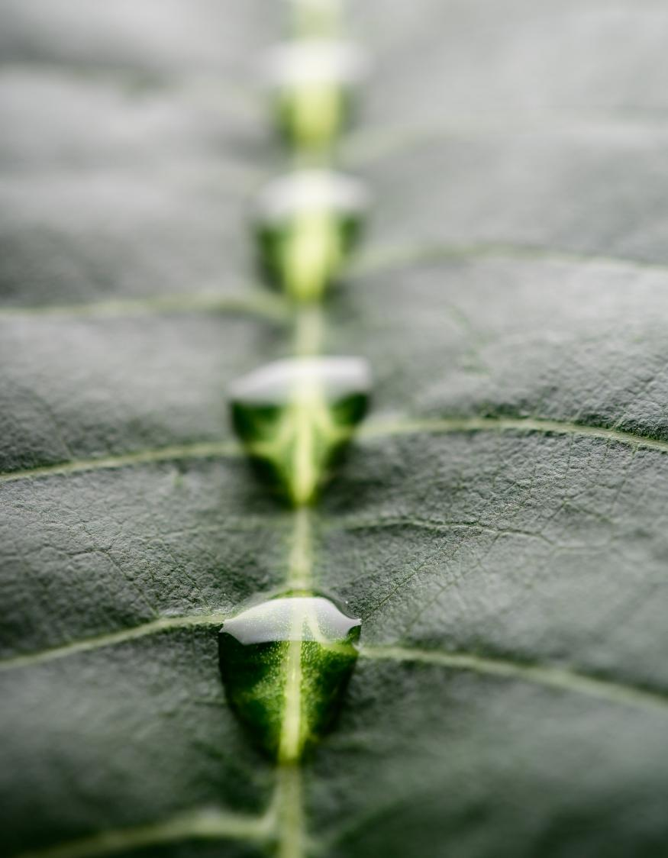
Injection methods and devices
The correct injection equipment is as important as choosing the right nutrient. Incorrect equipment can damage the irrigation system, affect the efficiency of the system's operation, or reduce the effectiveness of nutrients.
Applicable equipment:
injector
dosing pump

Slide 10
Injector
Dosing pumps
The injector works on the basis of a phenomenon known as the Venturi effect. Its functioning is based on creating a pressure difference during the flow of water. The negative pressure created by the water, flowing through the system, sucks the nutrient solution into the irrigation system.
Dosing pumps are used to apply ready-made liquid fertilizer mixtures by injecting a pressurized solution into irrigation systems. With the help of pumps, it is possible to feed nutrients and fertilizing acids directly into the root system at the same time.

Slide 11

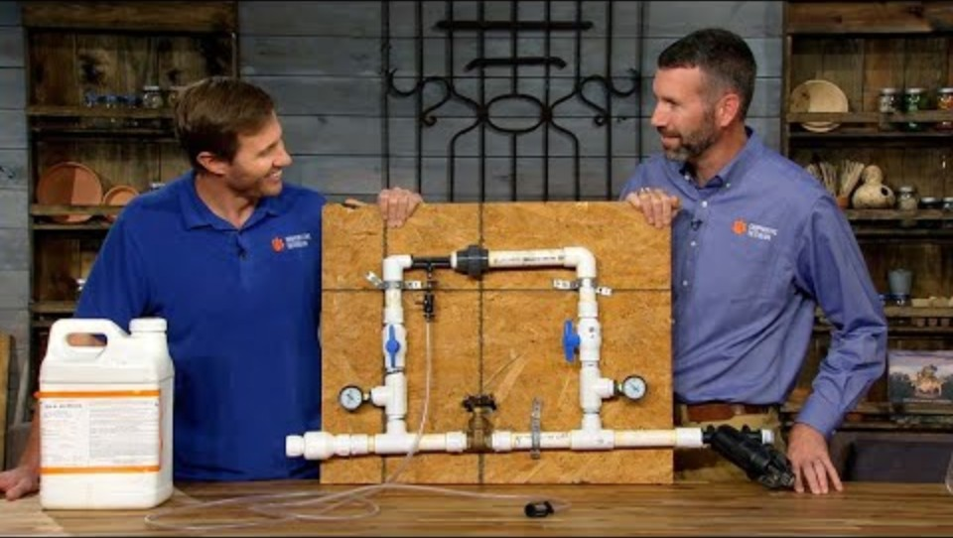
Principles of operation of the injector
Watch this video that explains in simple terms what fertigation is and what is the principle of the injector's operation.
Venturi effect

Slide 12
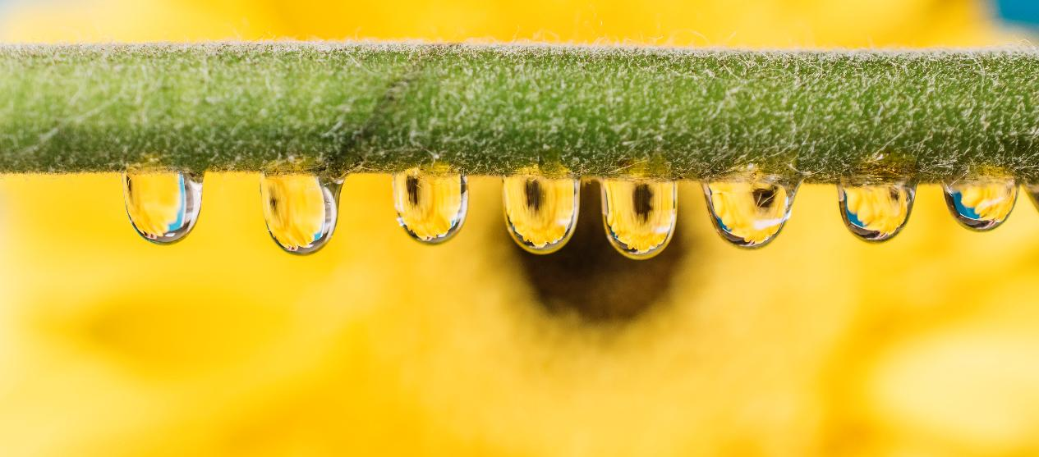
03
BEST PRACTICES FOR IMPLEMENTATION

Slide 13
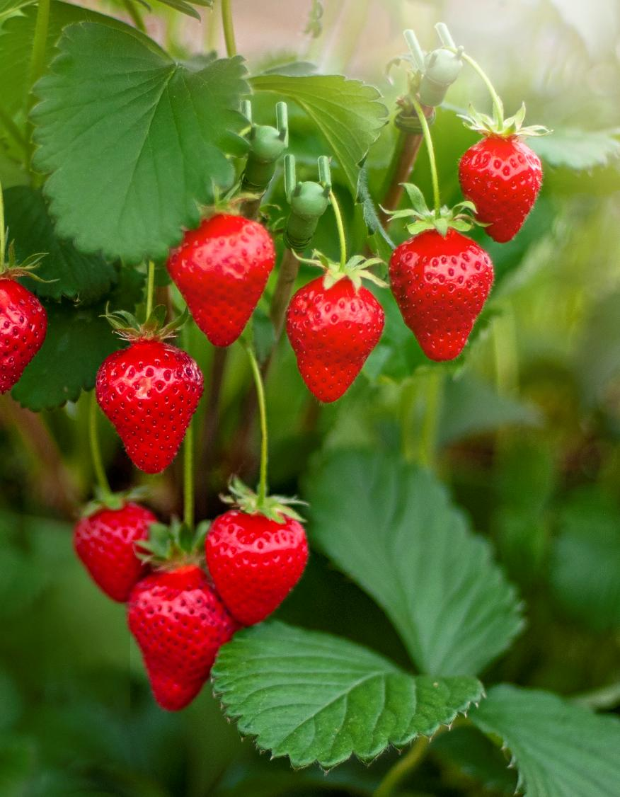
The main application of fertigation in agriculture
Fertigation is most often used in field crops of species that are prone to water shortages or when the producer wants to obtain the highest quality of the crop. These species include mainly strawberries, raspberries, blueberries, but also in vegetables: cucumbers, peppers, tomatoes, broccoli. Fertigation is widely used in crops under cover, where it is a basic element.

Slide 14
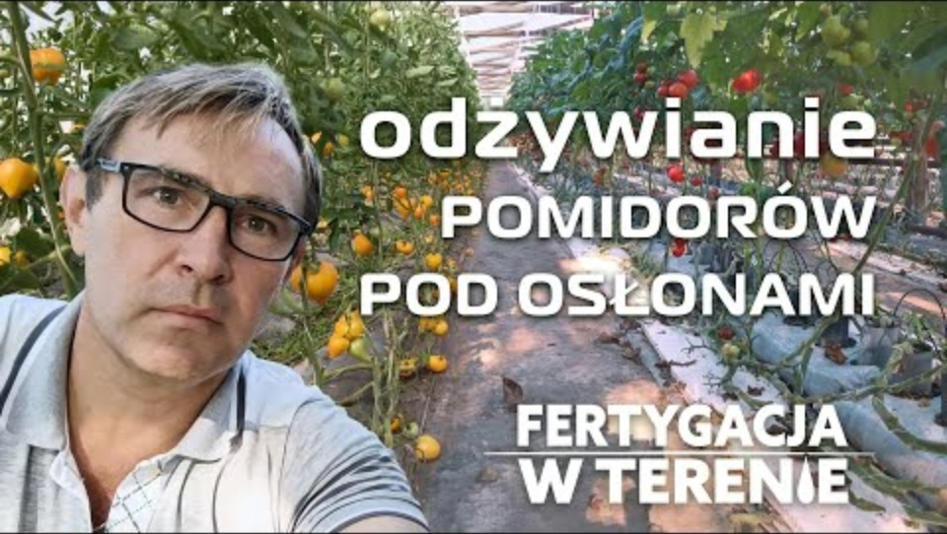
Growing tomatoes under cover
Precise irrigation and fertilization in tomato cultivation under cover affects the quantity and quality of crops. This video presents the fertilization plan and the positive effects of fertigation.
Fertygacyjne odżywianie pomidorów pod osłonami

Slide 15


04
LET’S PRACTICE

Slide 16
Answer A
Learner Exercise:
Scenario
I will install sprinklers to irrigate plantations during periods of drought
You take over a strawberry plantation from your parents. You intend to continue cultivating this species in the coming years. You are planning a change in your approach to cultivation and investments. Choose the most advantageous solution
Answer B
I will apply appropriate fertilization using a drip irrigation system for plants
Answer C
I will conduct soil tests and apply fertilization tailored to the needs of the plants.

Slide 17
Feedback on answers
Option A
Option C
Proper fertilization is the basis for high yields and savings. Analyze whether this is a sufficient step to ensure your success. Pay attention to the water needs of strawberries.
A good start. Plants like these need the right amount of water throughout the growing season
Option B
Sensational! Fertigation is an effective way to provide your plants with water and proper fertilization

Slide 18
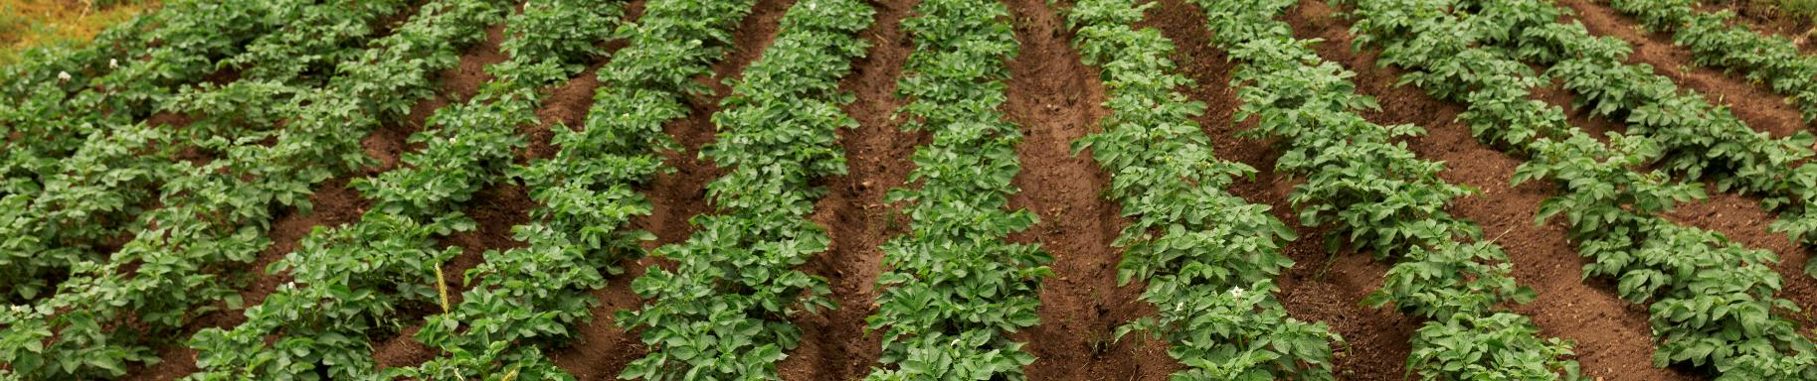
GREAT JOB!
You already know what fertigation is and what its use is in agriculture. Check how renewable energy sources can be used in the irrigation process. Take a look at module 5 and enrich your knowledge!

Slide 19
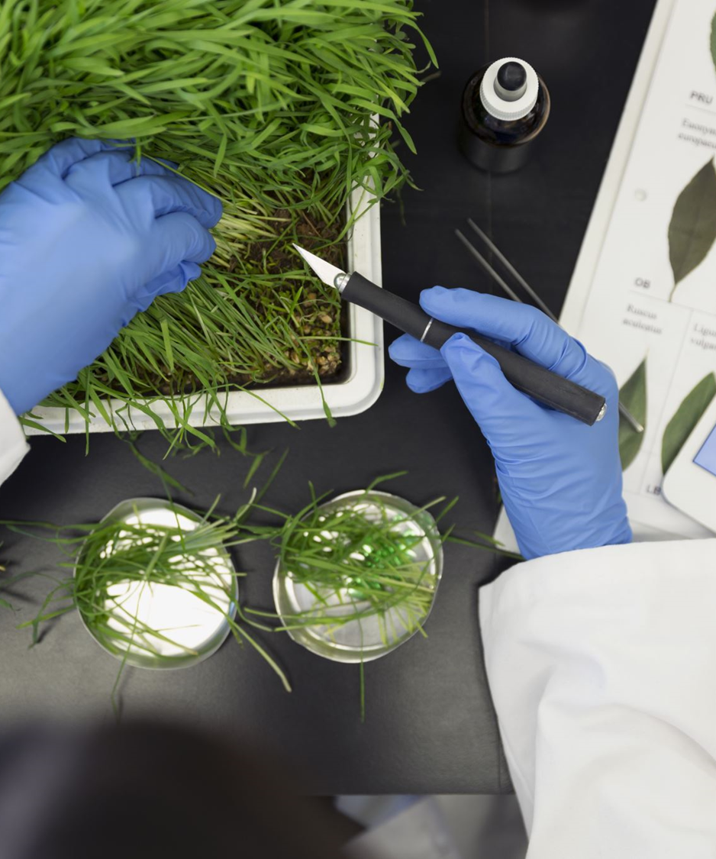

www.smartskills.eu
Follow our journey

