Slide 1



Course 2: Smart Irrigation and Fertilisation
M5: Renewable Energy-Powered Irrigation Systems
www.smartskillsproject.eu

Slide 2
What will you learn?
Understand…
…the basics of irrigation technology using renewable energy sources.
This module aims to introduce to the world of irrigation systems powered by renewable energy, with a focus on solar technologies. You will learn how solar installations for pumping and distributing water work and what their main advantages are. You will also learn about the challenges and limitations of using renewable energy sources in agriculture. This module will show you how to combine agriculture with the green energy of the future.
Identify…
… benefits and limitations of renewable energy in agriculture .
Explain…
…opportunities for combining photovoltaics with other areas of agriculture.

Slide 3

contents
This module explores how renewable energy—especially solar power—can drive irrigation systems in agriculture. Learners examine the components, benefits, and limitations of solar pumping, alongside concepts like agrivoltaics, highlighting how green energy supports sustainable farming and boosts resilience in off-grid or rural areas
01
Solar-powered irrigation technologies
02
Pros & Cons of renewable energy in agriculture
03
Successful implementations of solar systems
04
Let’s Practice!
This license enables reusers to distribute, remix, adapt, and build upon the material in any medium or format, so long as attribution is given to the creator. The license allows for commercial use. CC BY includes the following elements:
BY: credit must be given to the creator.
This project has been funded with support from the European Commission. The author is solely responsible for this publication (communication) and the Commission accepts no responsibility for any use may be made of the information contained therein. In compliance of the new GDPR framework, please note that the Partnership will only process your personal data in the sole interest and purpose of the project and without any prejudice to your rights.

Slide 4
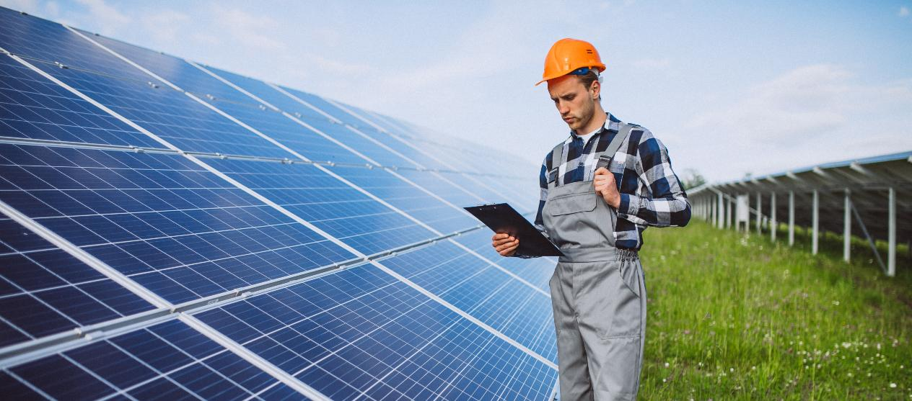
01
SOLAR-POWERED IRRIGATION TECHNOLOGIES

Slide 5

Using solar energy in agriculture
Solar energy allows for a revolution in water use in agriculture by providing a modern and sustainable way to irrigate crops. Solar-powered water pumps are used to pump small amounts of water. For rural areas, where the installation of solar panels is not a problem, the use of such a solution brings a number of benefits.

Slide 6
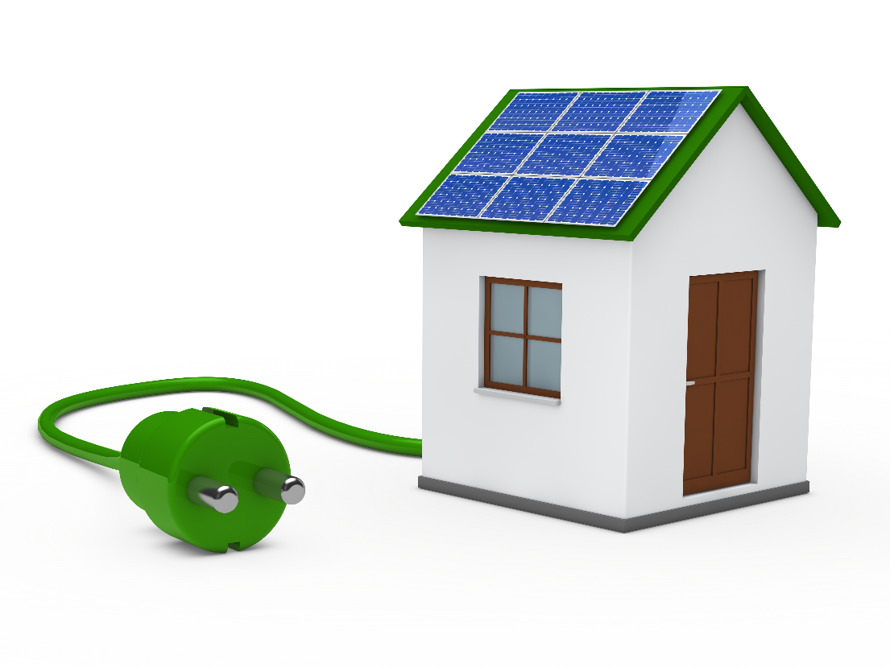
Solar Water Pump
It is a clean, simple and energy-efficient alternative to traditional electric and fuel-powered pump sets. They foster an environmentally friendly approach by reducing the negative impact of agricultural activities. The advantage is that solar energy can be used or exploited in any region, whether developed or poor.
The use of solar energy in water pumping systems can significantly help and accelerate the development of agriculture

Slide 7
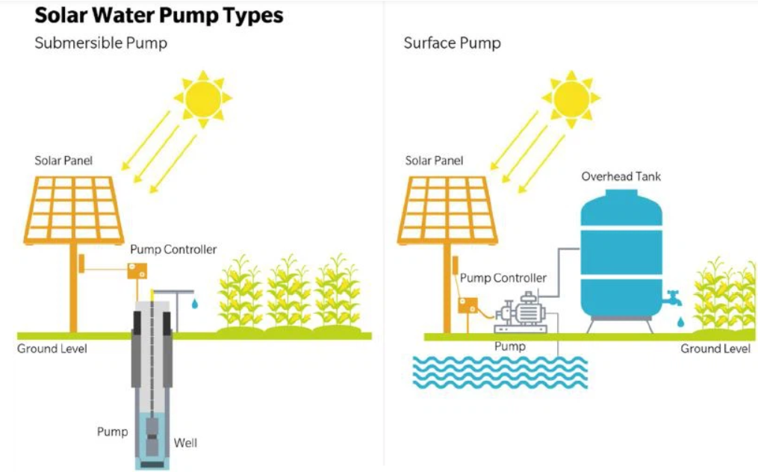
Solar Pumping System Components
photovoltaic (PV) system,
Electric Motor Pump:
submersible
surface

Slide 8
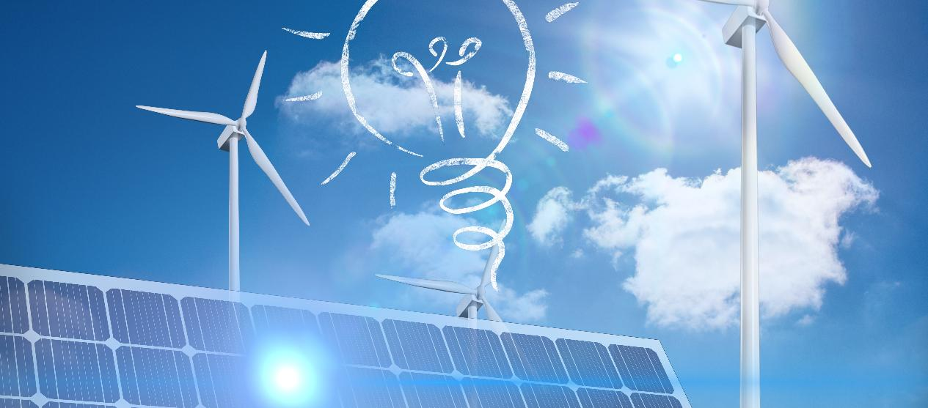
02
BENEFITS & LIMITATIONS OF RENEWABLE ENERGY IN AGRICULTURE

Slide 9
Benefits of renewable energy in agriculture
Reduce energy costs
Increasing energy independence
Ecological production
Source of income
financial support
own energy
reduced dependence on the power grid
avoid power cuts
reduce CO₂ emissions
reduced use of fossil fuels
use of agricultural waste
sale of surplus energy
land rental for wind and photovoltaic farms
subsidies (e.g. the EU supports RES in agriculture)
independence from electricity prices
reduction of fossil fuel purchase costs
free electricity in windy regions

Slide 10
Restrictions on the use of renewable energy
in agriculture
Energy Storage Problems
High upfront costs
Weather dependency
Space
requirements
01
03
02
04

Slide 11
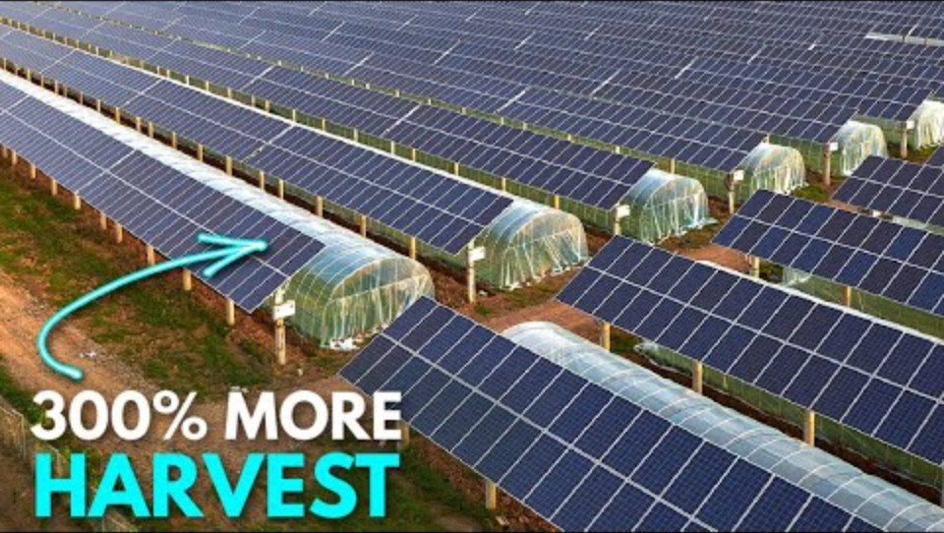
Agrovoltaics
The goal is to combine agricultural crops and livestock production with electricity production. It differs from large-scale photovoltaics in that agricultural production remains the priority, and the photovoltaic installation utilizes available space, further supporting production.
How Agri-Voltaics are Changing Agriculture | The Power of Solar Panels | EyeTech

Slide 12
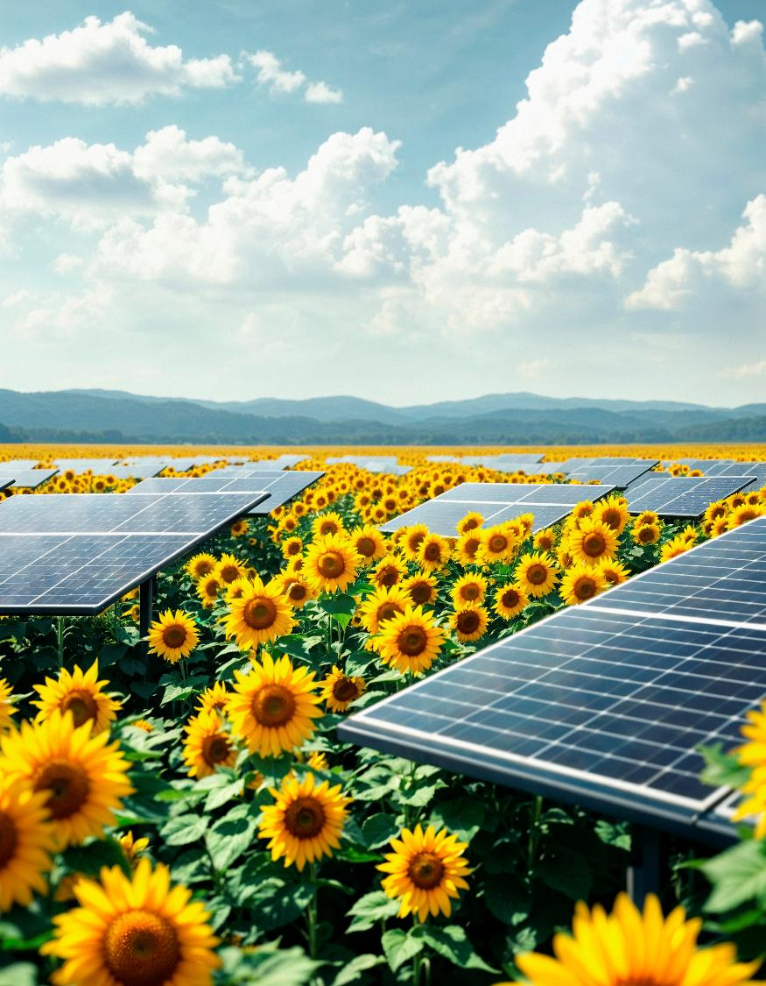
Advantages of agriphotovoltaics
Better use of agricultural space – growing crops and producing energy at the same time, rather than competing for land, especially in areas with limited agricultural space (e.g. the Netherlands)
Protection against extreme weather conditions - panels reduce heat stress for plants in hot weather, protect against hail, strong wind
Reduce evaporation and save water – reduce irrigation requirements
Increased yield of shade crops

Slide 13
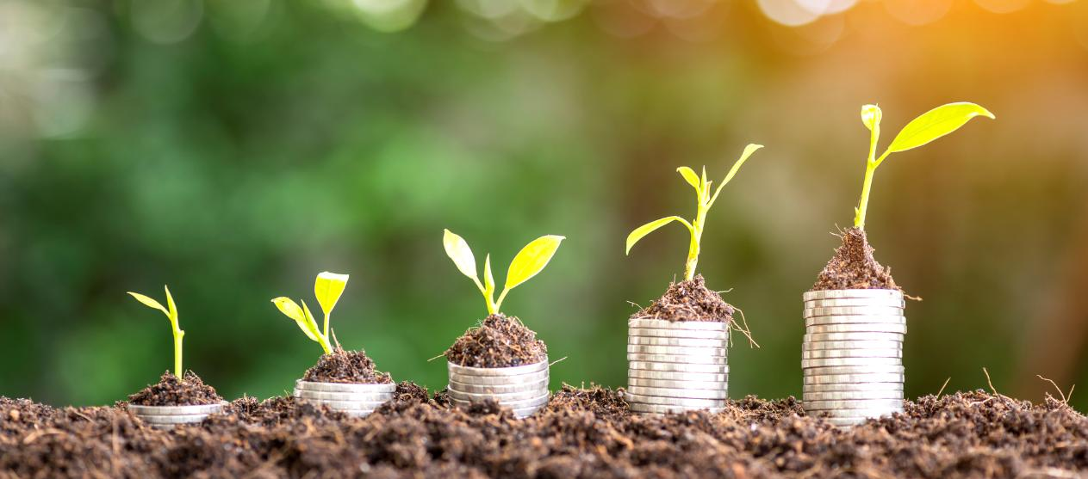
03
SUCCESSFUL IMPLEMENTATIONS OF SOLAR SYSTEMS

Slide 14
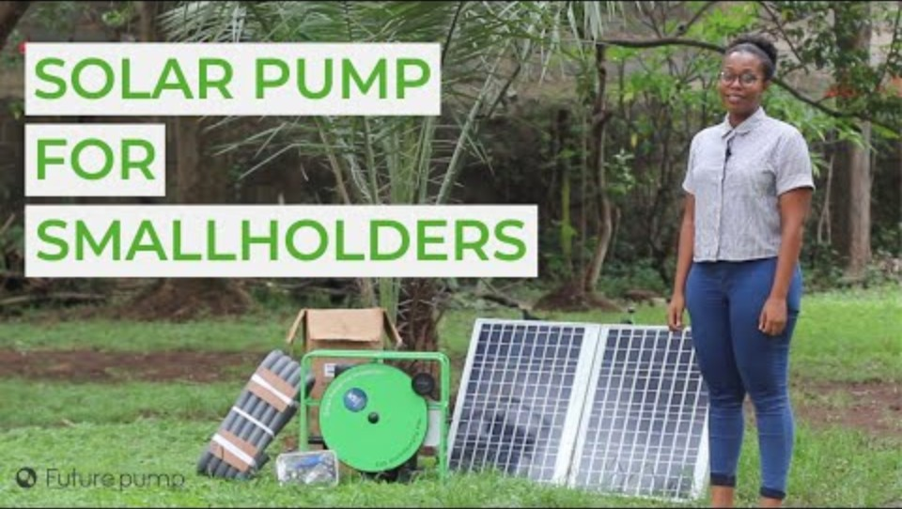
Benefits of using solar pumps in specific farms
No receipts
Yields during drought periods
Ease of Use
Equipment Mobility
Check out the entire set that makes up solar pumps and in which farms they have been used
Solar Water Pump for Smallholder Farmers - The Futurepump SF2

Slide 15
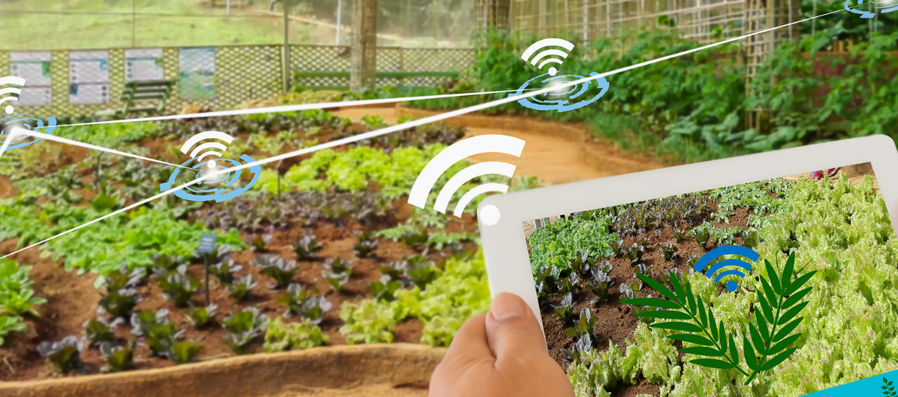
04
Let’s Practice

Slide 16
Learner Exercise: Scenario
Answer A
Every day I bring water and water the plants with a watering can.
You have a field where you have established a tomato crop under cover. The location of the crop is quite far from power lines. Cultivation requires constant watering. Choose the best strategy.
Answer B
Install a water tank with an irrigation system and solar panels to provide energy
Answer C
Installs a water tank with an irrigation system and a power generator

Slide 17
Feedback on answers
Option A
Option C
The chosen method is time-consuming and not very profitable. Choose another option and the time you would spend on this watering variant can be spent on other activities or relaxation
Not a bad choice. You will provide your plants with the right level of hydration. Maybe you will also think about caring for the environment and becoming independent of fossil fuels?
Option B
Title Four
The perfect choice! The plants will receive the right amount of water, and the panels will provide clean electricity.
You care about your crop and the environment!

Slide 18
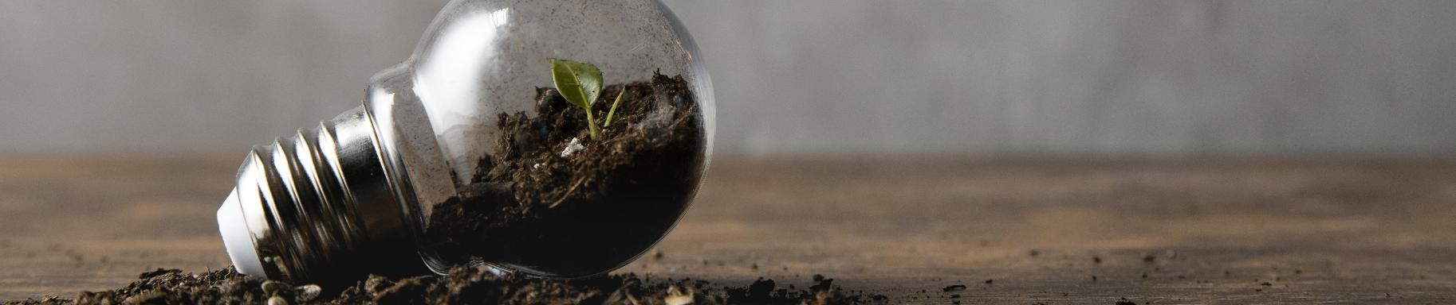
GREAT JOB!
Now you know that you can combine many different activities to get the maximum benefit for your farm and the environment. If you've completed all the modules, it's time for the quiz! If not, go back to the module you skipped.

Slide 19
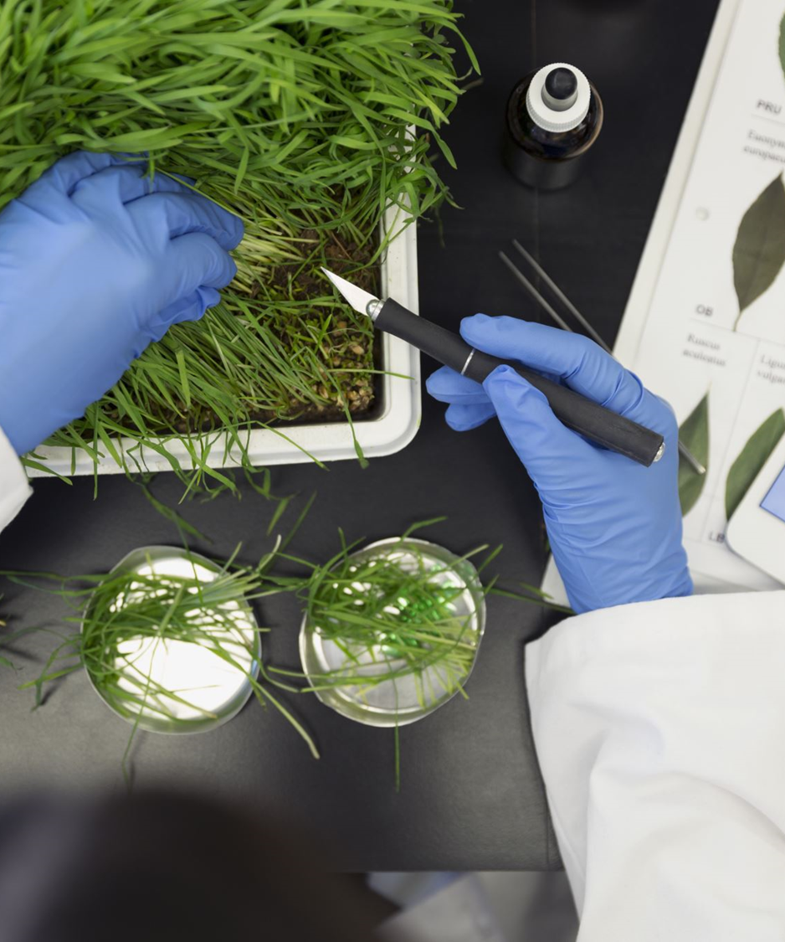

www.smartskills.eu
Follow our journey

