Slide 1
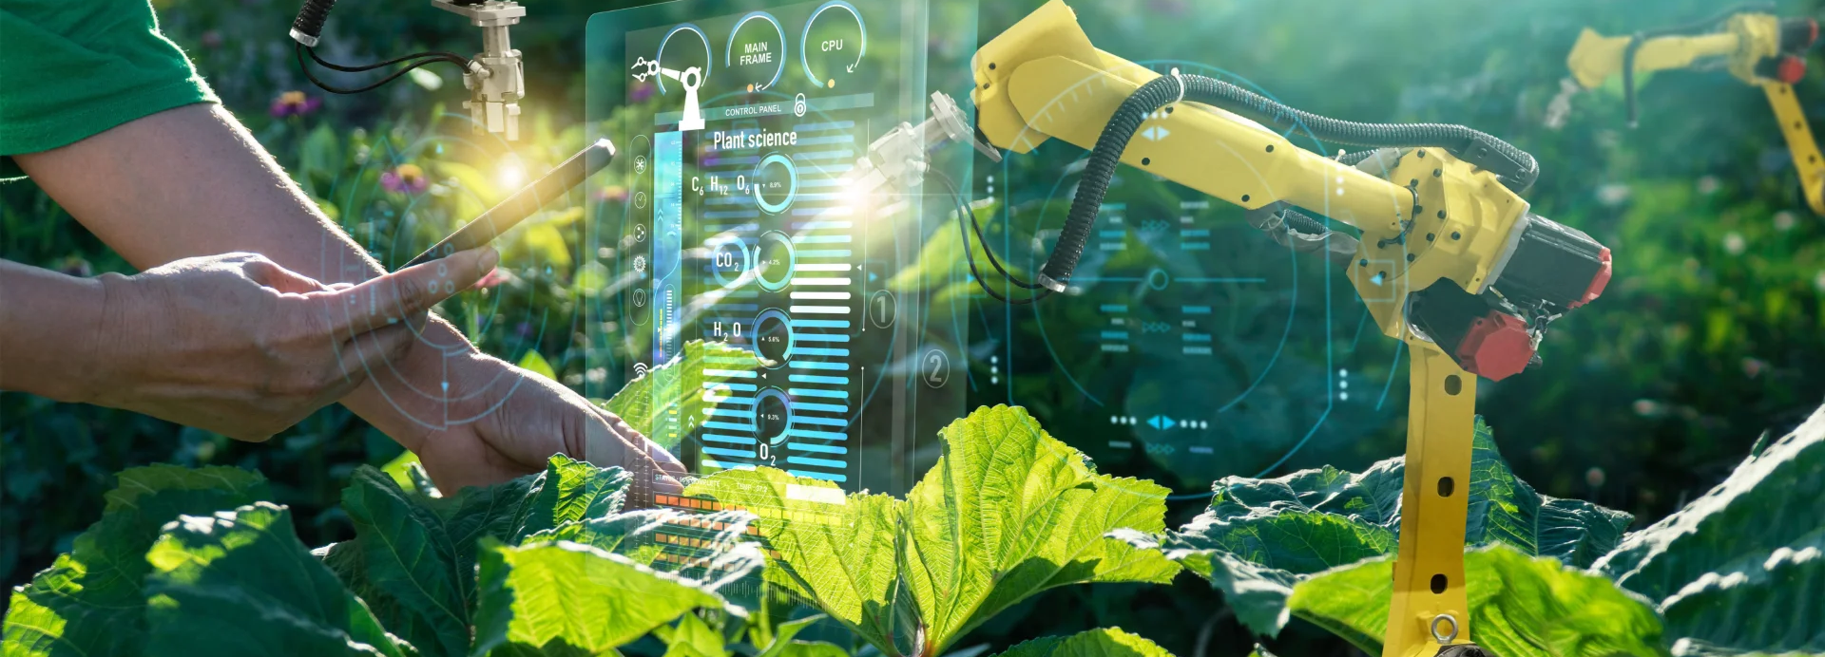


Course 1: Digital Farming and Precision Agriculture
M5: Advanced Tools in Precision Agriculture
www.smartskillsproject.eu

Slide 2
Learning Outcomes
Understand…
…the principles of precision agriculture and its benefits.
This module aims to introduce learners to the concept of precision agriculture and its growing role in making farming more efficient, sustainable, and data-driven. It explores a range of advanced technologies, including smart sensors, drones, satellite imagery, and AI-powered analytics, that are shaping the future of agriculture. Students will learn how these tools enable real-time monitoring of soil conditions, crop health, and weather patterns, supporting informed decision-making. The overall goal is to understand how such innovations can help optimise yields, reduce waste, and minimise environmental impact in agricultural practices.
Identify…
…key technologies such as IoT sensors, GPS-guided machinery, and remote sensing.
Explain…
….. how data from these tools is collected, analyzed, and applied in the field.

Slide 3
contents
This module focuses on developing AI skills to prepare learners for the future of farming. It explores how precision agriculture is data-driven. Learners will gain insights into how AI supports better decisions on the farm, helping to boost yields, reduce waste, and protect the environment.
01
Basic Principles of AI in Agriculture
02
AI Technologies and Applications
03
Visualisation, Case Studies and IoT
04
Advanced Approaches and Trends
05
Case Study
06
Let’s Practice

Slide 4
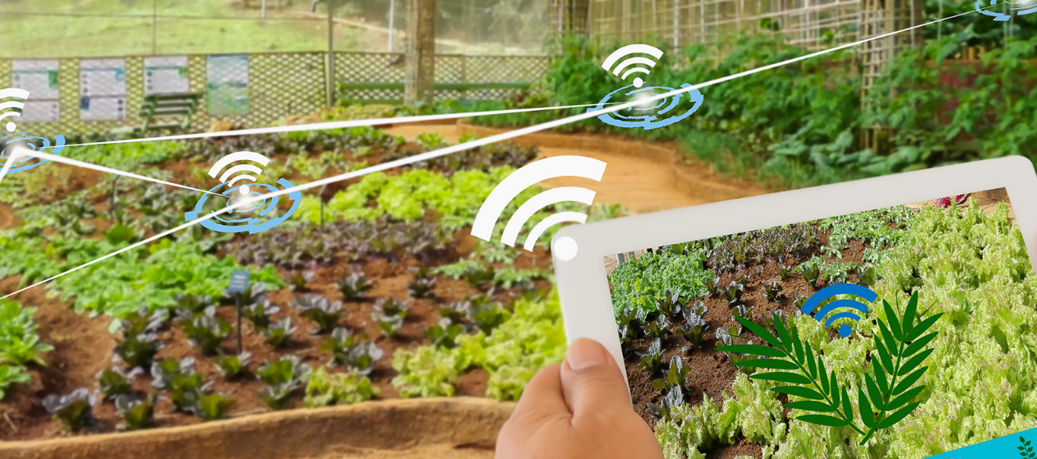
01
BASIC PRINCIPLES OF AI IN AGRICULTURE

Slide 5
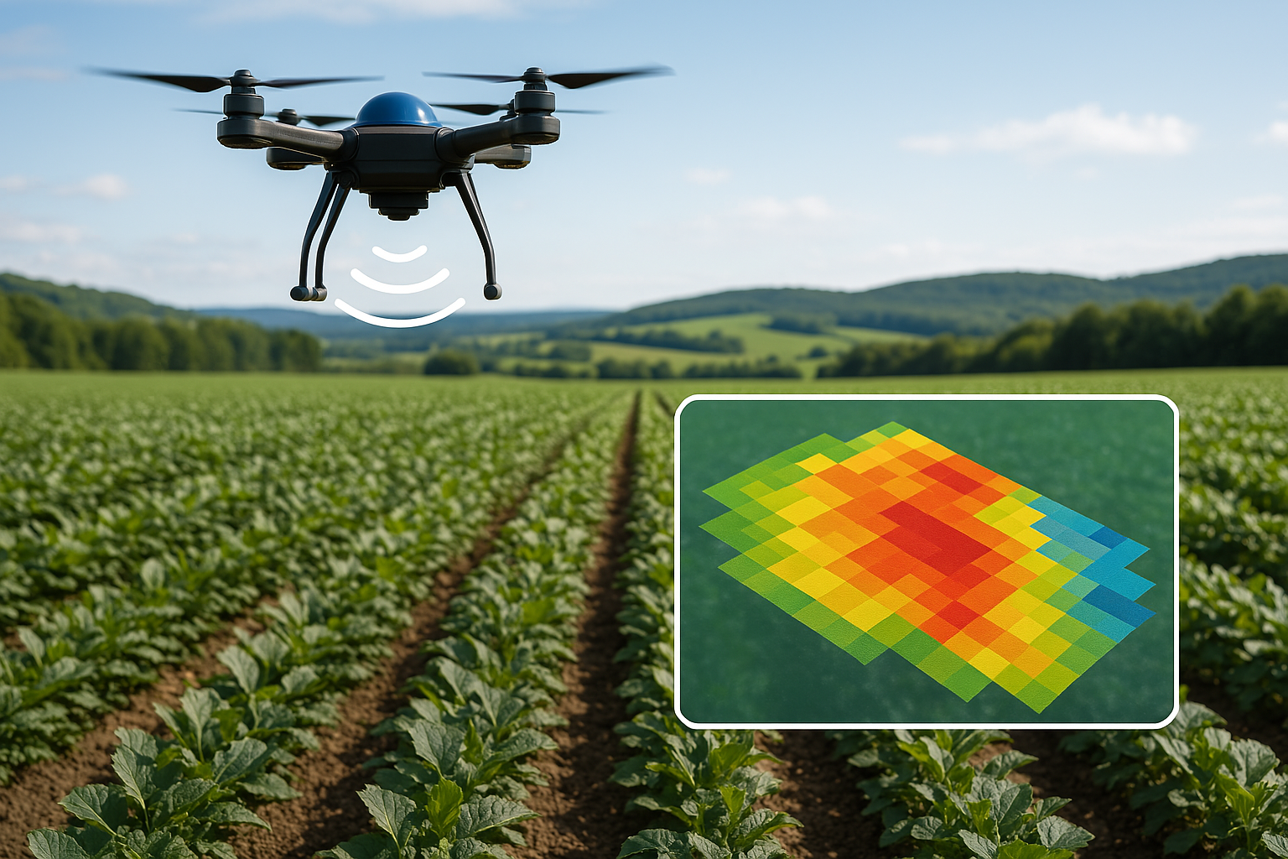
AI Possibilities for Precision Agriculture
AI technologies are revolutionising precision agriculture by enabling real-time crop monitoring using data from sensors, drones, and satellites to assess plant health across entire fields.
This continuous monitoring supports targeted interventions, allowing for variable rate applications of fertilizers, irrigation, and pesticides—delivering inputs only where and when they are needed. AI also facilitates predictive crop planning by analyzing historical and real-time data to recommend optimal planting and harvesting dates tailored to local conditions.
Furthermore, early detection of diseases and pests through AI image and sensor analysis helps minimize waste by preventing yield losses and reducing the need for widespread chemical treatments.
Together, these AI-driven capabilities increase efficiency, sustainability, and profitability in modern farming practices.

Slide 6
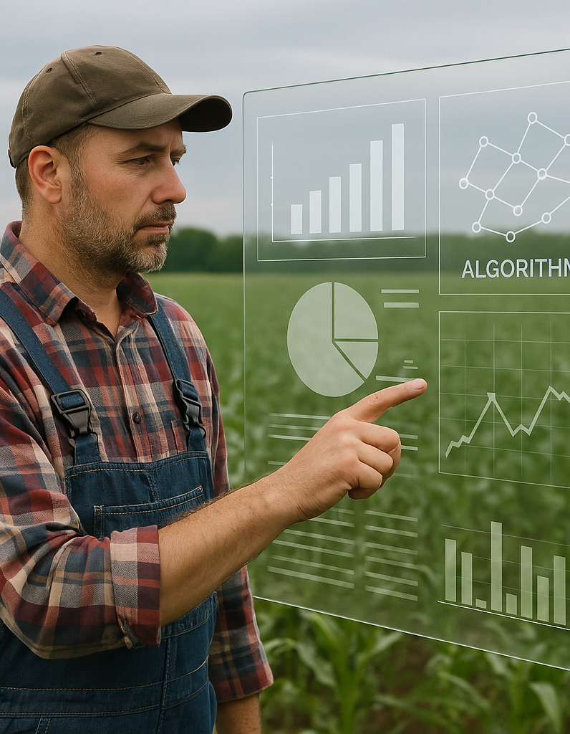
Machine Learning Algorithms in Agriculture
Machine learning algorithms are increasingly integral to modern agriculture, enhancing decision-making and operational efficiency. Decision trees and statistical models are widely used for predicting crop yields, analyzing market price trends, and forecasting weather patterns, helping farmers make informed, data-backed choices. Deep learning, particularly convolutional neural networks, excels at analyzing plant images to detect diseases and nutrient deficiencies early, often with higher accuracy than traditional methods. Data clustering techniques allow for field segmentation based on soil characteristics and local microclimates, enabling site-specific management strategies.
Additionally, reinforcement learning is being applied to train autonomous agricultural machinery, allowing these systems to learn and improve from real-world feedback, such as optimizing paths or adjusting actions based on environmental conditions.

Slide 7
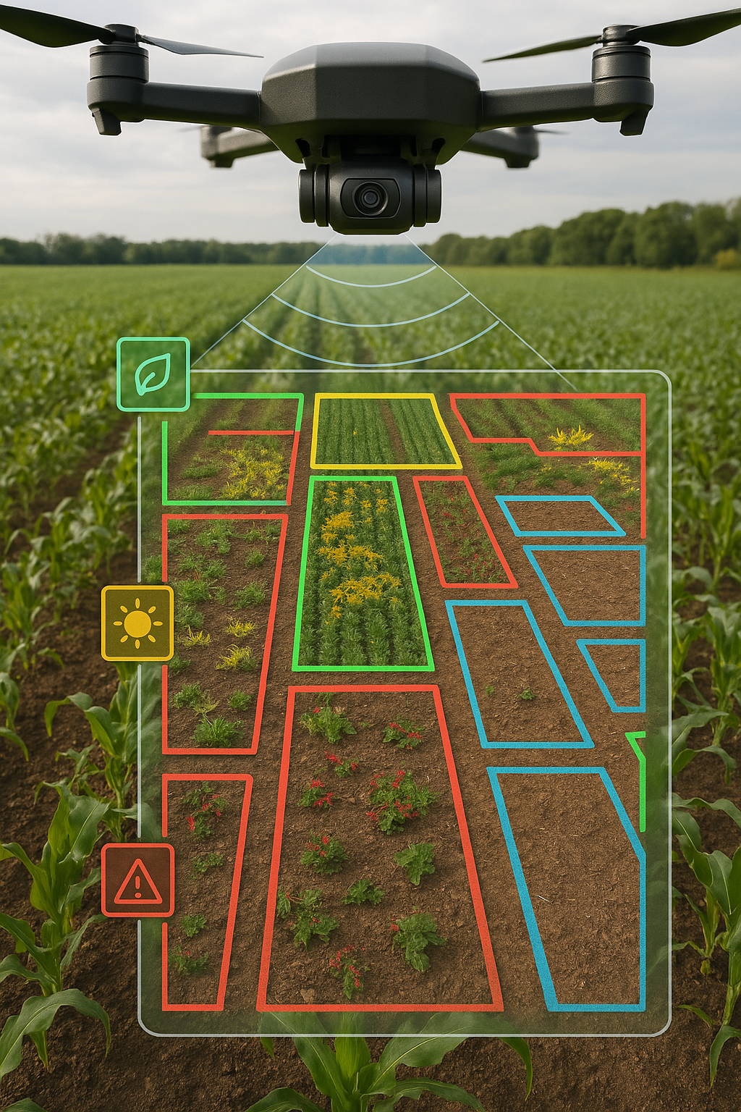
Computer Vision (in General)
Computer vision is a field of artificial intelligence that enables machines to interpret and understand visual information from the world, primarily through image and video analysis.
Using AI, it can automatically recognise objects and patterns in images—such as distinguishing between healthy plants and those affected by disease. Visual data captured from cameras, drones, and satellites provides detailed insights into field conditions, crop development, and livestock behavior.
Through object detection, classification, and segmentation, computer vision systems can accurately identify and differentiate between crops, weeds, pests, or animals in agricultural settings.
These capabilities support a wide range of on-farm applications, including real-time crop monitoring, yield estimation, precision spraying, and supervision of farm machinery, ultimately enhancing productivity and decision-making.

Slide 8
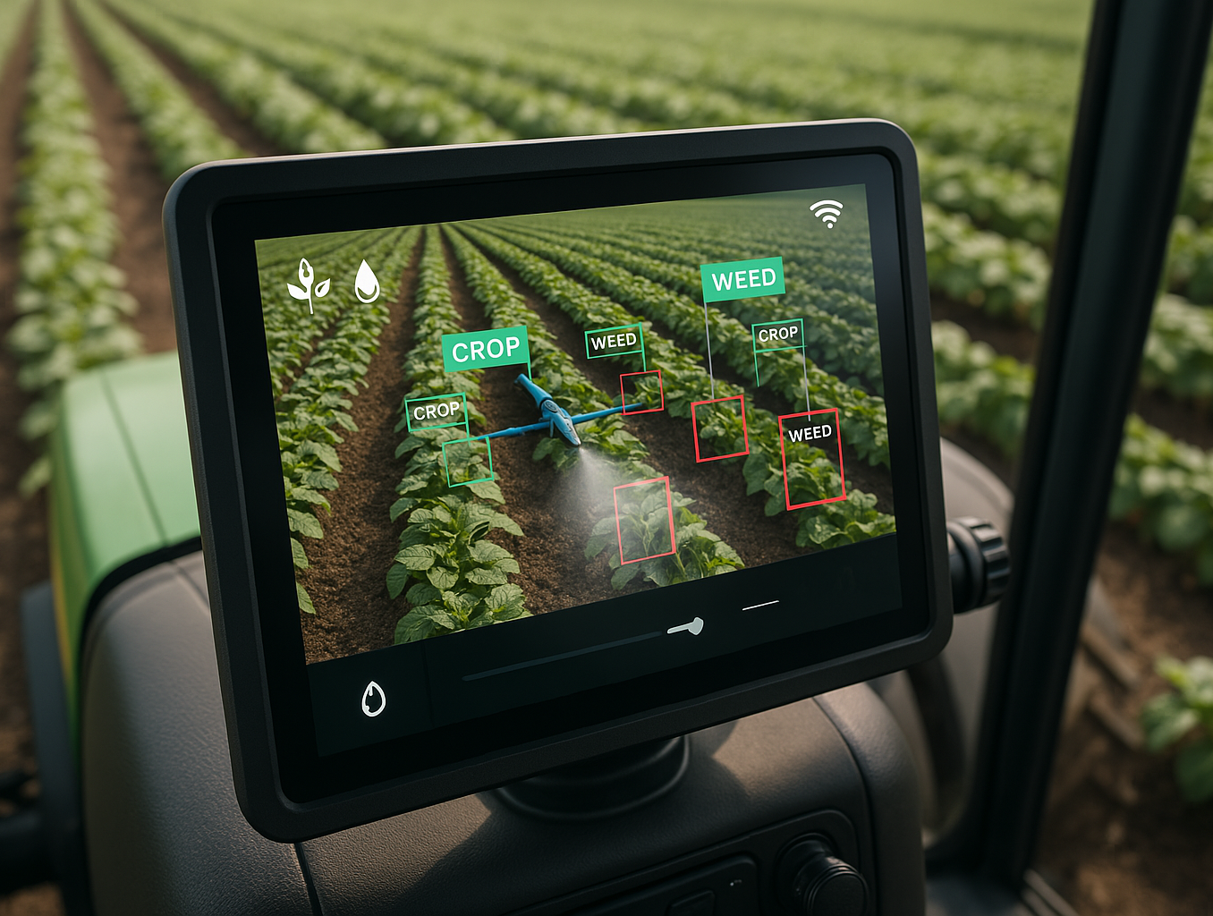
Object Detection in Agriculture
Object detection in agriculture leverages AI and computer vision to identify and locate specific items within images or video streams, enhancing precision and automation in farming practices.
For instance, weed detection systems use object detection to distinguish weeds from crops, enabling targeted spraying that reduces herbicide use and protects the crop. In orchards and vineyards, AI can count fruits like apples or grapes on trees, providing accurate yield estimations for harvest planning.
Livestock tracking uses camera systems and object detection algorithms to identify and monitor individual animals in pastures, improving herd management and security.
Additionally, AI-powered obstacle detectionon autonomous farm machinery helps detect stones, people, or other hazards, increasing operational safety and reducing equipment damage.

Slide 9
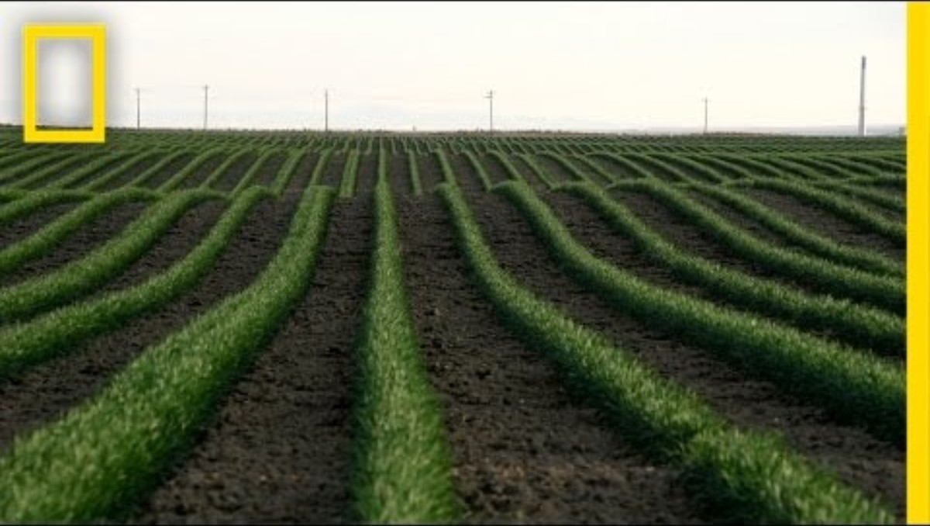
More information about drones
⬅ Drones and the Future of Farming
| National Geographic
Using of Drones in Precision Agriculture

Slide 10
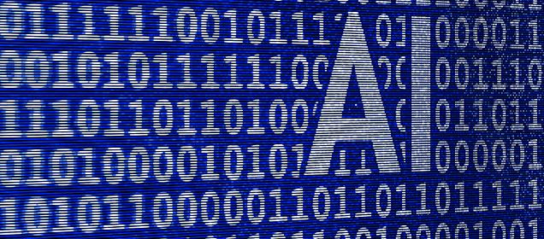
02
AI TECHNOLOGIES AND APPLICATIONS

Slide 11
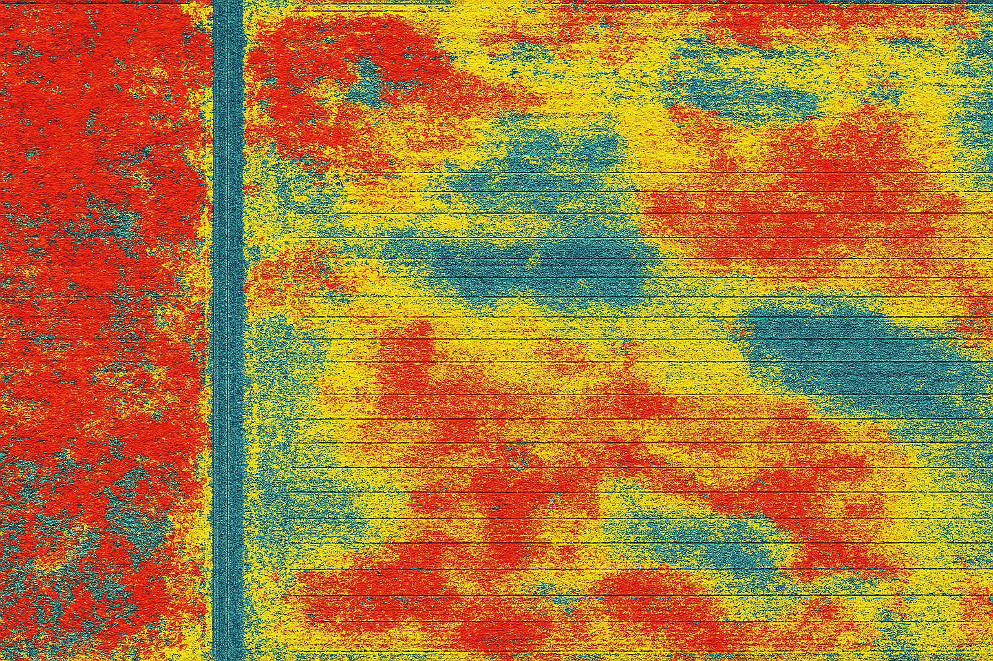
Segmentation in Agriculture
Segmentation in agriculture involves dividing visual data into meaningful regions to extract precise information about various elements in the field.
One key application is separating crops from weeds, allowing automated systems to differentiate cultivated plants and perform targeted mechanical or chemical weeding with high accuracy.
Disease segmentation on plant leaves or fruits highlights affected areas using colour-coded overlays, enabling early detection and focused treatment. In addition, segmentation techniques are used in mapping soil and yield zones, producing detailed color-coded maps that support precision irrigation, fertilization, and variable-rate application, ultimately improving resource efficiency and crop performance.

Slide 12
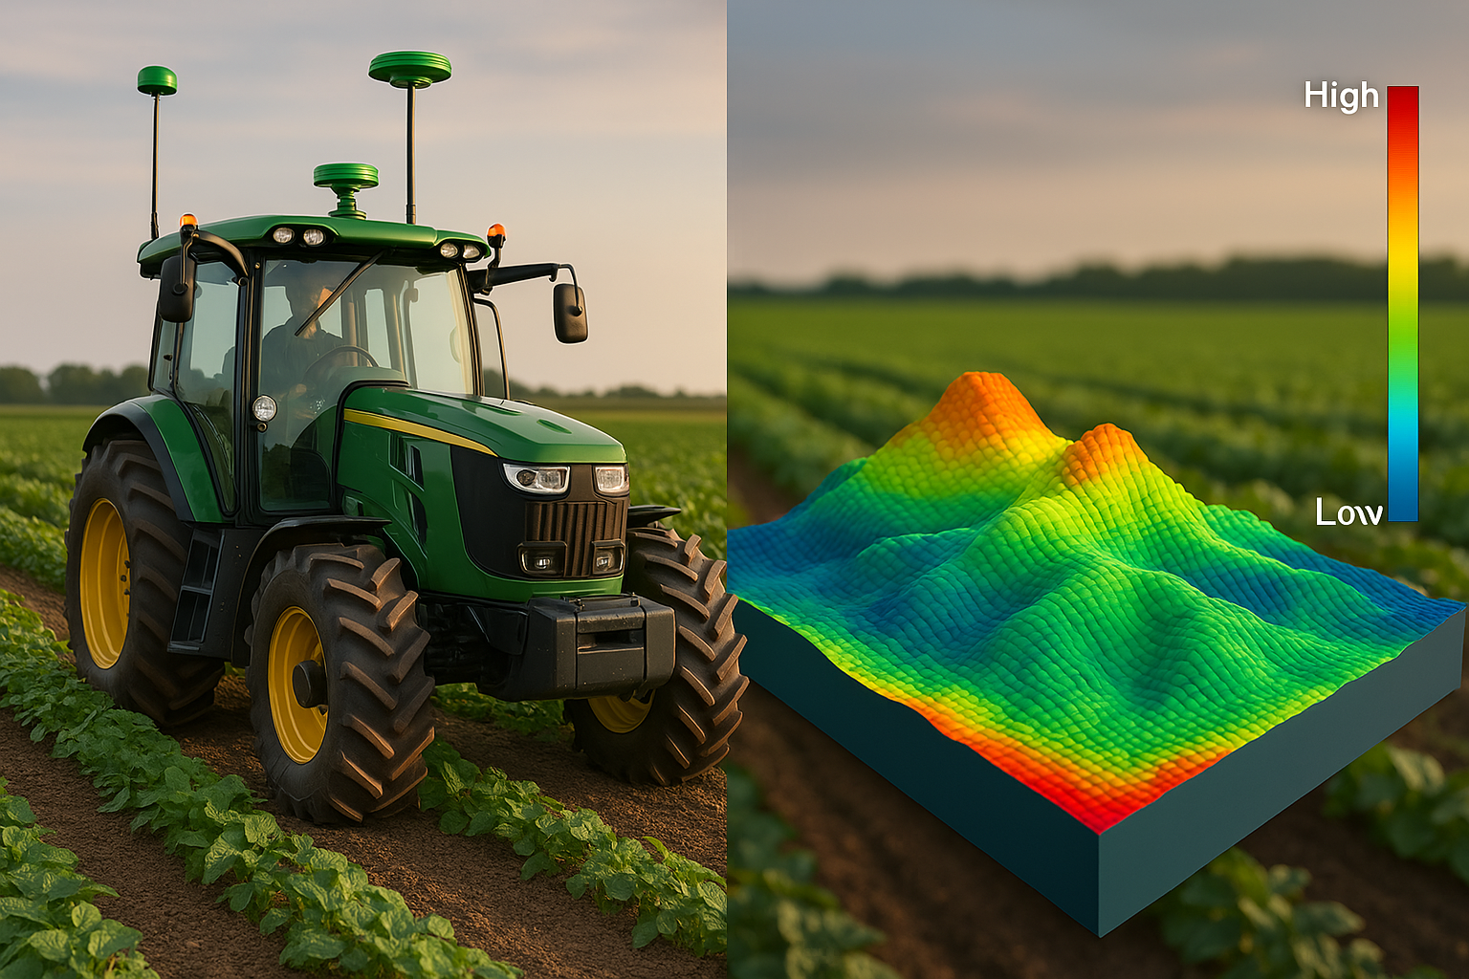
3D Computer Vision in Agriculture
3D computer vision in agriculture enhances spatial awareness by capturing the depth and structure of agricultural environments through technologies like drones, stereo cameras, and LiDAR.
This enables detailed 3D mapping of fields and orchards, allowing farmers to analyze terrain, canopy structure, and crop layout with high accuracy. By measuring plant volume and height, 3D data supports biomass estimation and monitoring of growth stages, which are crucial for yield prediction and crop health assessment. In the realm of automation, 3D cameras assist autonomous machinery in navigating safely by detecting and avoiding obstacles such as rocks or animals. Furthermore, robotic fruit picking systems rely on 3D vision to accurately localize fruits in space, ensuring precise and gentle harvesting without damaging the plant or produce.

Slide 13
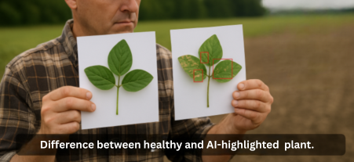
Benefits of AI-Driven Image Analysis
AI-driven image analysis offers significant benefits for modern agriculture by transforming how crops are monitored and managed. It enables early detection of problems such as diseases and pest infestations, often before they become visible to the naked eye, allowing for timely and effective responses. By automating field inspections, AI saves time and labor, reducing the need for manual scouting and enabling large-scale monitoring with minimal effort. This technology also supports precise targeting of interventions, helping farmers apply water, fertilizers, and pesticides only where necessary, thereby reducing waste and environmental impact. Ultimately, these efficiencies contribute to increased yields and improved crop quality, supporting more sustainable and profitable farming practices.

Slide 14
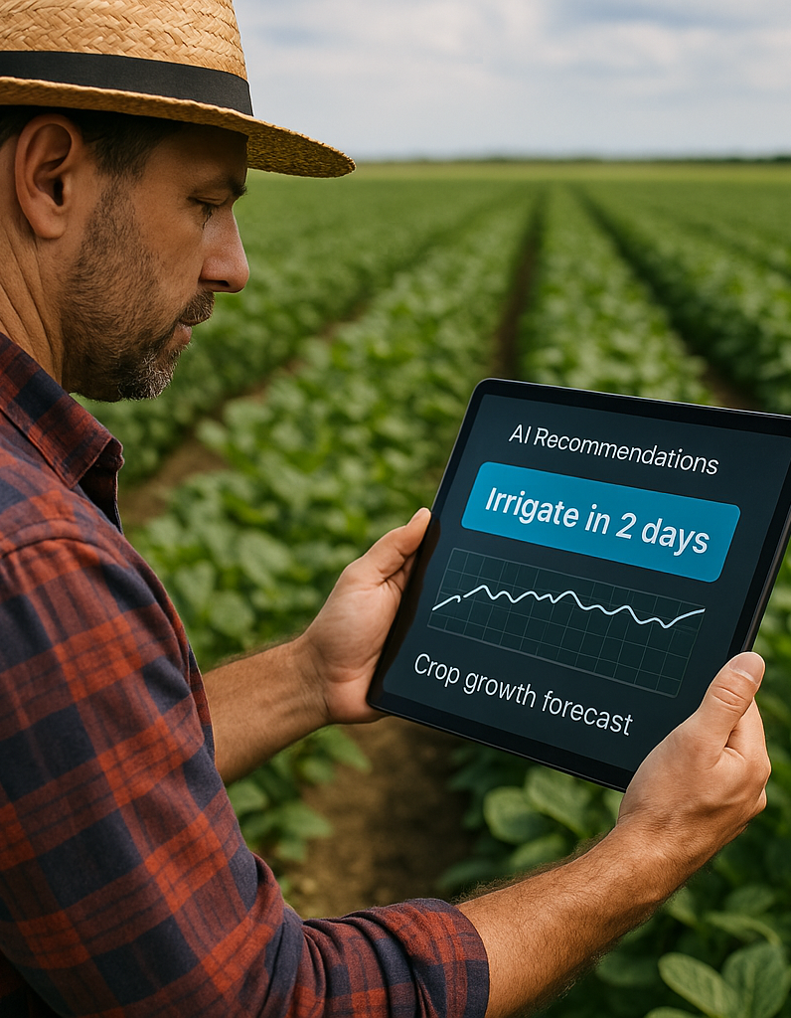
AI-Driven Decision Making
AI-driven decision making in agriculture empowers farmers with intelligent tools that enhance planning, responsiveness, and efficiency.
Recommendation systems use AI to provide tailored advice on when to sow, irrigate, fertilize, or harvest, based on specific field conditions and historical data. Through predictive farm management, AI integrates weather forecasts, soil parameters, and market trends to help farmers make informed, forward-looking decisions. In critical situations, AI enables real-time automated decisions, such as activating irrigation systems when early signs of drought stress are detected.
By basing recommendations on comprehensive data analysis, AI significantly reduces uncertainty, replacing guesswork with evidence-based strategies that optimise resource use and increase farm profitability.

Slide 15
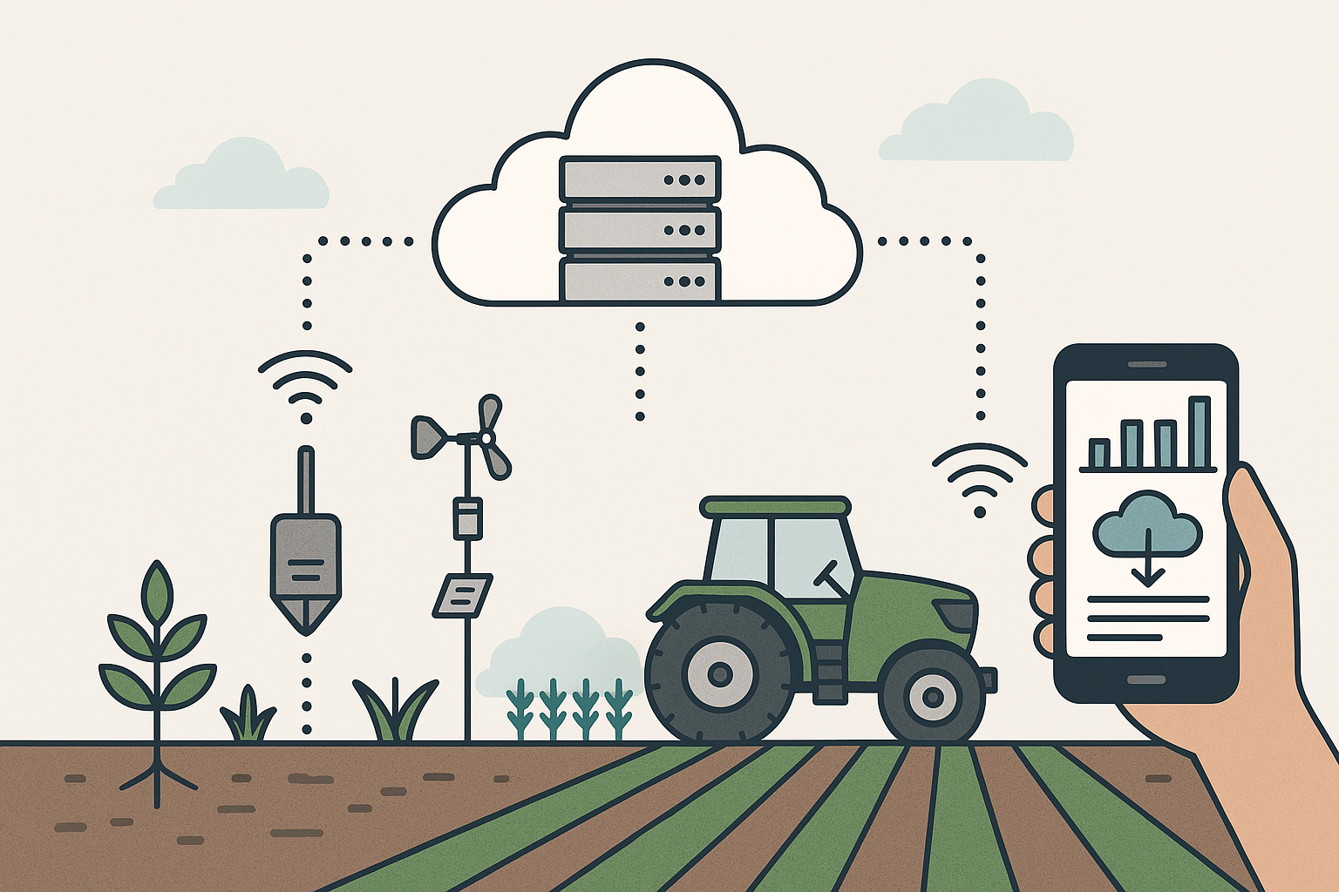
Integrating AI with Existing Data Systems
Integrating AI with existing data systems in agriculture enhances efficiency by bringing intelligence directly into the tools farmers already use.
AI platforms can be linked with farm management software, allowing outputs such as maps, recommendations, and alerts to appear within familiar dashboards and mobile apps. Sensors and machinery, including soil probes, weather stations, and tractors, can be connected to AI models, enabling real-time data flow for continuous analysis and decision-making. Ensuring data compatibility through APIs and standardized formats facilitates smooth integration between different hardware and software systems, avoiding data silos. Moreover, AI solutions can operate both in the cloud for large-scale processing and on local (edge) devices for fast, on-site responses, supporting flexible and responsive farm operations.

Slide 16

03
VISUALISATION, CASE STUDIES & IOT

Slide 17
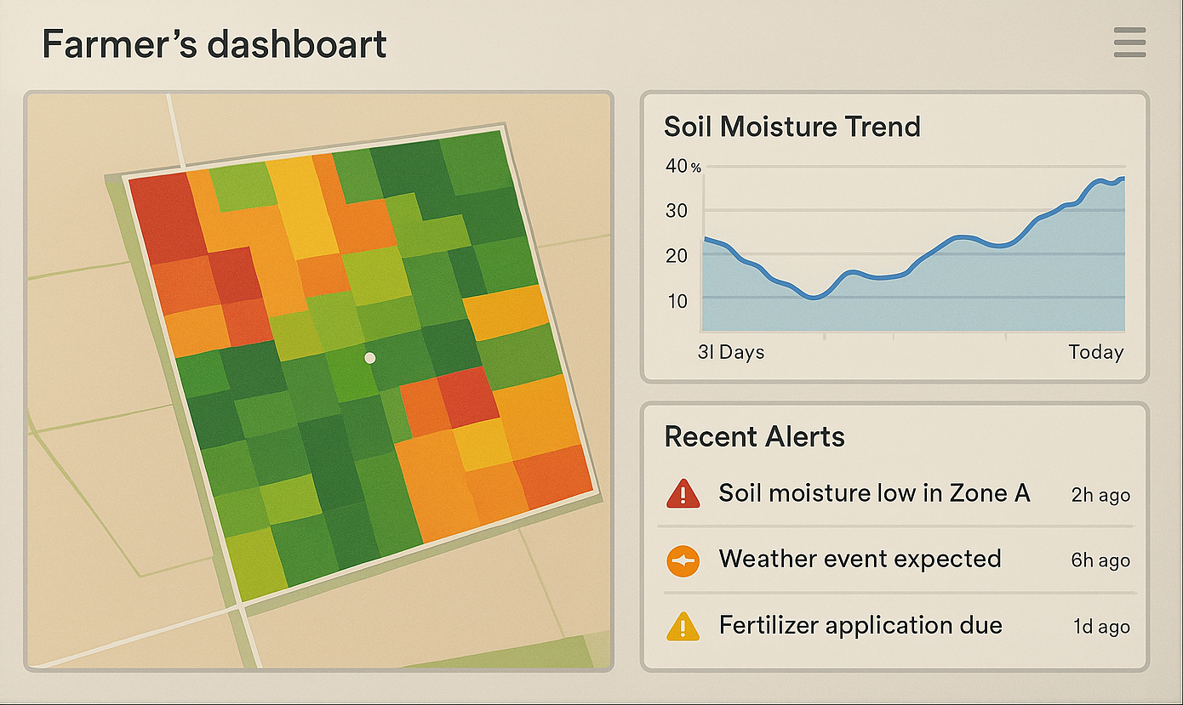
Visualization of AI Insights
Visualization of AI insights in agriculture transforms complex data into accessible and actionable information for farmers and agronomists. Map-based outputs display fields as colour-coded zones based on parameters like moisture levels, nutrient availability, or crop health, making it easy to identify areas needing attention.
Charts and dashboards present clear trends over time, such as crop growth stages, temperature changes, or yield forecasts, helping users track performance and plan accordingly.
Alerts and notifications, triggered by AI analysis, can be sent to mobile devices or computers, providing early warnings about droughts, pests, or disease outbreaks. Additionally, interactive visualisations allow users to explore historical data, simulate future conditions, and compare different management strategies, enhancing decision-making through visual understanding.

Slide 18
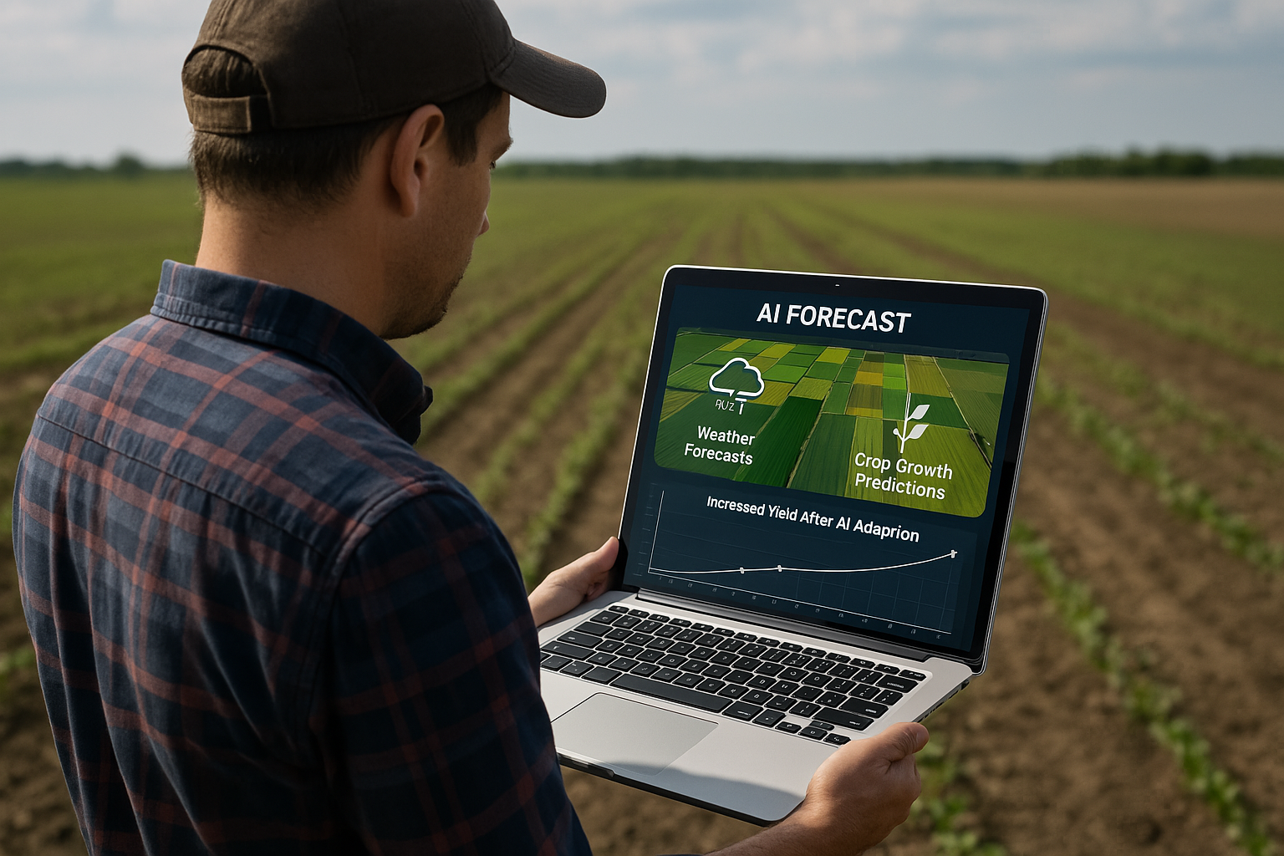
Case Study: AI-Driven Decision Making in Crop Management
AI analysis of weather and soil data (aWhere platform)
  hyper-local weather forecasts and crop growth models
Timely alerts for farmers
  notifications about drought, frost, or pest risks
Agronomic intervention recommendations
  advising on irrigation, fertilization, and harvest timing
Results: ~40% reduction in losses from adverse weather, +35% improvement in harvest planning
Example: Where AI Predictive Analytics Case Study

Slide 19
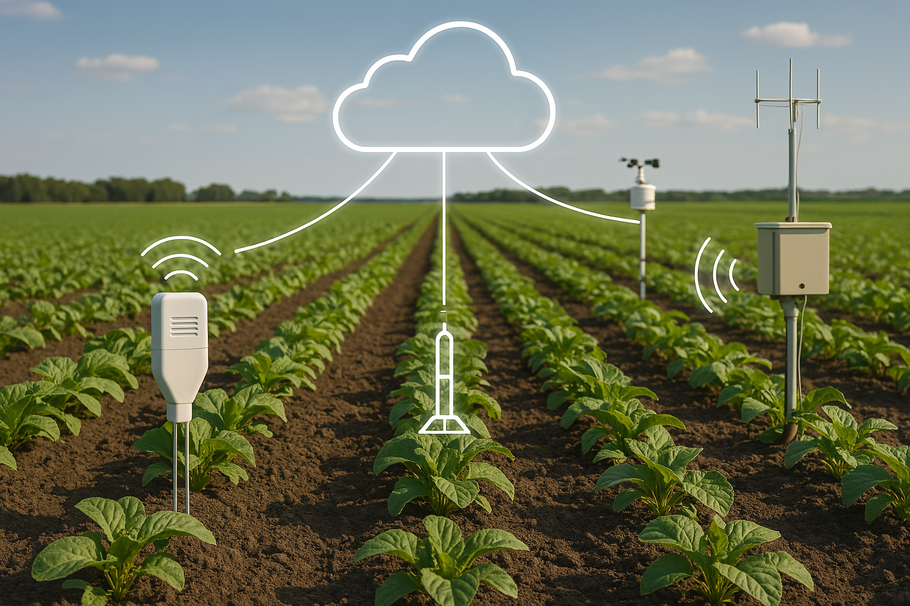
Advanced AI Tools for IoT in Agriculture
Advanced AI tools for IoT in agriculture create intelligent, responsive farming environments by tightly integrating smart sensors with AI algorithms. IoT sensors embedded in soil, irrigation systems, or weather stations are now equipped with AI logic to interpret data on moisture, temperature, and nutrient levels in real time. Through on-farm edge computing, AI can process this sensor data directly at the source—such as on a tractor or irrigation controller—allowing for immediate, autonomous actions without relying on external networks. In parallel, cloud platforms like Microsoft FarmBeats aggregate data from across the farm to enable centralized analysis, visualization, and strategic planning. AI also supports predictive maintenance, identifying early signs of machinery wear or failure and automatically adjusting operations to prevent downtime. In smart greenhouses and precision farms, this AI-IoT integration allows for fully automated control of climate, irrigation, and nutrient delivery, ensuring optimal growing conditions at all times.

Slide 20
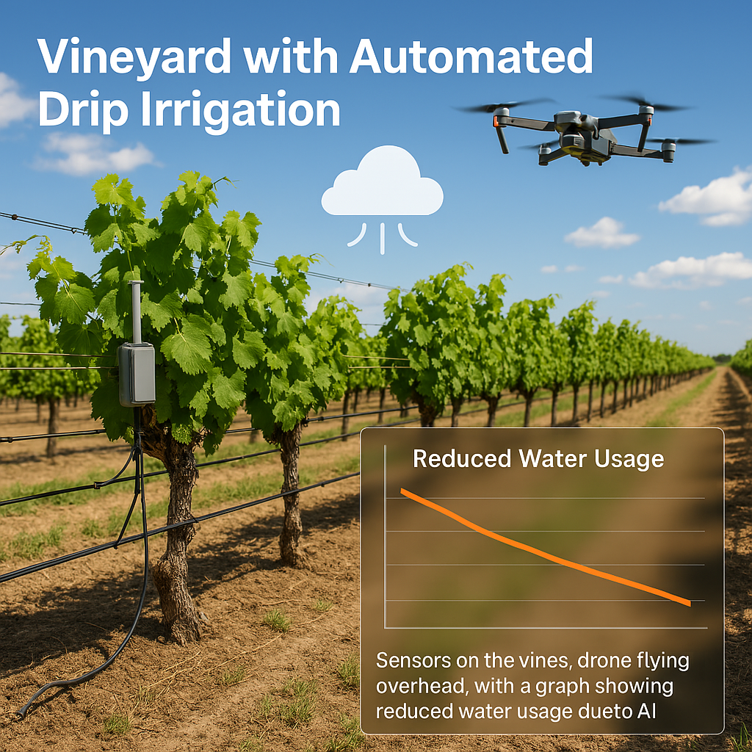
AI and IoT Case Studies
Smart vineyard irrigation (IoT + AI)
  soil moisture and weather sensors save
  ~45 % water without yield loss
Automated greenhouse management
  network of sensors and AI controlling ventilation, irrigation, and lighting for optimal growth
Real-time livestock monitoring
  IoT collars and AI detect health issues in animals before they become apparent
Example: FarmBeats AIoT Case Study

Slide 21
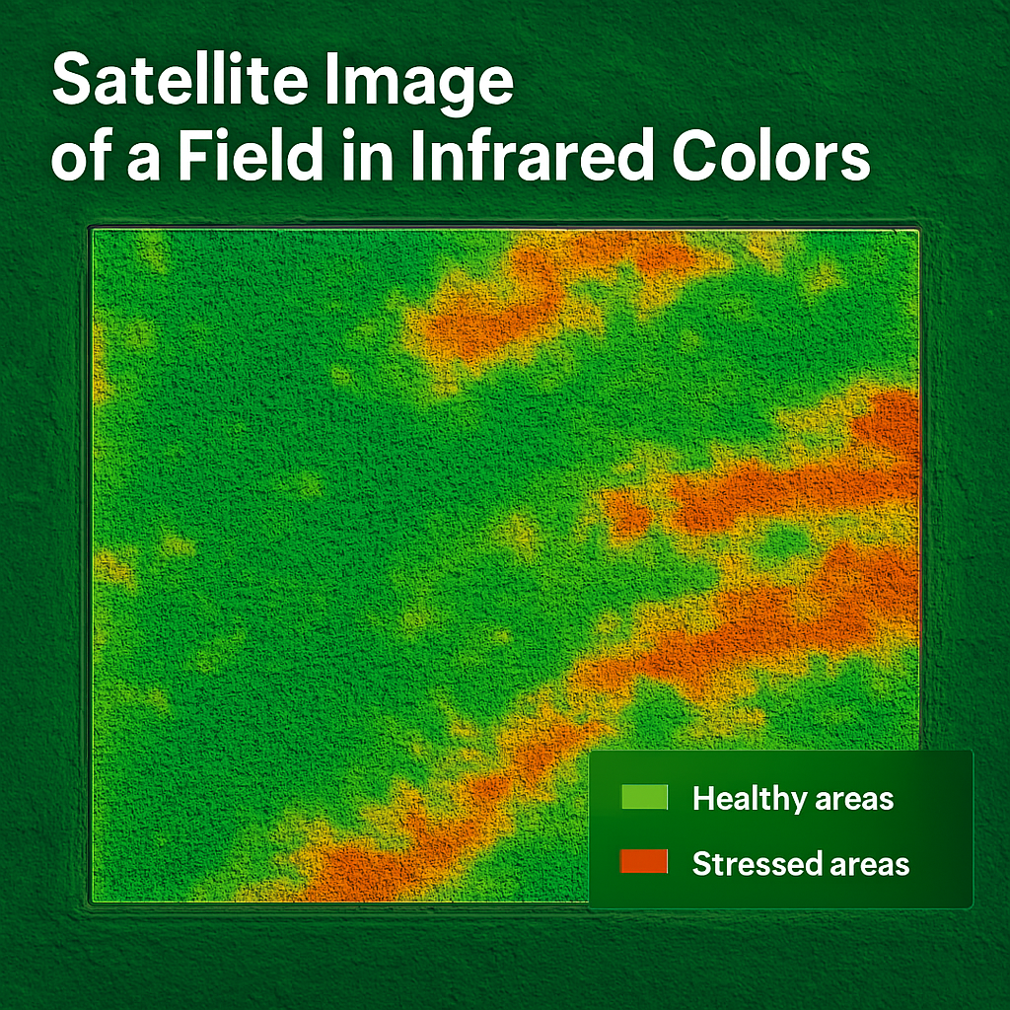
AI and Multi-Spectral Imaging
AI and multi-spectral imaging form a powerful combination in precision agriculture by enabling detailed, data-rich assessments of crop health.
Multi-band imagery, which includes both visible and infrared light, allows AI algorithms to analyze subtle differences in plant reflectance that are invisible to the human eye. Using vegetation indices such as NDVI (Normalized Difference Vegetation Index) or EVI (Enhanced Vegetation Index), AI can calculate plant vitality and detect anomalies in photosynthetic activity. This enables early detection of plant stress—including drought, nutrient deficiencies, or disease—often days before symptoms appear visually.
By processing drone or satellite imagery, AI generates color-coded maps that highlight healthy, stressed, or over-watered areas, guiding precise interventions and improving overall farm efficiency.

Slide 22
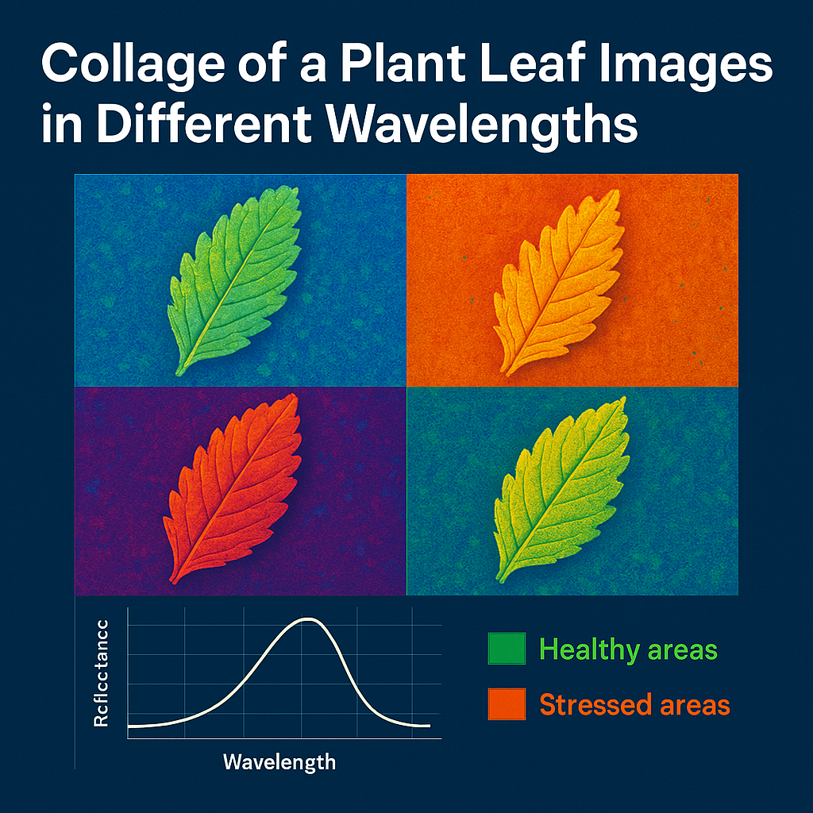
AI Analysis of Hyperspectral Data
AI analysis of hyperspectral data enables an exceptionally detailed view of agricultural conditions by interpreting images composed of dozens to hundreds of spectral bands that capture a unique “spectral signature” for every crop or material. These images generate massive volumes of data, which require advanced AI algorithms—such as deep learning and dimensionality reduction—to extract meaningful patterns and insights.
AI can identify subtle differences in reflectance that reveal crop types, nutrient levels, plant stress, or early disease presence, far beyond the capabilities of traditional imaging. It also supports quality control and composition analysis, such as estimating sugar content in fruits or moisture levels in grains, directly from spectral data. Though primarily used in research settings due to the need for specialized equipment and high computational power, hyperspectral AI analysis is paving the way for highly precise, data-rich agricultural practices.

Slide 23

04
ADVANCED APPROACHES AND TRENDS

Slide 24
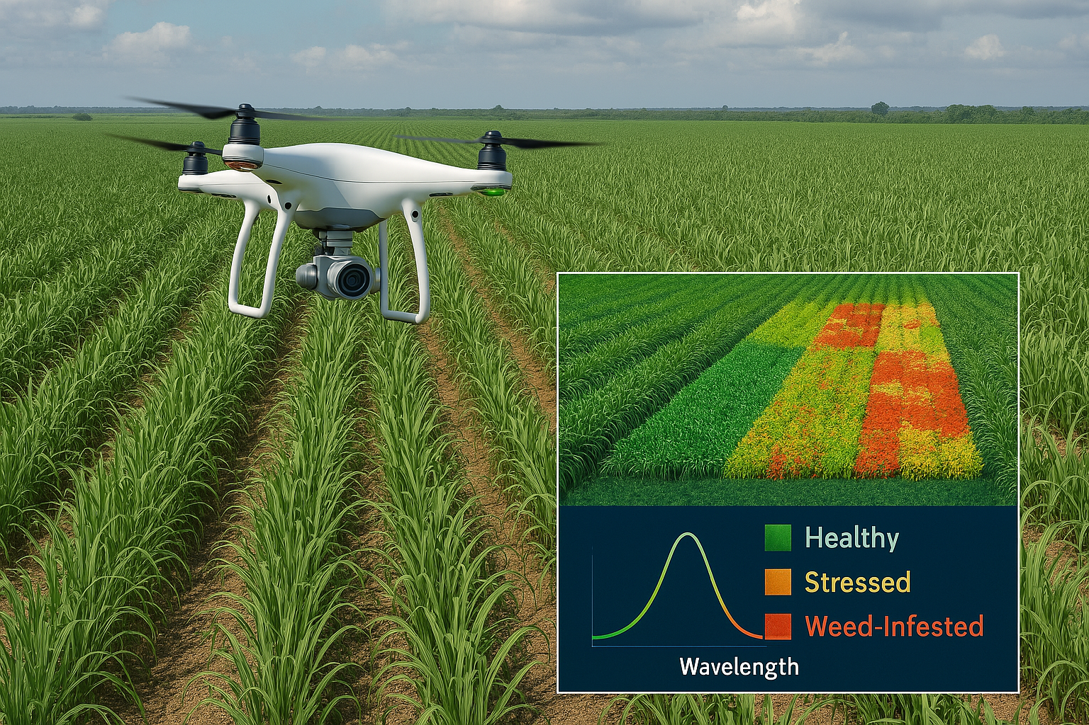
Case Study: Spectral Data Analysis with AI
Gamaya (Switzerland) – hyperspectral drone analysis of fields
  lightweight camera capturing ~40 spectral bands over large plantations (e.g., sugarcane)
AI processes thousands of images from a single flight
  stitching mosaics and detecting patterns in massive datasets
Detailed maps of crop health
  highlighting weeds, affected, and healthy areas directly on field maps
Targeted interventions and sustainability gains
  reduced water, fertilizer, and chemical usage by precisely localizing needs
Example: Gamaya – AI and Hyperspectral Crop Diagnostics

Slide 25
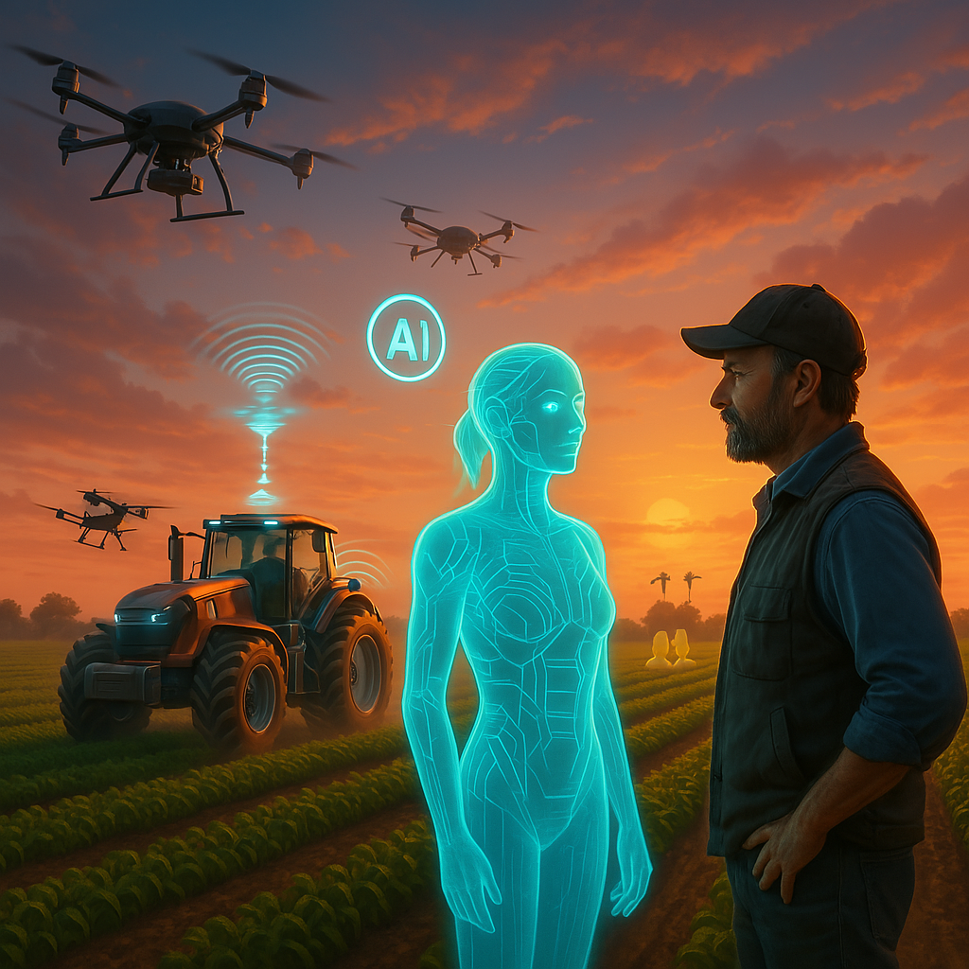
Emerging Trends in AI for Agriculture
Emerging trends in AI for agriculture are rapidly transforming the industry through smarter, more autonomous technologies.
Autonomous machines and robotics—such as self-driving tractors, drones, and field robots—are taking over repetitive tasks like seeding, spraying, and harvesting with precision and efficiency.
On-sensor AI, also known as AIoT (Artificial Intelligence of Things), allows edge devices to process sensor data directly in the field, enabling real-time decision-making without the need for constant connectivity.
Generative AI and simulation models are being used to create virtual farm environments, generating synthetic data for training algorithms and testing various management scenarios. AI is also playing a crucial role in climate adaptation strategies, predicting extreme weather events and recommending climate-resilient crop varieties or planting schedules.
Lastly, smart applications and chatbots are making advanced AI accessible to small-scale farmers via mobile apps, providing real-time advice, diagnostics, and management support in user-friendly formats.

Slide 26
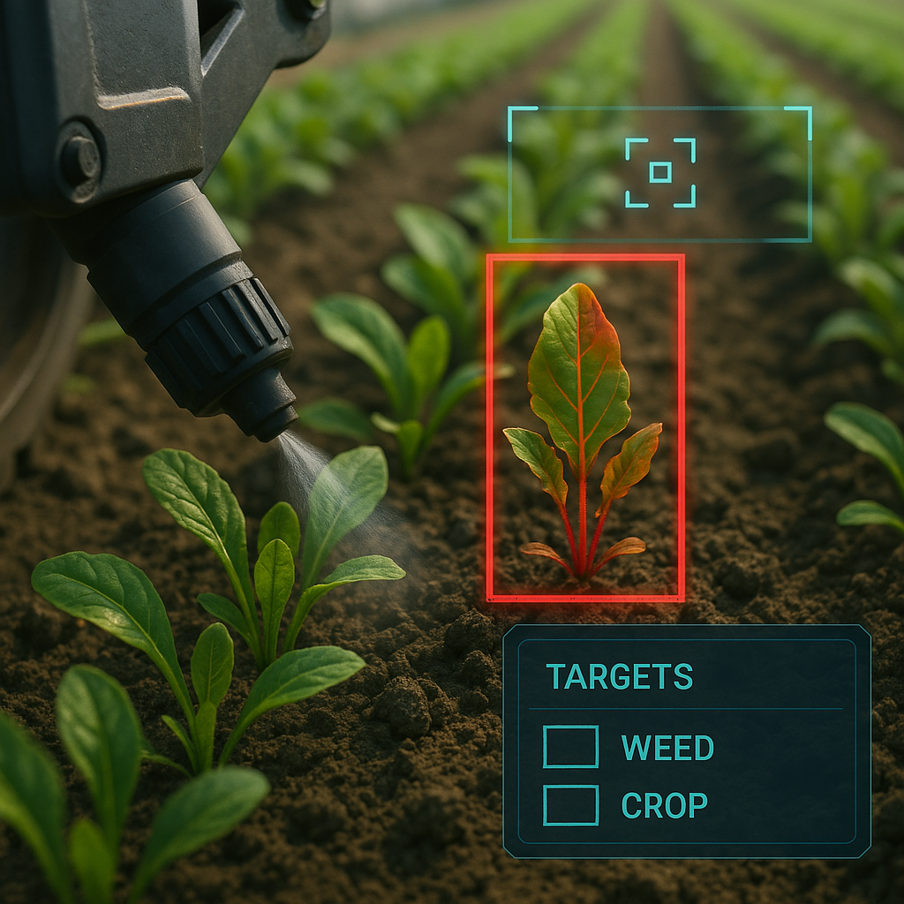
2D Computer Vision Case Studies
Blue River See & Spray (USA) – AI for precise weed spraying
  up to 90% reduction in herbicide usage by targeting only weeds
Mobile disease detection apps (e.g., Plantix)
  farmer snaps a leaf photo; AI identifies the disease and suggests treatment
Drone monitoring in vineyards (California)
  early detection of drought stress in vineyards, saving ~25% on irrigation
Example: Blue River See & Spray – Automated Weed Control

Slide 27
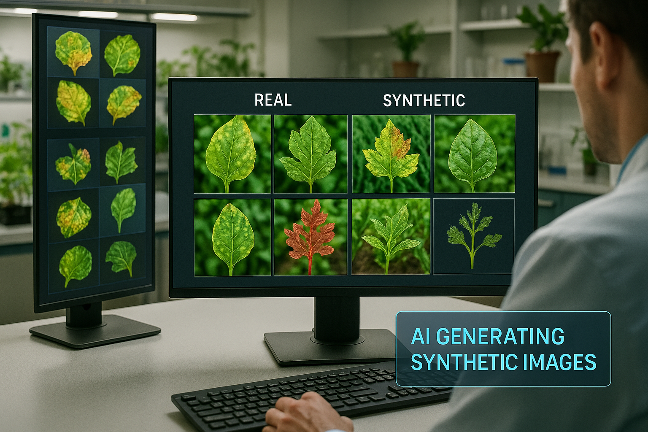
Generative AI for Synthetic Crop Data
Generative AI is becoming a valuable tool in agriculture by producing synthetic crop data that enhances the training and performance of machine learning models.
It helps augment datasets with rare events, such as infrequent disease symptoms or pest infestations, which are hard to capture in real-world field conditions but critical for early detection systems. By simulating diverse environmental scenarios—like droughts, floods, or frosts—generative AI enables stress-testing of models under varied and extreme conditions.
Techniques such as Generative Adversarial Networks (GANs) and diffusion models are used to create highly realistic images of crops and fields, broadening the variety of training inputs.
This approach significantly improves the robustness and generalisation of AI models, ensuring they perform more accurately and reliably when applied to real-world agricultural settings.

Slide 28
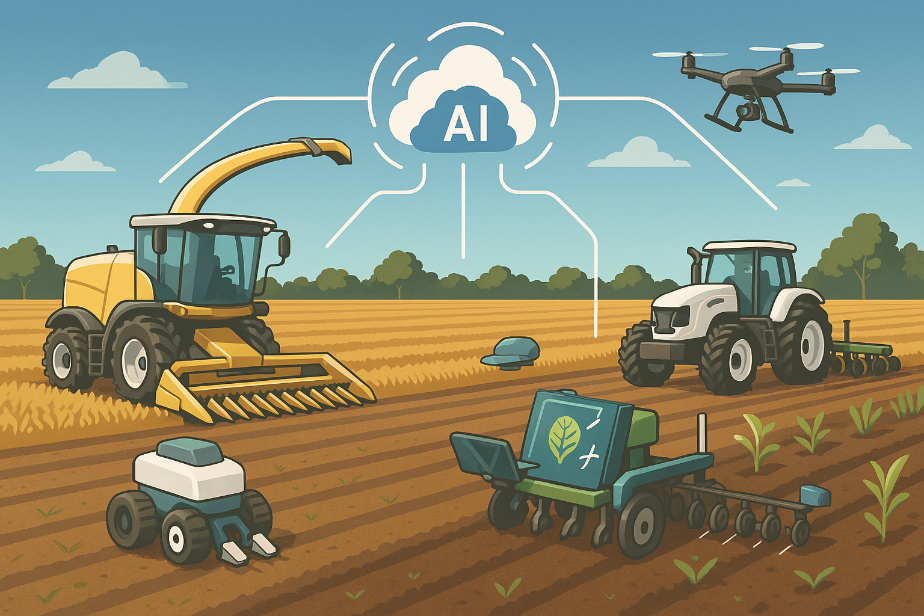
AI-Enhanced Robotics in Smart Farming
AI-enhanced robotics is revolutionising smart farming by automating key agricultural tasks with high precision and efficiency.
Autonomous tractors and harvesters use a combination of AI vision systems and GPS technology to navigate fields without human drivers, ensuring accurate and consistent operations.
Planting and weeding robots, often small and agile, employ AI to identify crop rows and remove weeds or plant seeds with minimal disturbance to the soil. Robotic harvesters equipped with AI-guided arms can detect and selectively harvest ripe produce, reducing damage and labor costs.
Additionally, AI-powered drones are used for targeted spraying, applying pesticides or fertilizers only where needed based on real-time analysis. Advanced farms are also exploring multi-robot collaboration, where drones and ground robots share data in real-time, coordinating their actions for synchronized, efficient field management.

Slide 29

05
ADVANCED APPROACHES & TRENDS

Slide 30
Case Study: AI-Driven Decision Making in Crop Management
Problem:
Farmers often struggle with unpredictable weather conditions and limited access to localized agronomic data, resulting in poor decision-making and reduced crop yields.
Solution:
The platform uses artificial intelligence to analyze hyper-local weather forecasts, soil conditions, and crop growth models.
Implementation:
Data from weather stations and soil sensors is processed using AI algorithms to generate real-time alerts (e.g., frost, drought) and personalized recommendations for irrigation, fertilization, and harvesting. The system delivers these insights via mobile or web interfaces.
Results:
Farmers experienced a reduction in weather-related crop losses and improved harvest planning,leading to greater efficiency and productivity.

Slide 31
Case Study: Smart Vineyard Irrigation (AI + IoT)
Problem:
Traditional irrigation methods often waste water and energy due to overwatering or improper timing, especially in water-stressed regions.
Solution:
An AI-integrated IoT irrigation system monitors soil moisture and weather conditions in real-time to optimise water use.
Implementation:
Sensors placed in vineyards continuously collect data on moisture levels and environmental conditions. This data is analyzed by AI algorithms that determine the precise amount and timing of irrigation required.
Results:
Water usage was reduced without any loss in yield. The system also minimized energy consumption and promoted sustainable water management.

Slide 32
Case Study: Automated Greenhouse Management
Problem:
Manual control of greenhouse conditions can be labor-intensive and imprecise, affecting crop quality and consistency.
Solution:
A fully automated greenhouse management system integrates IoT sensors and AI to regulate ventilation, lighting, irrigation, and temperature.
Implementation:
Real-time data from sensors is processed locally or in the cloud. Based on this analysis, the system makes autonomous adjustments to maintain optimal growing conditions.
Results:
Improved crop quality and uniformity, reduced labor costs, and energy savings through optimized climate control.

Slide 33
Case Study: Automated Greenhouse Management
Problem:
Many farms lack reliable internet or infrastructure to analyze data from multiple sources, limiting precision farming opportunities.
Solution:
Microsoft FarmBeats combines IoT sensors, edge computing, and AI to create a robust platform for farm data analysis, even with limited connectivity.
Implementation:
The system collects data from soil sensors, drones, and cameras, processes it locally, and syncs with cloud servers when possible. AI algorithms analyze the data to detect issues like crop stress or equipment failure.
Results:
Enhanced decision-making, predictive maintenance, and higher productivity with reduced dependency on constant internet access.

Slide 34

06
LET’S PRACTICE

Slide 35
Learner Exercise:
Practical Activity: "Explore AI in Agriculture"
Choose one advanced AI technology or case study presented in the module (e.g., Blue River See & Spray, FarmBeats, Gamaya, Plantix app).
Task: Write a short paragraph explaining how the AI system works, what agricultural challenge it solves, and what benefits it brings to farmers or sustainability.
Optional: Attach an image or video of the solution.
Tip: Focus on automation, decision-making, or environmental impact.

Slide 36
Group Exercise or Reflection:
Discussion Prompt:
How can AI reshape the future of farming? What risks or barriers (e.g. cost, complexity, data privacy) must be addressed to support wider adoption of AI in agriculture?
Purpose:
Engage learners in evaluating the real-world impact of AI tools and encourage critical reflection on their potential and limitations.

Slide 37
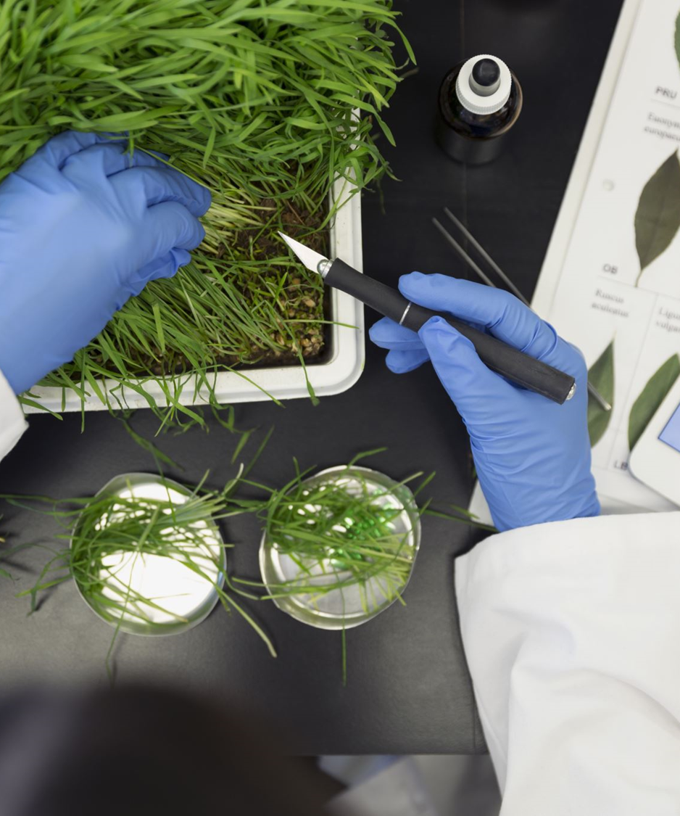

Congratulations!
You have completed Course 1! ​
Why not test your knowledge by taking the related quiz now!!
www.smartskillsproject.eu
Follow our journey

