Slide 1
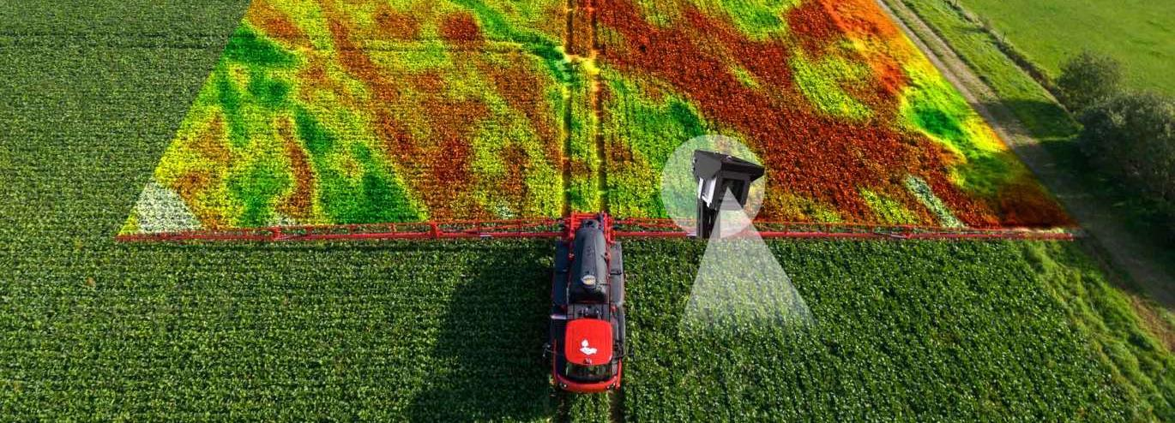


Course 1: Digital Farming and Precision Agriculture
M4: GIS Mapping & Field Optimisation
www.smartskillsproject.eu

Slide 2
Learning Outcomes
Understand…
…the importance of spatial context in IoT data analysis.
Learners will explore the importance of spatial context in IoT data analysis and gain the ability to identify key components and data types used
in the integration of GIS and IoT systems. They learn how to use GIS tools to visualise and interpret IoT data, analyze spatial patterns and relationships based on real-time sensor input, and apply GIS techniques in real-world scenarios such as smart cities or environmental monitoring. In addition, they will develop the skills to critically evaluate how effective GIS-based solutions are in addressing location-specific problems.
Identify…
…key components and data types used in GIS and IoT integration.
Explain…
….. how GIS tools can be used to visualize and interpret IoT data.

Slide 3
contents
This module discusses how to use GIS tools alongside IoT sensor data to better understand the land and make informed decisions. Learners will explore how to monitoring soil, crops, and weather conditions in real time, can help identify patterns across their fields, and they can then apply this knowledge to improve productivity, sustainability, and resource management.
01
Introduction
02
GIS description
03
GIS in use
04
Case Study

Slide 4
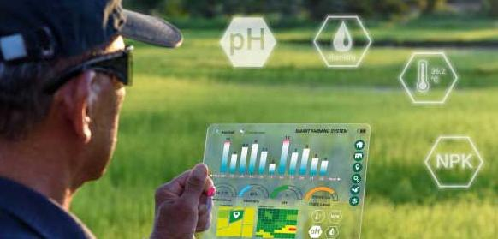
01
INTRODUCTION

Slide 5
What is GIS?
GIS mapping (Geographic Information System mapping) is a digital tool used to collect, manage, analyse, and visually display geographic data. It links location-based data (like coordinates or addresses) with other types of information—such as soil quality, crop health, or rainfall—to create interactive maps and spatial insights.
GIS makes it easier for farmers and agri-planners to make data-driven decisions by seeing patterns and trends based on geography.

Slide 6
What GIS solves?
Geographic Information Systems (GIS) are powerful tools used to answer
a wide range of spatial and location-based questions. They help determine what is found at a specific location, where certain features are, and how many of them exist in a given area.
GIS can also analyze what has changed over time, such as land use, vegetation, or urban development. Additionally, it can uncover causes of spatial phenomena—for example, identifying factors contributing to flooding or pollution. Finally, GIS enables scenario modeling, allowing users to explore "what if" questions, such as predicting the impact of rising sea levels or infrastructure changes. Altogether, GIS supports better decision-making in fields like urban planning, environmental monitoring, agriculture, and emergency response.

Slide 7
GIS is not…
While GIS is a powerful tool for spatial analysis and decision-making, it’s important to understand what it does not do or represent:
GIS is not just a map. While maps are a key output, GIS is much more than cartography. It involves data analysis, modeling, and spatial reasoning.
GIS is not a GPS. GPS (Global Positioning System) provides location data, but GIS is used to analyze and visualize that data in context.
GIS is not only for geographers. It’s used across many fields: urban planning, environmental science, public health, logistics, agriculture, and more.
GIS is not a static tool. It’s dynamic and interactive, allowing users to update data, run simulations, and perform real-time analysis.
GIS is not a single software. It’s a system that can include multiple tools and platforms (e.g., ArcGIS, QGIS, web-based GIS, databases, etc.).
GIS is not only about visualization. It also includes data management, spatial querying, statistical analysis, and predictive modeling.

Slide 8
Areas where GIS is used
GIS is used in a wide variety of fields to analyze spatial data, support decision-making, and visualize geographic patterns.
In agriculture, GIS mapping helps to:
🗺️ Create nutrient or soil maps for precision fertilisation
💧 Plan irrigation by analysing slope, soil moisture, and water flow
🌾 Monitor crop health using satellite or drone imagery
🚜 Manage farm operations across different fields or regions
🌍 Track environmental impact and support sustainable land use

Slide 9
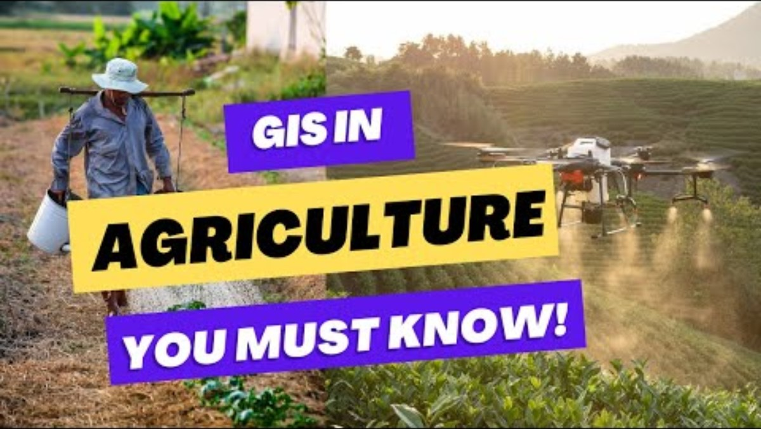
More information about GIS
⬅ Unlocking Agricultural Potential: Exploring the Applications of GIS in Agriculture You Must Know!
| Mapever
Using GIS in Precision Agriculture

Slide 10
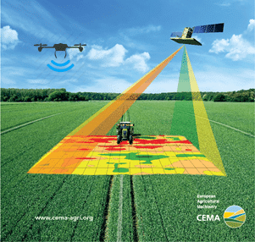
02
GIS DESCRIPTION

Slide 11
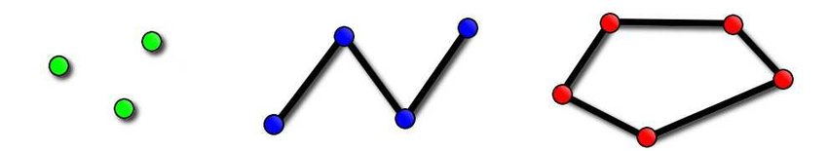
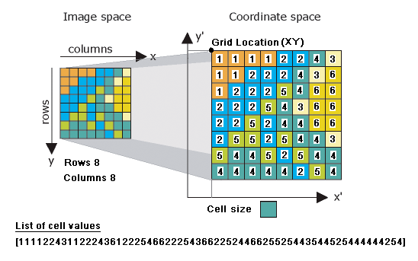
Objects in GIS
Vector data is made up of geometrical shapes that represent real-world features. It is divided into three basic types:
Point – represents a single location, such as a weather station, tree, or sensor.
Line – represents linear features like roads, rivers, or pipelines.
Polygon – represents enclosed areas such as lakes, buildings, or land parcels.
These vector features are ideal for precise mapping and analysis of boundaries and
structures.
Raster data is made up of a grid of pixels (like a digital photo), where each pixel holds a value representing information such as elevation, temperature, vegetation index (e.g. NDVI), or satellite imagery. Raster data is especially useful for continuous data and remote sensing applications.
Together, vector and raster data allow GIS to capture both detailed features and large-scale
environmental conditions.

Slide 12
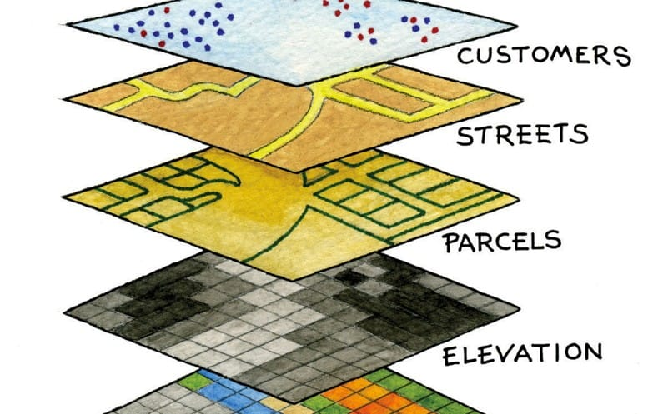
Layers in GIS

Slide 13
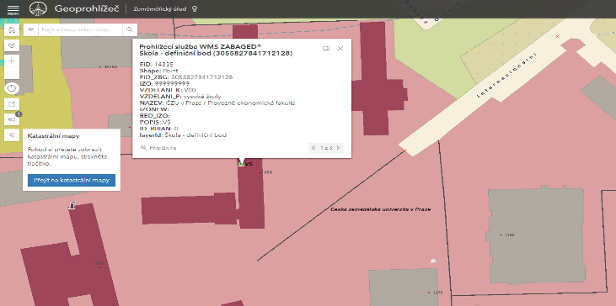
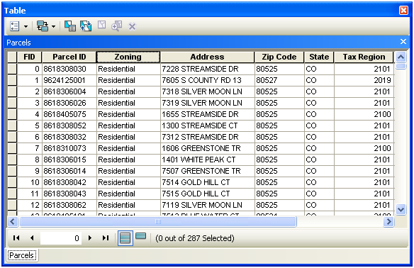
Attribute table
Attributes refer to descriptive information or data associated with spatial features. While spatial data defines the location and shape of features (such as points, lines, and polygons on a map), attribute data provides context and meaning to these features.
These attributes are stored in attribute tables, which are similar to spreadsheets:
Each row represents a spatial feature.
Each column represents an attribute field (e.g., Name, Type, Population).

Slide 14
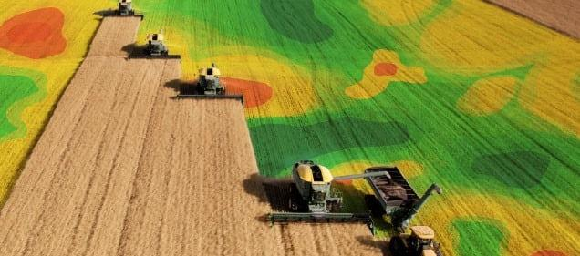
03
GIS IN USE

Slide 15
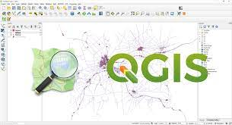
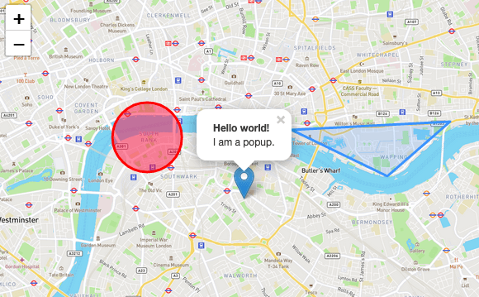
Examples of Open Source
QGIS
PostGIS
OpenStreetMap
Leaflet
Examples of Commercially
ESRI – ArcGIS
Mapbox
Intergraph

Slide 16
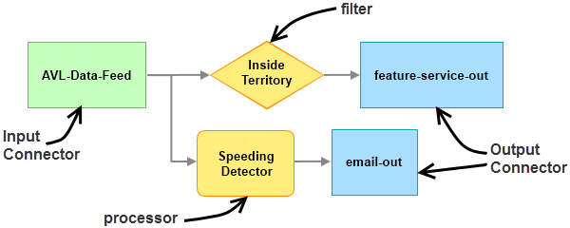
ArcGIS Geoevent
ArcGIS GeoEvent Server is an extension of the ArcGIS platform by Esri designed to process and analyze real-time data streams. It allows organizations to ingest continuous data from various sources such as IoT sensors, GPS trackers, weather stations, or mobile apps. GeoEvent can immediately filter, transform, and evaluate incoming data based on user-defined rules—for example, detecting threshold violations, tracking movement, or triggering alerts. The processed data can then be visualized on maps, stored in databases, or used to initiate automated responses, making it a powerful tool for applications in smart agriculture, logistics, public safety, and environmental monitoring.
IoT
GIS

Slide 17
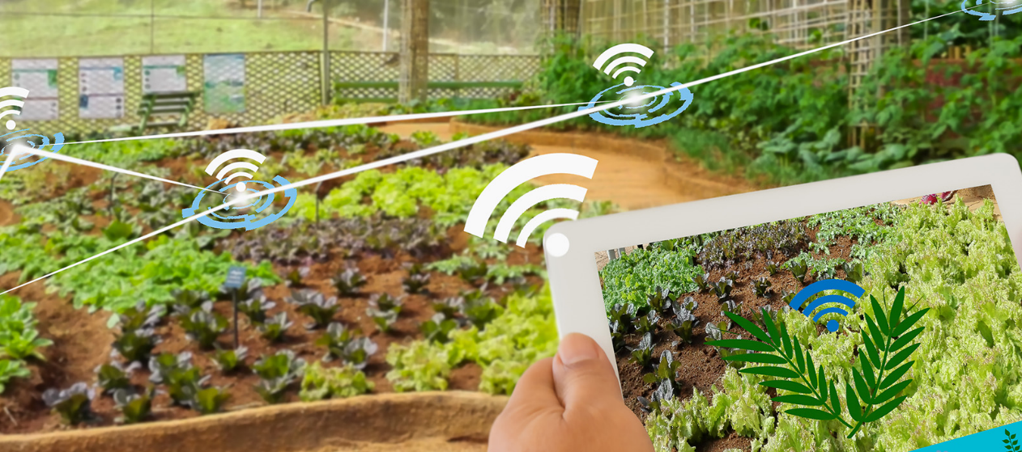
04
CASE STUDIES

Slide 18
Case Study: Geophysical Instruments for Soil Variability Monitoring
Soil variability within a field significantly impacts crop performance, but conventional sampling is slow and low-resolution. Geophysical instruments like the EM38 (electromagnetic induction sensor) measure soil conductivity, which correlates with texture, moisture, and salinity. Meanwhile, gamma spectrometers detect natural radioisotopes in the soil, revealing its mineral composition. These data layers are processed and visualized in GIS systems to define management zones for variable-rate fertilization or seeding. The main challenges include high cost of instruments, the need for trained operators, and complex data interpretation.
Problem: Soil properties vary within a field but are hard to map manually
Solution: Use of geophysical tools (EM38, gamma spectrometer)
EM38 – measures soil electrical conductivity (moisture, texture, salinity)
Gamma spectrometer – detects soil mineral composition
Benefits: Supports creation of precise management zones
Challenges: Data interpretation, equipment cost, need for expertise

Slide 19
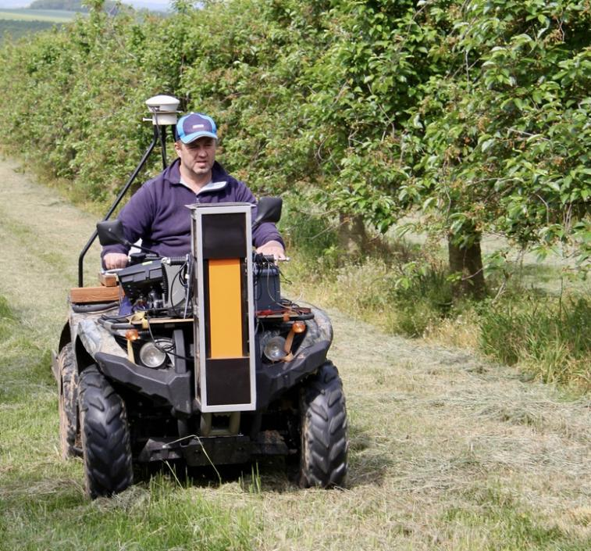
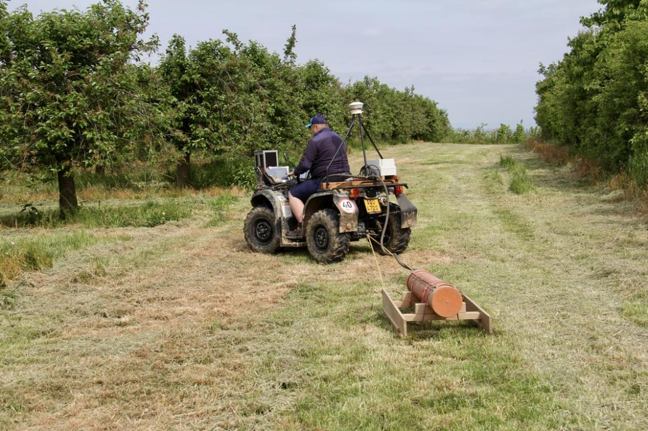
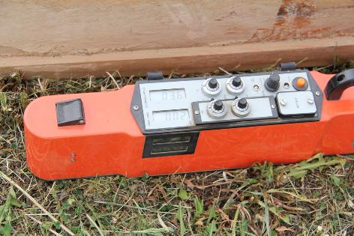
Use of geophysical instruments for monitoring soil property variability
Gamma spectrometer (GF Instruments, CZ) EM38 MK2 (Geonics Limited, Kanada)

Slide 20
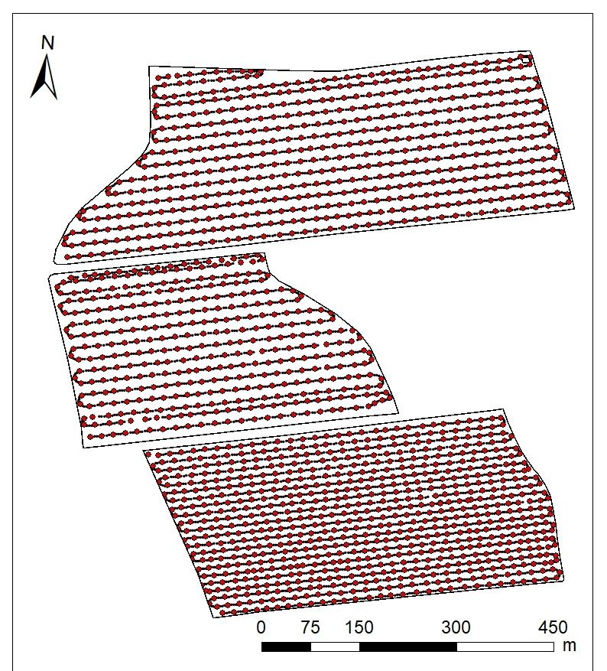
Data from Gamma spectrometer
Using data from the EM38-MK2 gamma spectrometer—a specialised instrument for soil monitoring and electromagnetic induction (EMI) measurements—in a Geographic Information System (GIS) involves a structured workflow to convert raw sensor readings into spatial insights about soil properties. This device is commonly used for mapping apparent electrical conductivity (ECa), which correlates with soil moisture, salinity, texture, and compaction.

Slide 21
Case Study: UAVs for Disease Detection in Crops
Diseases like fungal infections or nutrient deficiencies can be hard to detect in early stages. Unmanned Aerial Vehicles (UAVs) with multispectral cameras can spot subtle changes in reflectance, indicating stress. These images are processed into GIS maps showing likely hotspots. This allows targeted treatment and lower pesticide use. However, interpreting the imagery requires expertise or AI-based tools.
Problem: Crop diseases are often detected too late
Solution: Drones with multispectral cameras identify stress patterns
GIS maps disease risk zones before symptoms appear
Benefits: Early intervention, reduced chemical use
Challenges: Image interpretation, cost of drone tech

Slide 22
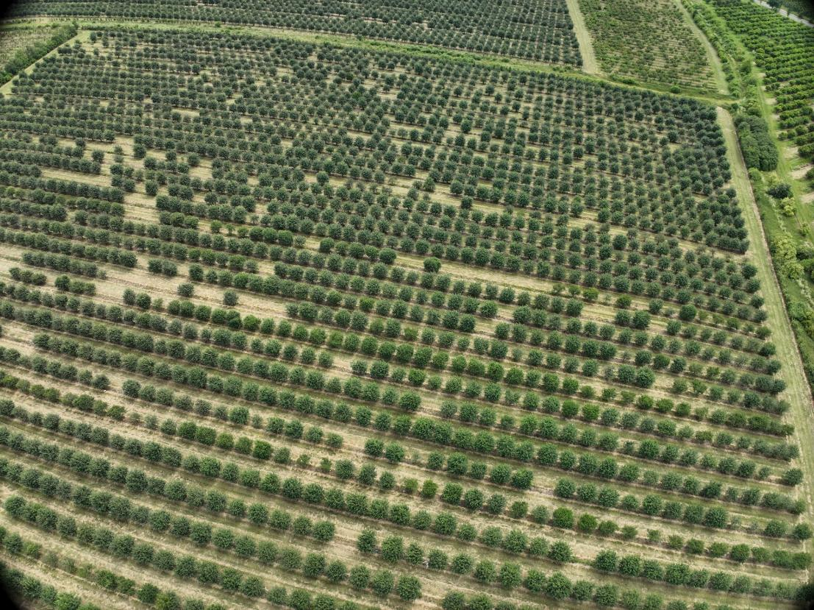
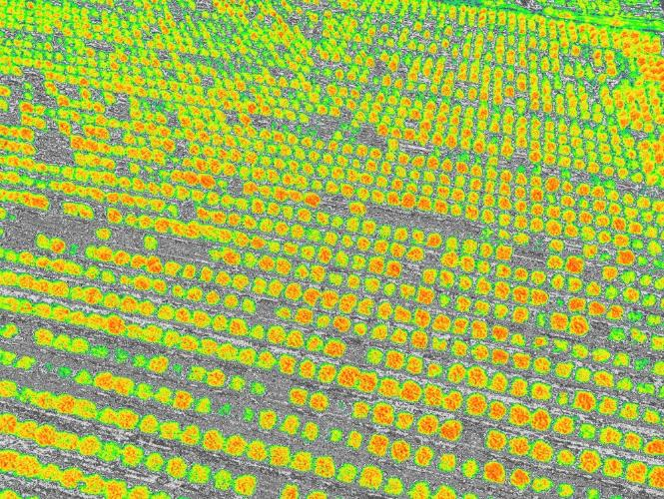
Tree inspection, stand organization, number of trees
RGB image, multispectral image, thermogram (was used).
RGB snímek, multispektrální snímek, termogram.

Slide 23
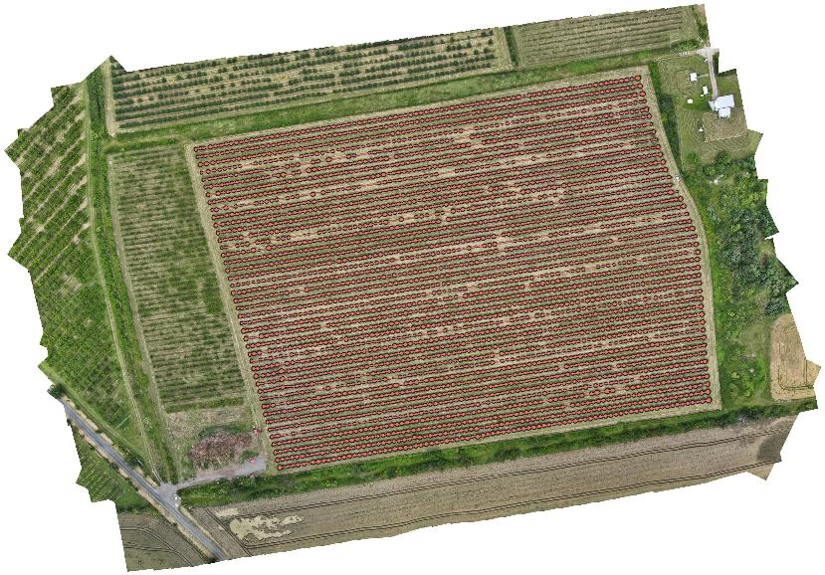
Example of using UAVs in orchard
In orchards, UAVs can capture high-resolution imagery that, when analyzed in GIS, enables accurate detection of tree number, location, size, and spacing, supporting better inventory and management. Vegetation indices derived from multispectral drone images help assess tree vitality, allowing for targeted water regime adjustments and precise spot applications of fertilizers or pesticides. Additionally, UAV-GIS integration facilitates planning and monitoring of new tree planting based on spatial gaps and vitality patterns, improving overall orchard productivity.

Slide 24
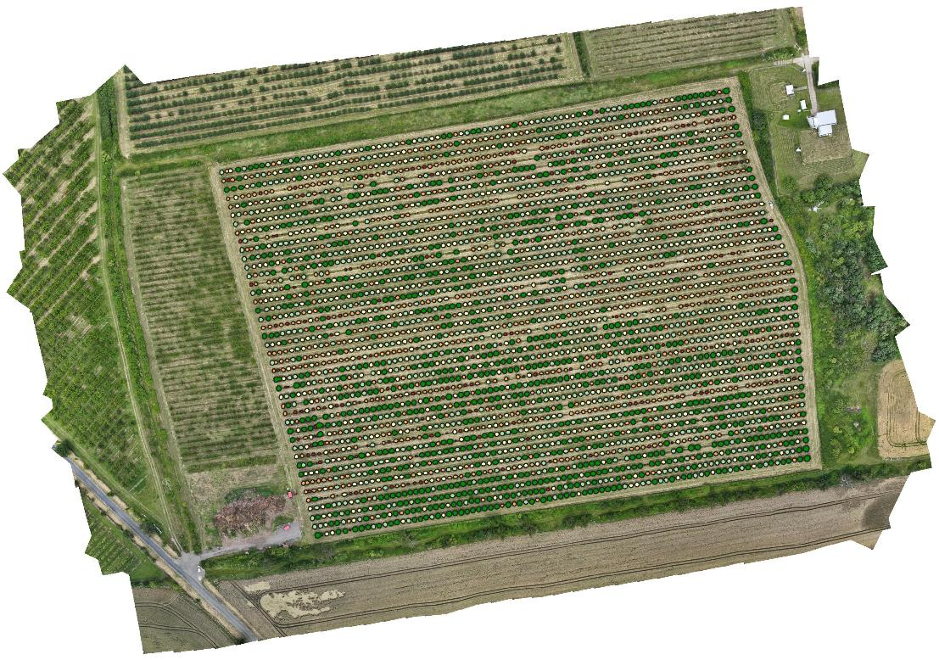
Example of using UAVs in orchard
Land area: 9.59 ha
Number of trees: 4 411
Number of missing trees: 218
Gap: 4.7 %
The question is the number of production trees

Slide 25
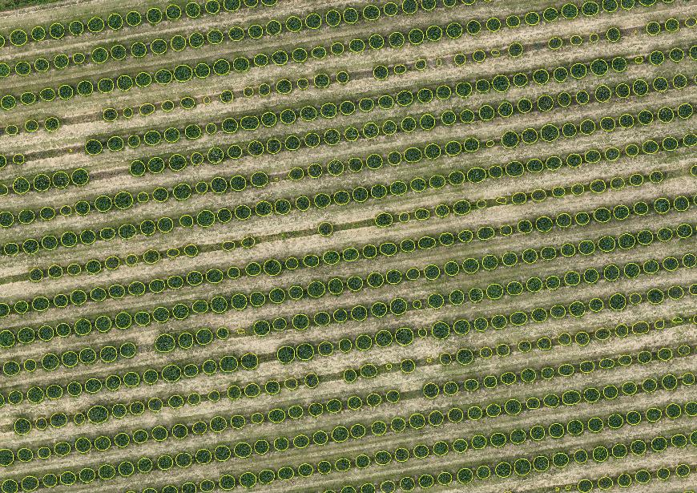
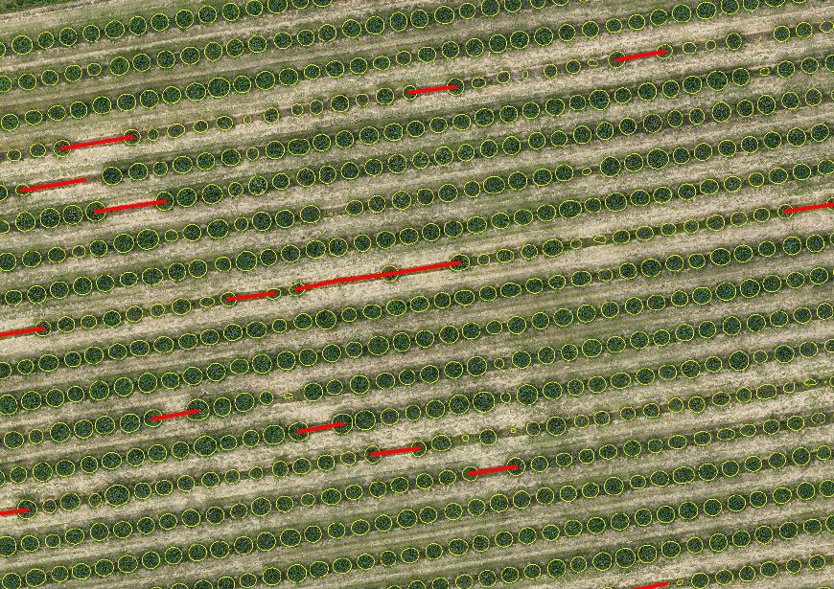
Example of evaluation of orchard spacing

Slide 26
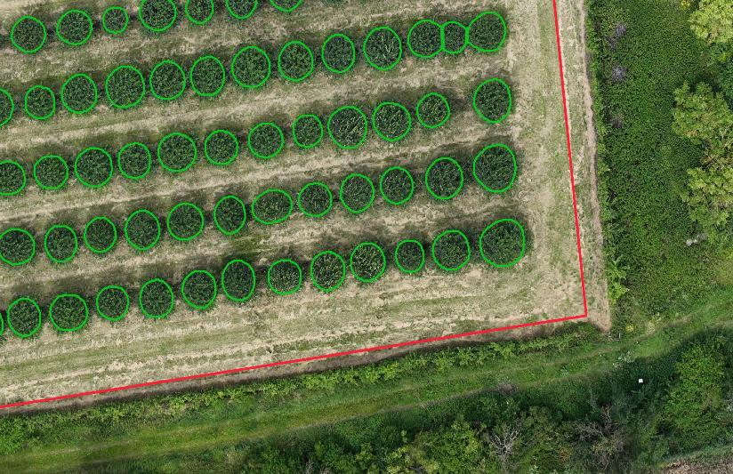
Creating orchard management
In orchard management, UAVs combined with GIS technology enable detailed mapping from the land level down to individual trees, capturing precise boundaries of plots, rows, and tree positions. This high-resolution spatial data provides critical tree-level information such as health, size, and spacing, essential for effective planning and resource management. Establishing such detailed geospatial layers lays the groundwork for future robotization in orchards, as autonomous systems require accurate environmental and positional data to operate efficiently and safely.

Slide 27


Well done!
You have finished the fourth module of Course 1! Keep going on this learning journey.
In the next module, you will learn about Advanced Tools in Precision Agriculture.
www.smartskillsproject.eu
Follow our journey

